Slide 1


STRUCTURE OF CONTRACTILE PROTEINS, MECHANISM OF MUSCLE CONTRACTION
SUBJECT : BIOLOGY
CHAPTER NUMBER: 20
CHAPTER NAME : LOCOMOTION AND MOVEMENT

Slide 2
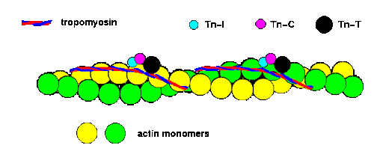
Contractile proteins- Actin
STRUCTURE OF CONTRACTILE PROTEINS
Each actin (thin) filament is made of two ‘F’ (filamentous) actins helically wound to each other and each ‘F’ actin is a polymer of monomeric ‘G’ (Globular) actins.
Bound to actin are a complex of regulatory proteins, which include tropomyosin and troponin-T, C, and I.
Two filaments of another protein, tropomyosin also run close to the ‘F’ actins throughout its length.
A complex protein troponin is distributed at regular intervals on the tropomyosin.

Slide 3
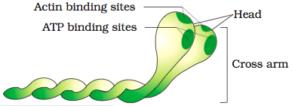
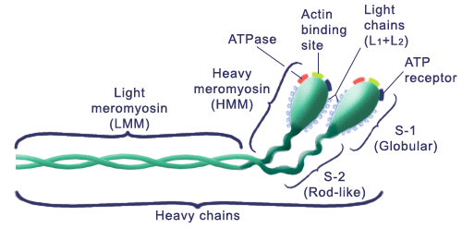
Contractile proteins- Myosin
STRUCTURE OF CONTRACTILE PROTEINS
Each myosin (thick) filament is also a polymerised protein and many monomeric proteins called meromyosins constitute one thick filament.
Each head with a short arm and a tail, the former being called the heavy meromyosin (HMM) and the latter, the light meromyosin (LMM).
The HMM component, i.e, the head and short arm projects outwards at regular distance.
meromyosin has two important parts, a globular and angle from each other from the surface of a polymerised myosin filament and is known as cross arm.
The globular head is an active ATPase enzyme and has binding sites for ATP and active sites for actin.

Slide 4
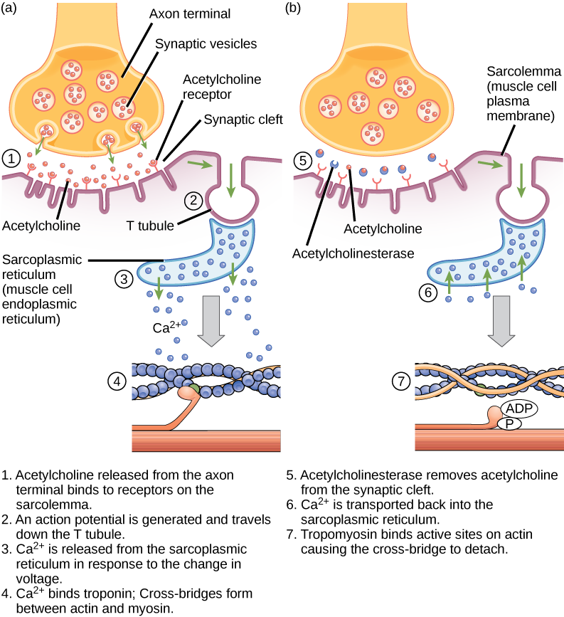
The mechanism of muscle contraction
During the muscles contraction, the thin filaments slide over the thick filaments.
A signal sent by the central nervous system via motor neuron initiates muscle contraction.
The neuromuscular junction is the junction between a motor neuron and sarcolemma.
Acetylcholine is released when a neural signal reaches this junction and action potential is generated in the sarcolemma.

Slide 5
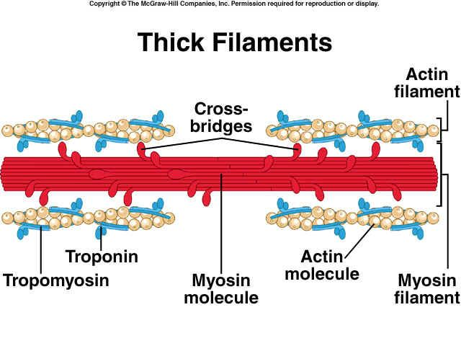
The mechanism of muscle contraction
During contraction when neural signal spreads through the muscle fibre, calcium ion is released in the sarcoplasm. calcium is bound to Tn-C, a conformational change in this protein complex occurs, Tn-I dissociates from actin, tropomyosin shifts toward the middle of the actin filament, and exposes the active sites for myosin.
Myosin binds to the exposed active site on actin using energy from the hydrolysis of ATP.
Myosin ATPase catalyzes ATP hydrolysis, causing a conformational change in the actin myosin cross-bridge and contraction

Slide 6
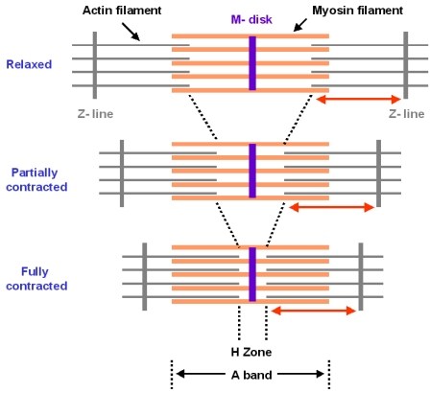
Contd..
This pulls the actin towards the centre. The Z lines attached to these are also pulled, and contraction occurs.
Myosin is in a relaxed state.Consequently, the hydrolysis of ATP at the myosin head continues and this leads to further sliding.
This is repeated till calcium ions are pumped back to the sarcolemma and results in covering of the actin sites again.
The Z lines move back to their original positions. This causes relaxation.
During relaxation, ATP hydrolysis is required for myosin detachment from actin, calcium dissociation from Tn-C, and active sequestration of calcium by the sarcoplasmic reticulum
In the relaxed state, in the absence of calcium, myosin cannot bind to actin because the binding site is occupied by troponin-I.

Slide 7
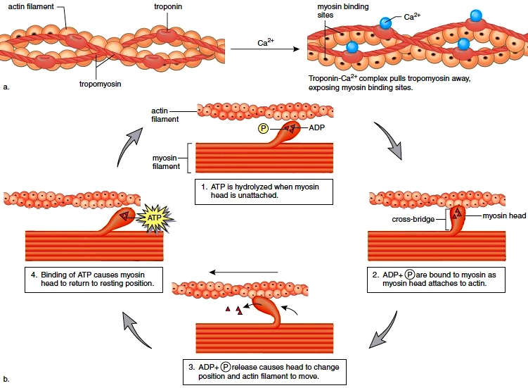

Slide 8
Types of muscles- red muscle and white muscle
Muscle fatigue occurs due to repeated activation of the muscles leading to accumulation of lactic acid.
Muscles appear in red colour due to a pigment called myoglobin.
Myoglobin rich muscles are called red fibers. They also contain lots of mitochondria, which they may use for energy production.
Muscles which lack myoglobin and white in colour are called white fibers.
Two types of muscles- Red muscle and white muscle.
Red muscle- Muscle contains a red colored oxygen storing pigment called myoglobin . Myoglobin content is high in some of the muscles which gives a reddish appearance. Such muscles are called the Red fibres. These muscles also contain plenty of mitochondria which can utilize the large amount of oxygen stored in them for ATP production. These muscles, therefore, can also be called aerobic muscles.
White muscle- Some of the muscles possess very less quantity of myoglobin and therefore , appear pale or whitish. These are the White fibres. Number of mitochondria are also few in them, but the amount of sarcoplasmic reticulum is high. They depend on anaerobic process for energy. So also it is said as anaerobic respiration.

Slide 9
Sliding Filament Theory
“Sliding filament theory is the mechanism by which the muscle is thought to contract at the cellular level.”
What is Sliding Filament Theory?
Muscles are fibres which cause movement in our body. They also enable the functioning of our internal organs. Specialists claim that a human body has around 650 muscles, skeletal muscles to be precise.
Muscles are specialized tissues having the property of elasticity, where each muscle has innumerable muscle fibres. Muscle fibres successively have thin and tiny strands called myofibrils. For movement, muscles need to contract. It contracts when tension-generating sites within the muscle fibres are activated. This mechanism is explained by the sliding filament theory.
The sliding filament theory is a suggested mechanism of contraction of striated muscles, actin and myosin filaments to be precise, which overlap each other resulting in the shortening of the muscle fibre length. Actin (thin) filaments combined with myosin (thick filaments) conduct cellular movements.
Myosin is a protein that converts ATP (chemical energy) into mechanical energy, thus creating thrust and movement. This movement generates muscular contraction and movement of non-muscle cells, such as mitosis and meiosis (cell division).

Slide 10
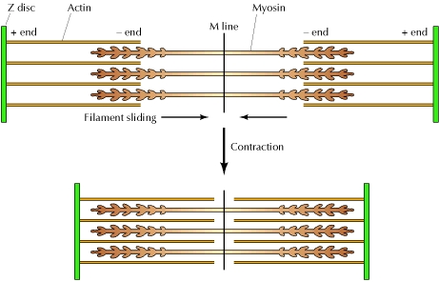
Contd ..
Also, actin polymerization and actin-myosin interaction are responsible for movements of a cell across a surface.
Actin filaments have myosin-binding sites which are revealed when troponin molecules bind to calcium ions in filaments, facilitating bridge formation between actin and myosin.
This process is fueled by ATP, which acts as an energy source.
ATP is hydrolysed in the heads of molecules of myosin causing a change in the shape of the head and binding to actin filaments.

Slide 11
THANKING YOU
ODM EDUCATIONAL GROUP

