Slide 1


GENERATION & CONDUCTION OF NERVE IMPULSE, TRASMISSION OF IMPULSES
SUBJECT : BIOLOGY
CHAPTER NUMBER: 21
CHAPTER NAME :NEURAL CONTROL AND COORDINATION

Slide 2
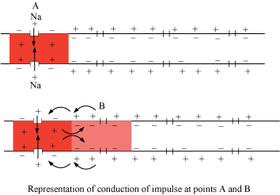
Impulse Generation and Conduction
When neurons are not conducting any impulse they are in a resting-state.
The membrane, in this event, is not permeable to sodium ions and negatively charged proteins found in the axoplasm and are more permeable to potassium ions.
There is a high concentration of proteins and potassium ions in the plasma in axon while the concentration of sodium ions is low.
The fluid in the periphery of the axon has a low concentration of potassium ions and a high concentration of sodium ions. As a result, a concentration gradient is established.
Active transportation of ions takes place through the membrane via the sodium-potassium pump wherein 2 potassium ions enter the cell and 3 ions of sodium are transported outwards.
Consequently, the inner surface is negatively charged and the membrane’s outer surface is positively charged. The cell is now in a polarised state.
Resting potential is the electrical potential difference, established through the resting plasma membrane.

Slide 3
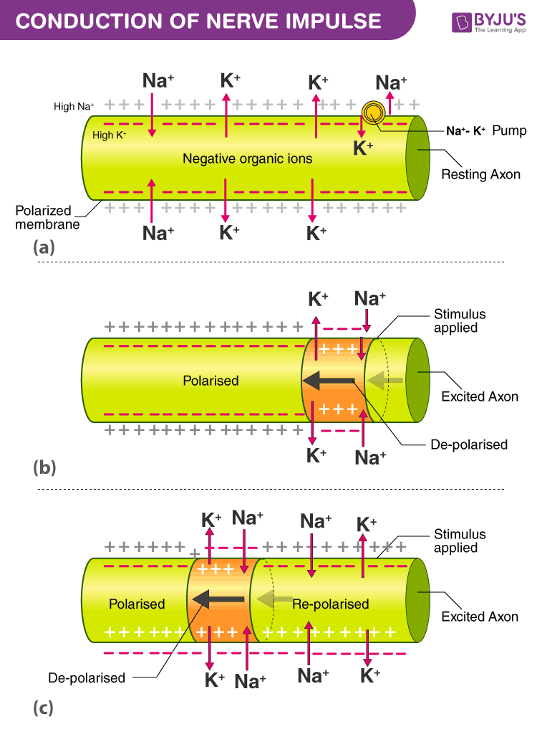
Impulse Generation and Conduction
The membrane, at a particular region on the polarised membrane, turns freely permeable to ions of sodium when a stimulus is applied.
As a result, sodium ions pass into the cell. The inner side of the membrane turns positively charged while the outer side becomes negatively charged.
Now, the membrane is in the depolarised state. An electrical potential difference is hence established.
This difference at the site through the plasma membrane is referred to as a nerve impulse or action potential.
The area turns into a stimulus for the adjacent region of the membrane that turns depolarised.
The previous membrane is repolarised as a result of the exit of the sodium ions from the cell. Hence, the conduction of impulses.

Slide 4
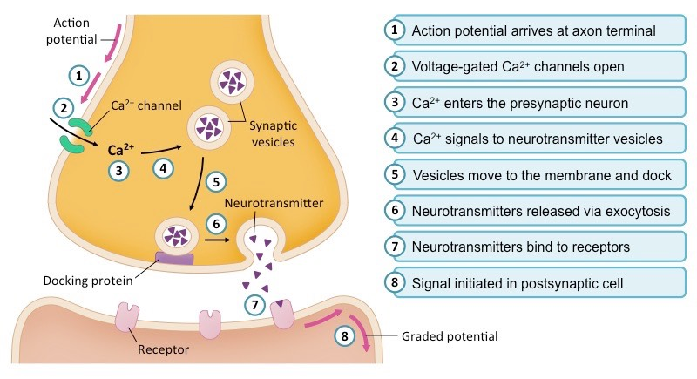
Impulse Generation and Conduction

Slide 5
Transmission Of Nerve Impulse
Nerve impulses are transmitted from one neuron to another neuron through synapses which are formed by membranes of a pre-synaptic and post-synaptic neuron.
Synapses are of two types – electrical synapses and chemical synapses
When an impulse reaches the axon terminal, it triggers the movement of synaptic vesicles towards the membrane. The plasma membrane and the vesicles fuse and release neurotransmitters in the synaptic cleft which in turn bind to specific receptors found on the post-synaptic membranes

Slide 6
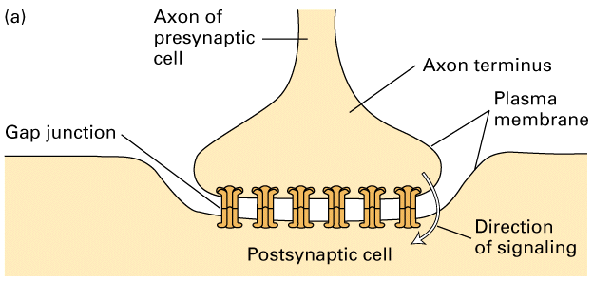
Electrical Synapse
While electrical synapses are fewer in number than chemical synapses, they are found in all nervous systems and play important and unique roles.
The mode of neurotransmission in electrical synapses is quite different from that in chemical synapses.
In an electrical synapse, the presynaptic and postsynaptic membranes are very close together and are actually physically connected by channel proteins forming gap junctions.
Gap junctions allow current to pass directly from one cell to the next.
In addition to the ions that carry this current, other molecules, such as ATP, can diffuse through the large gap junction pores.

Slide 7
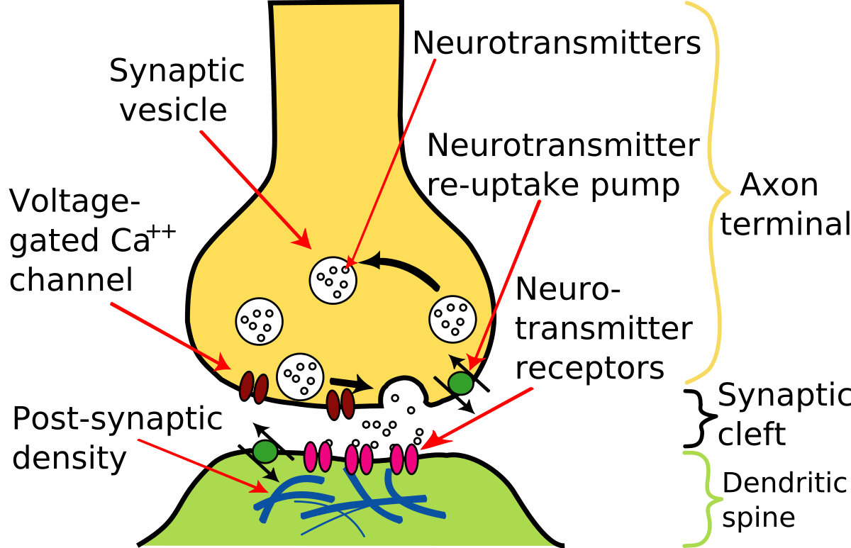
Chemical synapse
At a chemical synapse, both the presynaptic and postsynaptic areas of the cells are full of the molecular machinery that is involved in the transmission of nerve impulses.
The presynaptic area contains many tiny spherical vessels called synaptic vesicles that are packed with chemicals called neurotransmitters.
When an action potential reaches the axon terminal of the presynaptic cell, it opens channels that allow calcium to enter the terminal.
Calcium causes synaptic vesicles to fuse with the membrane, releasing their contents into the narrow space between the presynaptic and postsynaptic membranes. This area is called the synaptic cleft.
The neurotransmitter molecules travel across the synaptic cleft and bind to receptors, which are proteins that are embedded in the membrane of the postsynaptic cell.

Slide 8
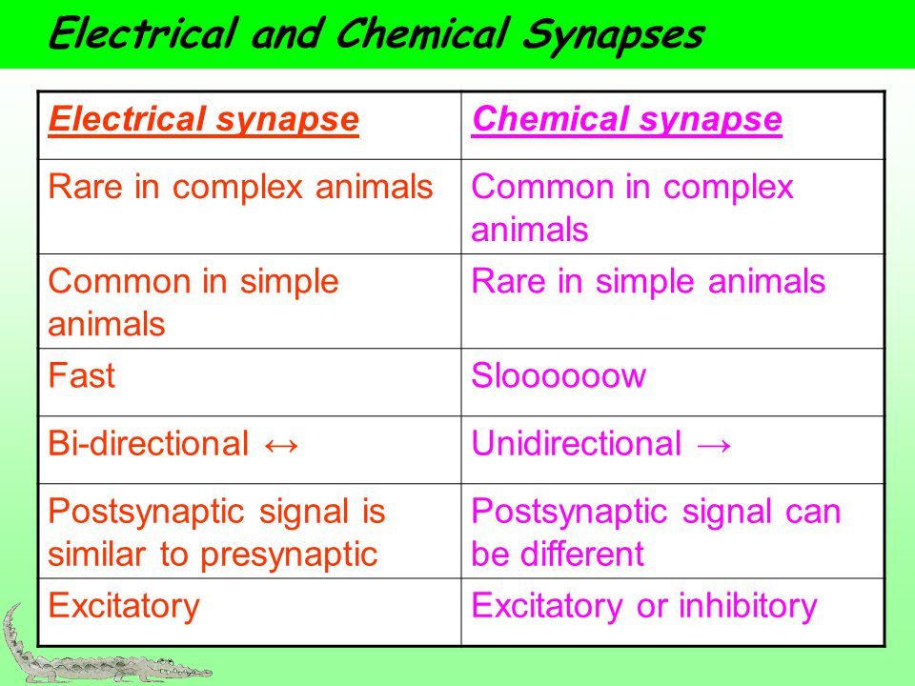

Slide 9
THANKING YOU
ODM EDUCATIONAL GROUP

