Slide 1


SKELETAL MUSCLE : STRUCTURE
SUBJECT : BIOLOGY
CHAPTER NUMBER: 20
CHAPTER NAME : LOCOMOTION AND MOVEMENT

Slide 2
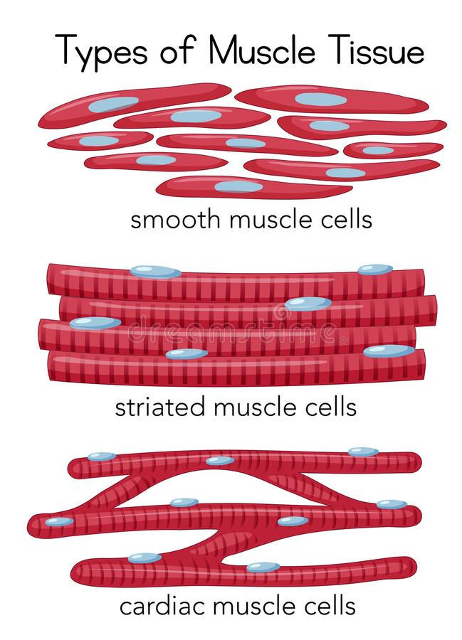
Types of Muscles
There are three types of muscles as given below:
Skeletal Muscles appear striped/striations in the microscope. These are voluntary muscles as they are under the control of our will. They help in locomotion and changes in body postures.
Cardiac Muscles are muscles associated with the heart. They help in rhythmic contraction and relaxation of the heart. They also appear striped/striations in the microscope similar to the skeletal muscles.
Smooth Muscles are involuntary muscles and cannot be controlled by our will. They are present in lining of the alimentary canal, reproductive system etc. They do not exhibit characteristic stripes/striations.

Slide 3
Skeletal Muscle Definition
Skeletal muscle is a specialized contractile tissue found in animals which functions to move an organism’s body.
Skeletal muscle is comprised from a series of bundles of muscle fibers, surrounded by protective membranes.
This arrangement allows skeletal muscle to contract quickly and release quickly without subjecting the individual fibers to too much friction.
Skeletal muscle tissue can be found across the animal kingdom, in most multi-cellular forms of life.

Slide 4
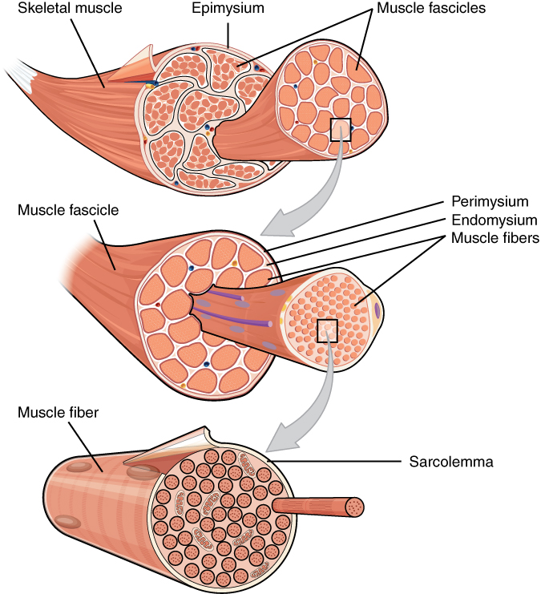
Skeletal Muscle Structure
Skeletal muscle is comprised of a series of muscle fibers made of muscle cells.
These muscle cells are long and multinucleated.
At the ends of each skeletal muscle a tendon connects the muscle to bone.
This tendon connects directly to the epimysium, or collagenous outer covering of skeletal muscle.
Underneath the epimysium, muscle fibers are grouped into bundles called fascicles.
These fascicles are surrounded by another protective covering formed from collagen.
The perimysium, as it is called, allows nerve and blood vessels to make their way through the muscle.
Each fascicle is formed from tens to hundreds of bundled muscle fibers.
Each muscle fiber is formed from a chain of multinucleated muscle cells.

Slide 5
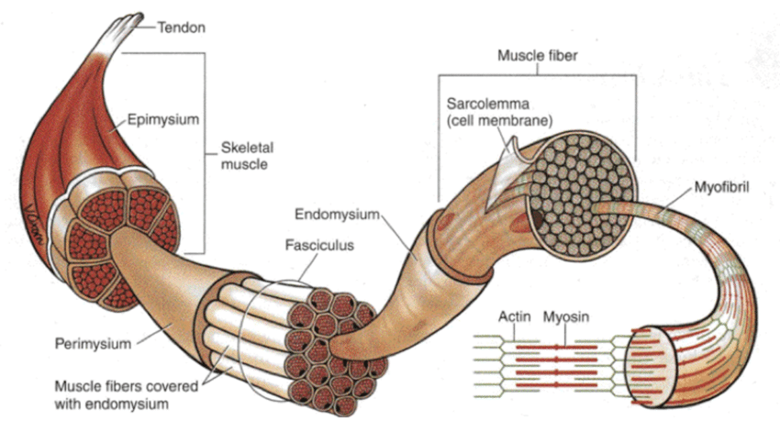
Skeletal Muscle Structure
These fibers are then protected by another layer called the endomysium as they are bundled into fascicles.
Each muscle cell has distinct regions when viewed under a microscope.
These are known as sarcomeres, and give skeletal muscle a banded or striated appearance.
Each sarcomere is a complex of proteins, which operates to contract the muscle.

Slide 6
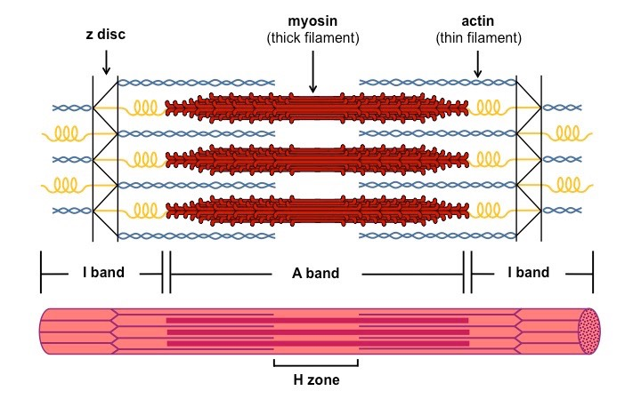
The sarcomere
A sarcomere is the functional unit (contractile unit) of a muscle fiber.
Each sarcomere contains two types of myofilaments: thick filaments, composed primarily of the contractile protein myosin, and thin filaments, composed primarily of the contractile protein actin.
Thin filaments also contain the regulatory proteins, troponin and tropomyosin.
When myofilaments are viewed under an electron microscope, their arrangement gives the appearance of alternating bands of light and dark striations.
The light bands are called I bands and contain only thin filaments.
The dark bands are called A bands and contain thick and thin filaments, with the thick filaments running the entire length of the A band

Slide 7
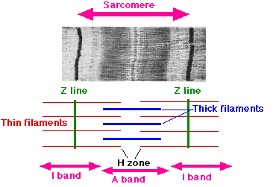
The sarcomere
The names for the various regions of the sarcomere are not arbitrary.
They are derived from the first letter of the German word that describes their appearance.
The names for the bands describe the refraction of light through the respective bands.
The I band is abbreviated from the word isotropic, which means that this area appears lighter because more light can pass through it.
The A band is so named because of its anisotropic properties, meaning that it appears darker because it does not allow as much light to pass through.
These properties are directly related to the type of filament present.

Slide 8
The sarcomere
Each A band is interrupted in the midsection by an H zone (from the German Hellerscheibe, for “clear disc”), where there is no overlap of thick and thin filaments.
Running through the center of the H zone is a dense line called the M line (from the German Mittelsclzeibe, for “middle disc”).
The I bands are also interrupted at the midline by a darker area called the Z disc (from the German Zwischenscheibe, for “between disc”). A sarcomere extends from one Z disc to the successive Z disc.
The Z disc serves to anchor the thin filaments to adjacent sarcomeres.
A sarcomere consists of contractile and regulatory proteins.
Proteins of the cytoskeleton provide much of the internal structure of the muscle cell.
The cytoskeleton of the sarcomere and its relationship to the contractile proteins.
The M line and the Z disc hold the thick and the thin filaments in place, respectively.
The elastic filament helps keep the thick filament in the middle between the two Z discs during contraction.

Slide 9
THANKING YOU
ODM EDUCATIONAL GROUP

