Slide 1


NEURON, NERVES, NEURAL SYSTEM:CENTRAL & PERIPHERAL
SUBJECT : BIOLOGY
CHAPTER NUMBER: 21
CHAPTER NAME :NEURAL CONTROL AND COORDINATION

Slide 2
Introduction and neural system
To maintain homeostasis it is necessary that the functions of the organs or organ systems in our body must be coordinated.
In our body there are two systems which are responsible for control and coordination. These organs systems are neural system and the endocrine system. These systems jointly coordinate and integrate all the activities of the organs so that they function in a synchronized fashion.
The neural system provides an organized network of point-to-point connections for a quick coordination.
The neural system of in animals is composed of highly specialized cells called neurons which can detect, receive and transmit different kinds of stimuli.
Neural system is at first appears in phylum Cnidaria. Since in Porifera nerve cells are all together absent, so these animals are known as brain less animal. First organized brain appeared in phylum Platyhelminthes. The brain in this group of animals is very simple.
As we move from this phylum to higher animal phylum the complexity of brain increases. It is highly complex in human being.

Slide 3
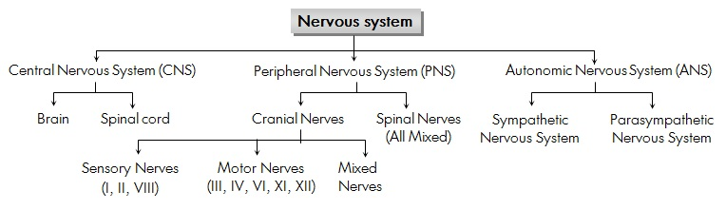
Human Nervous System
One of the most complex organ system to ever evolve, the human nervous system consists of two parts, namely:
Central Nervous System (consists of the brain and spinal cord)
Peripheral Nervous System (includes all the nerves of the body)

Slide 4
Central Nervous System
Central Nervous System (CNS) is often called the central processing unit of the body.
It consists of the brain and the spinal cord.
Brain
The brain is one of the important, largest and central organ of the human nervous system.
It is the control unit of the nervous system, which helps us in discovering new things, remembering and understanding, making decisions, and a lot more.
It is enclosed within the skull, which provides frontal, lateral and dorsal protection. The human brain is composed of three major parts:
Forebrain: The anterior part of the brain, consists of Cerebrum, Hypothalamus and Thalamus.
Midbrain: The smaller and central part of the brainstem, consists of Tectum and Tegmentum.
Hindbrain: The central region of the brain, composed of Cerebellum, Medulla and Pons.

Slide 5
Central Nervous System
Spinal Cord
The spinal cord is a cylindrical bundle of nerve fibers and associated tissues enclosed within the spine and connect all parts of the body to the brain.
It begins in continuation with the medulla and extends downwards. It is enclosed in a bony cage called vertebral column and surrounded by membranes called meninges.
The spinal cord is concerned with spinal reflex actions and the conduction of nerve impulses to and from the brain.

Slide 6
Peripheral Nervous System
Peripheral Nervous System (PNS) is the lateral part of the nervous system that develops from the central nervous system which connects different parts of the body with the CNS. We carry out both voluntary and involuntary actions with the help of peripheral nerves.
PNS includes two types of nerve fibers:
Afferent nerve fibers – These are responsible for transmitting messages from tissues and organs to the CNS.
Efferent nerve-fibers – These are responsible for conveying messages from CNS to the corresponding peripheral organ.
Classification of the peripheral nervous system:
Somatic neural system (SNS): It is the neural system that controls the voluntary actions in the body by transmitting impulses from CNS to skeletal muscle cells. It consists of the somatic nerves.
Autonomic neural system (ANS): The autonomic neural system is involved in involuntary actions like regulation of physiological functions (digestion, respiration, salivation, etc.). It is a self-regulating system which conveys the impulses from the CNS to the smooth muscles and involuntary organs (heart, bladder and pupil).
The autonomic neural system can be further divided into:
Sympathetic nervous system
Parasympathetic nervous system

Slide 7
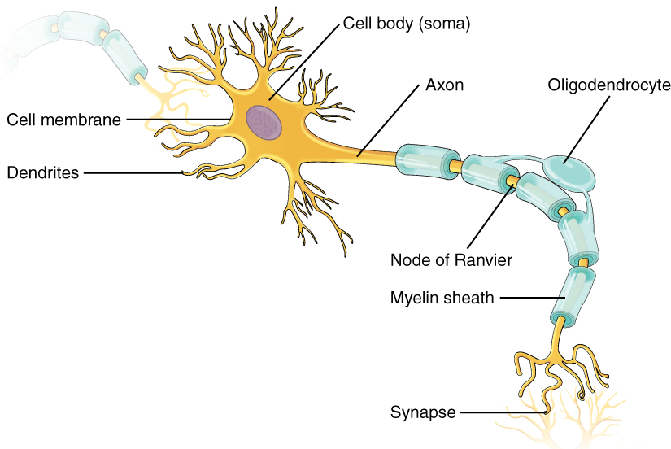
Neuron
Nerve tissue is consisted of two types of cells- The neuron and glial cells. Neurons form the structural and functional unit of neural system.
A neuron is composed of three major parts cell body, dendrites and axon.
The cell body granular bodies called Nissl’s granules.
Short fibres which branch repeatedly and project out of the cell body also contain Nissl’s granules and are called dendrites.
These fibres transmit impulses towards the cell body. The axon is a long fibre, the distal end of which is branched.
Each branch terminates as a bulb-like structure called synaptic knob which possess synaptic vesicles containing chemicals called neuro transmitters.
The axons transmit nerve impulses away from the cell body to a synapse or to a neuro-muscular junction.

Slide 8
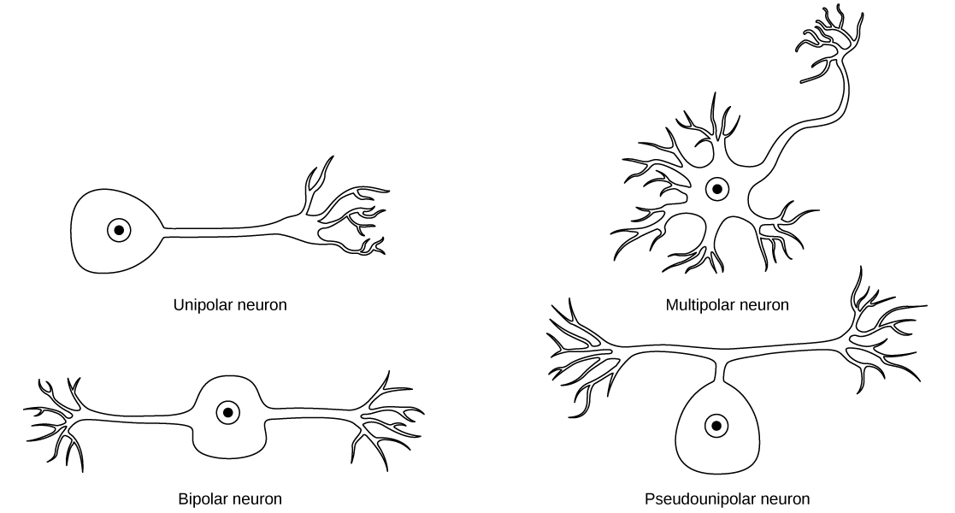
Types of neuron
Types of neurons- Based on the number of axon and dendrites, the neurons are divided into three types
(i) Multipolar neuron- A neuron with one axon and two or more dendrites.
(ii) Bipolar neuron- A neuron with one axon and one dendrite.
(iii) Unipolar neuron- A neuron with one axon only. The nerve transmission occurs through it. It may of may not be surrounded with myelin sheath accordingly nerve fibres may be of two types
(i) Myelinated- Myelinated nerve fibres are found in spinal and cranial nerves.
(ii) Non-myelinated- It is commonly found in autonomous and the somatic neural systems.

Slide 9
Nerves
Nerves are thread-like structures that emerge from the brain and spinal cord. It is responsible for carrying messages to all the parts of the body. There are three types of nerves. Some of these neurons can fire signals at speeds of over 119 m/s or above 428 km/h.
1.Sensory Nerves
These are the nerves that send messages to the brain or the spinal cord from the sense organs. These are enclosed in the form of a bundle like structures or nerve fibres in the peripheral nervous system. They carry information from the PNS to the CNS( Central Nervous System).
2.Motor Nerves
Motor nerves are those nerves those that carry the messages in the form of a response from the brain or the spinal cord to other parts of the body such as the muscles and glands. They are responsible for carrying the information from the CNS to the PNS.
3.Mixed Nerves
Mixed nerves are the nerves that perform both the action of sensory nerves as well as a motor nerve. They transform electrical impulses from the central nervous system to the muscles of the body. Generally, the mixed nerves transmit impulses at the rate of 120 metres per second or 432 kilometres per hour.

Slide 10
Function of Nerves
The primary function of nerves to conduct an electrochemical impulse and convey information. These impulses are carried by the individual neurons that make up the nerve.
These impulses travel from one neuron to another by crossing a synapse. The messages are converted from electrical to chemical and then back to electrical.
The sensory nerves carry information from the receptor to the central nervous system where the information gets processed.
The motor nerves, on the other hand, carry information from the central nervous system to the muscles.

Slide 11
THANKING YOU
ODM EDUCATIONAL GROUP

