Slide 1


INTRODUCTION & TYPES OF MOVEMENT
SUBJECT : BIOLOGY
CHAPTER NUMBER: 20
CHAPTER NAME : LOCOMOTION AND MOVEMENT

Slide 2
Introduction
What is Locomotion?
It is defined as the ability of the body to move from one place to another. For Example: Walking, Moving, Jumping, Crawling, Propelling etc.
What is the difference between Movement and Locomotion?
Movement can be at organism level, tissue level as well as cell level. For Example: Cell moves from one place to another at the time of embryo formation. Whereas Locomotion is termed as movement of a body from one axis to another (or many) in terms of co-ordinates.
It has to be noted that Movement of cell from one place to another cannot be considered as Locomotion. Movement, on one hand, can be voluntary or involuntary. Whereas Locomotion is always voluntary in nature.

Slide 3
Locomotor Movements
What is Locomotor Movements?
Movements that occur over some distance is known as Locomotor Movements. For Example: walking, running, etc. Locomotion always occur at the organism level. Locomotion involves locomotory organs that help the body to move from one place to another. Locomotion is always voluntary.
Methods of locomotion performed by animals vary with their habitats and the demand of the situation. In different animals locomotion is generally for search of food, shelter, mate, suitable breeding grounds, and favourable climatic conditions or to escape from enemies or predators.

Slide 4
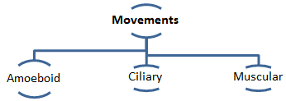
Introduction :Types of Movement
Movement is one of the important features of living beings.
All the living beings including animals and plants exhibit a wide range of movements.
Cyclosis streaming of protoplasm in the unicellular organisms like Amoeba is a simple form of movement.
Amoebic movement as in amoeba and other unicellular organisms.
Movement of cilia e.g. as in Paramoecium. Tentacles e.g. as in Hydra
Human beings can move limbs, jaws, eyelids, tongue, etc.
.

Slide 5
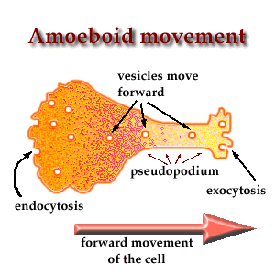
Types of Movement
In human being different cells shows three different types of movement-
Ciliary Movement
Amoeboid Movement
Muscular Movement
Amoeboid movement- Certain cells like leukocytes, macrophages show amoeboid movement. The amoeboid movement occurs by pseudopodia formation which is formed by protoplasmic streaming movement and cytoskeleton like microfilaments.

Slide 6
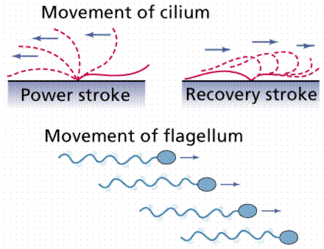
Ciliary movement
Ciliary movement- There are several hollow structures which are lined with ciliated epithelium, e.g. as in trachea, fallopian tube etc. In trachea the coordinated movement of cilia results in movement of dust particles towards outside.

Slide 7
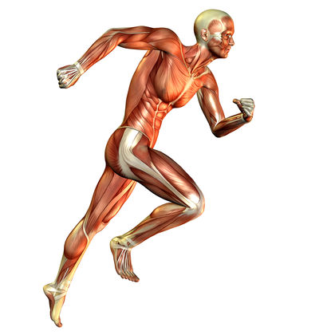
Muscular movement
Muscular movement- Movement of jaw, tongue, limbs etc are example of muscular movement. Muscle is contractile tissue. Muscular movement is used in most of the multicellular organisms for movement and locomotion. Muscular movement requires proper coordinated.

Slide 8
THANKING YOU
ODM EDUCATIONAL GROUP

