Slide 1

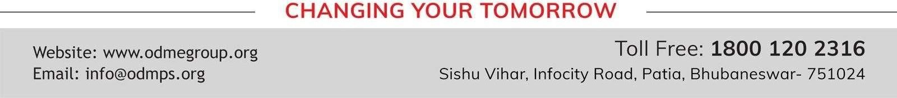
OUR ENVIRONMENT SUBJECT: BIOLOGY CHAPTER NUMBER 15
CHAPTER NAME: OUR ENVIRONMENT. PERIOD -4

Slide 2
Testing previous knowledge –
1.What is biological magnification.? Explain with examples. 2.Can an ecosystem survive without producers?
3.What is pyramid of numbers, biomass and energy?

Slide 3
How do our activities affect the environment?
The activities of man that affect the environment are mainly
Deforestation
Construction of road, building etc.
Excessive use of pesticide and weedicide
Use of CFCs

Slide 4
Environmental problems
The two major environmental problems are
Depletion of ozone layer and
Waste disposal

Slide 5
Ozone Layer:
It is a layer of the earth's atmosphere, where ozone is concentrated.
The Ozone layer is very important for the existence of life on earth because it absorbs most of the harmful ultraviolet radiation coming from the sun and prevents them from reaching the earth.
Sources of CFCs-
Refrigerants for refrigerators, automobiles and air-conditioners.
Cleaning agents for semi-conductors and precision parts.
Foaming agents for insulating materials and packing cushions.
Propellants for aerosol sprays.

Slide 6
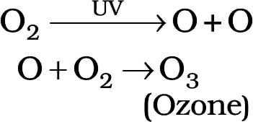
Ozone depletion:
Ozone is being depleted by air pollutants.
Chlorofluorocarbons (CFCs) are air pollutants that are mainly responsible for the depletion of ozone layer in the stratosphere.
Besides, methane (CH4) and oxides of nitrogen (NOx) also cause destruction ofozone.

Slide 7
Effect of Ozone Depletion:
Ultraviolet radiations cause skin cancer.
These cause damage to eyes and also can cause increased incidence of cataract disease in eyes.
These cause damage to immune system by lowering the body's resistance to diseases.

Slide 8
CLASSIFICATION OF WASTES
Bio–degradable wastes Non–bio-degradable wastes
Substances that are broken down by biological process of biological or microbial action are called bio-degradable waste. e.g. wood, paper and leather.
Substances that are not broken down by biological or microbial action are called non-bio- degradable wastes. e.g. Plastic substances and mineral wastes.

Slide 9
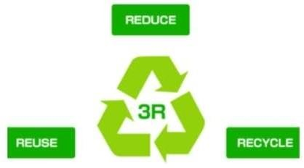
Managing the Garbage, we produce.

Slide 10
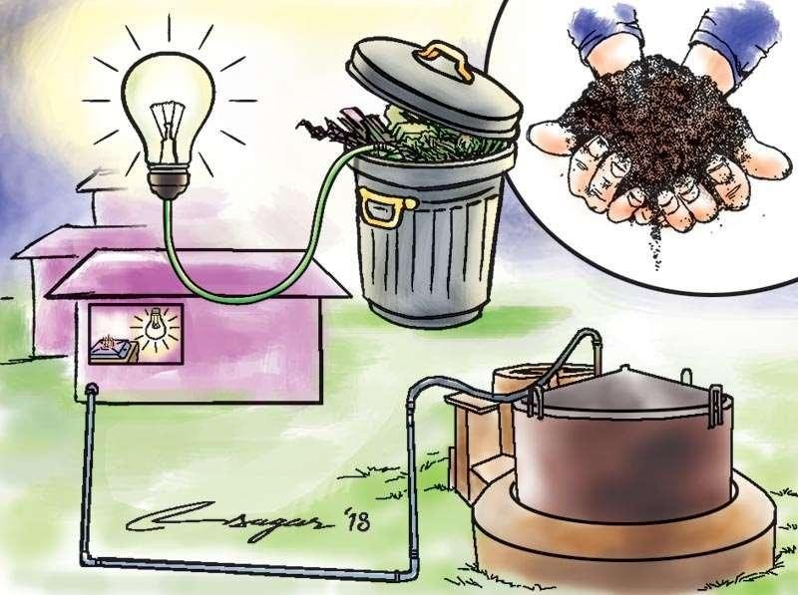

Slide 11
https://www.youtube.com/watch?v=WE3y1Gj2dec

Slide 12
HOME ASSIGNMENTS
How can you help in reducing the problem of waste disposal? Give any two methods.
Name the radiation absorbed by the ozone layer. What would happen to living beings on earth if the ozone around us disappears? How can we prevent ozone depletion?
Damage to the ozone layer is a cause for concern. Justify this statement. Suggest any two steps to limit this damage.
What is a biodegradable waste? If all the waste we generate is biodegradable, what impact may this have on the environment?

Slide 13
THANKING YOU
ODM EDUCATIONAL GROUP

