Slide 1

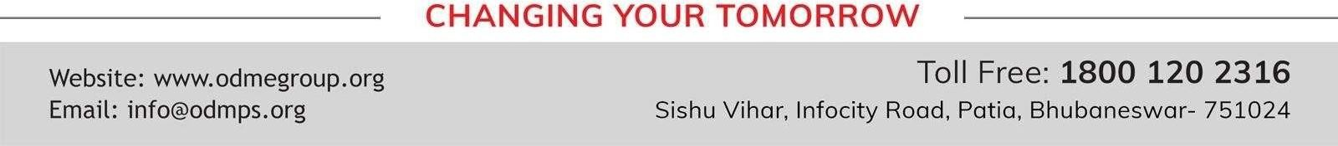
OUR ENVIRONMENT SUBJECT:BIOLOGY CHAPTER NUMBER 15
CHAPTER NAME : OUR ENVIRONMENT. PERIOD -3

Slide 2
Testing previous knowledge –
1.What are the importance of decomposers? 2.What is a food chain?
What is food web?
Distinguish between a food chain & a food web

Slide 3
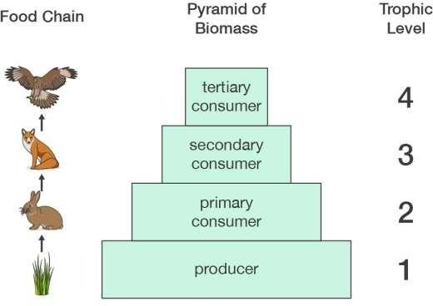
Pyramid of biomass

Slide 4
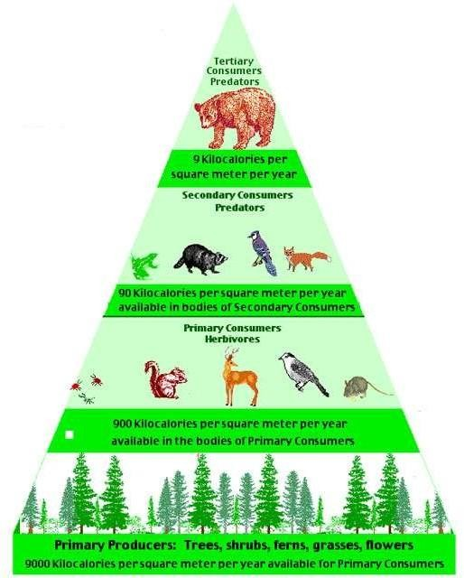
Pyramid of numbers

Slide 5
Bio magnification or biological magnification
Increase in concentration of the pollutants or toxic substances in the successive tropical levels of food chain in an ecosystem is called bio magnification or biological magnification

Slide 6
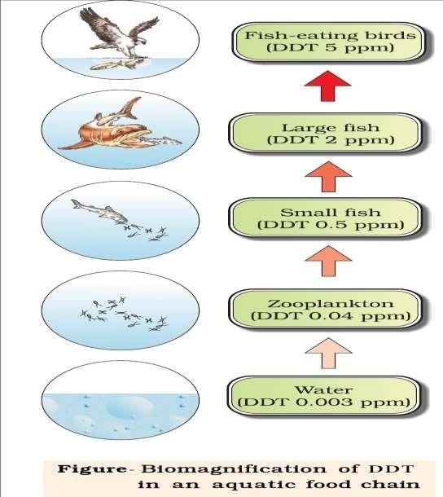

Slide 7
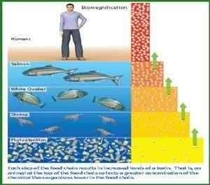

Slide 8
https://www.youtube.com/watch?v=xhqeqiL7Kjo

Slide 9
HOME ASSIGNMENTS
What is biological magnification.
Will the levels of Biomagnification be different at different levels of the ecosystem? If yes, identify your answer.
What will happen if we kill all the organisms in one trophic level?
What is pyramid number and pyramid biomass.?

Slide 10
THANKING YOU
ODM EDUCATIONAL GROUP.

