Slide 1


OUR ENVIRONMENT SUBJECT:BIOLOGY CHAPTER NUMBER 15
CHAPTER NAME : OUR ENVIRONMENT PERIOD-2

Slide 2
Testing previous knowledge –
Give two examples of Artificial ecosystems.
Which is the ultimate source of the energy for an ecosystem?
Do we have to clean ponds or lakes in the same manner of aquarium? Why or why not?

Slide 3
Food chain
“A food chain in an ecosystem is a series of organisms in which each organism feeds on the one below it in the series.”

Slide 4
Some common food chains are mentioned below:
Plants → Deer → Lion
Plants → Worm→ Bird → Cat
Plants→ Grasshopper→ Frog→ Snake→ Hawk
Algae→ Small→ animal → Small fish → Big fish —> Bird

Slide 5
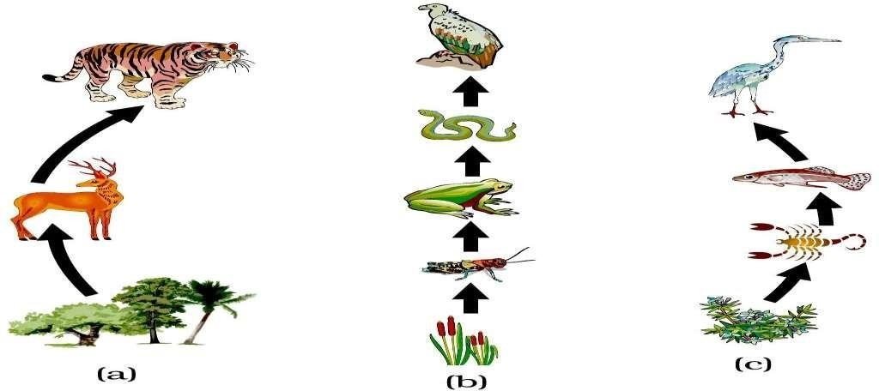

Slide 6
Food web
A food web is a graphical depiction of feeding connections among species of an ecological community.
Food web consists of food chains of a particular ecosystem. The food web isa illustration of various methods of feeding that links theecosystem.
The food web also defines the energy flow through species of a community as a result of their feeding relationships.
All the food chains are interconnected and overlapping within an ecosystem . They also make up a food web. It increases the stability of ecosystem.
It provides other source of food and allows the endangered species to grow.

Slide 7
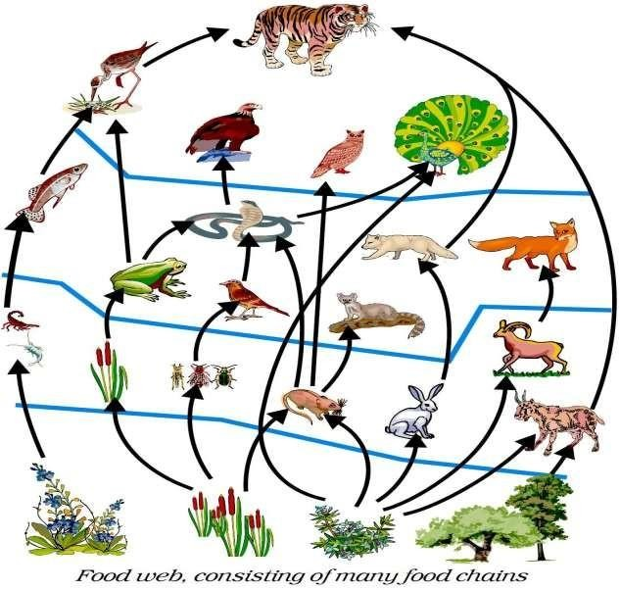

Slide 8
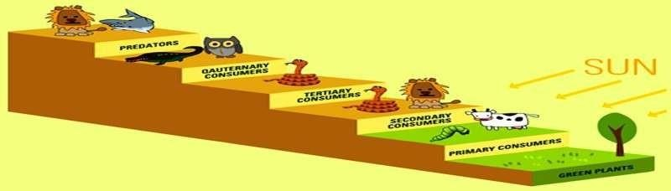
TROPHIC LEVELS OF FOOD CHAINS
The levels of a food chain (food pyramid) is called Trophic levels. The trophic levelof an organism is the level it holds in a food pyramid.

Slide 9
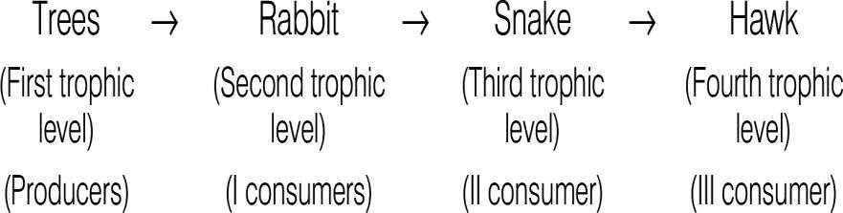
Each stage of a food chain is known as tropic level

Slide 10
Energy flow
The transfer of energy in each tropic level in an ecosystem is called energy flow

Slide 11
ENERGY FLOW IS UNIDIRECTIONAL AND REQUIRESCONTINUOUS INPUTS.
Out of the energy consumed by an organism at a tropic level, 90% is utilized its own need and rest 10% is left for the organism of the nexttropic level.
So, very little energy is left for the organism which is at the tertiarylevel.

Slide 12

10 percent law
Let us assume that a green plant makes 100% energy in the form ofchemical energy.
90% of this energy would be utilized for its own purpose.
This would leave just 10% energy for the primary consumer
Now, primary consumer shall also utilize 90% of energy which was consumed by it.
This would leave just 1% energy for (10% of 10 = 1) the secondary consumer.
By this logic, the tertiary consumer would get just 0.1% of energy whichwas originally made by the green plant.
This is the reason, why there can be just one or two organisms at the top of the food pyramid.

Slide 13
https://www.youtube.com/watch?v=j78g5iRnYBM

Slide 14
HOME ASSIGNMENTS
Name the different levels of consumers
which two factors decide the formation of a food chain?
Why are food chains interconnected and never operate In isolated sequences?
How do insecticides enter a food chain.?

Slide 15
THANKING YOU
ODM EDUCATIONAL GROUP

