Slide 1

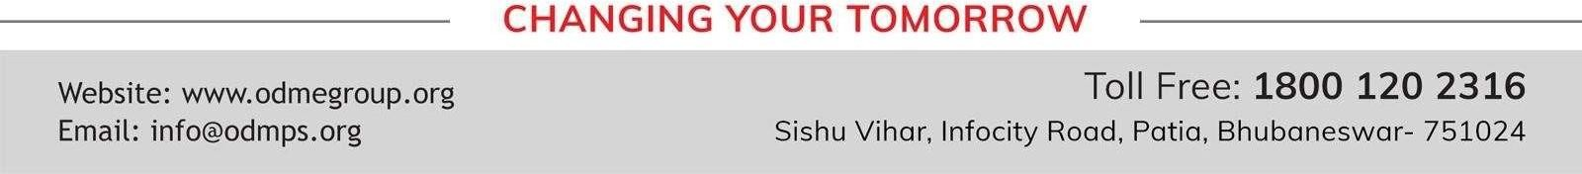
OUR ENVIRONMENT SUBJECT: BIOLOGY CHAPTER NUMBER 15
CHAPTER NAME: OUR ENVIRONMENT. PERIOD-1

Slide 2
Environment
Our surrounding is called environment.
Environmental science can be defined as the study of organisms in relation to their surrounding.
The environment includes our physical surroundings like air (or atmosphere), water bodies, soil (land) and all the organisms such as plants, animals, human beings and microorganisms like bacteria and fungi (called decomposers).
Human activities related to livelihood and welfare generate waste. All wastes are pollutants and they create pollution in one way or another. Air, land and water surroundings are affected due to improper disposal of wastes which create an imbalance in the environment.

Slide 3
Pollution.
Any undesirable change in the physical, chemical or biological characteristics of air, land and water that affect human life adversely is called pollution.

Slide 4
Pollutant
A substance released into the environment due to natural or human activity which affects adversely the environment is called pollutant. e.g. Sulphur-di-oxide, carbon-monoxide, lead, mercury, etc.

Slide 5
WHAT ARE ITS COMPONENTS?
An ecosystem has two types of components, viz. biotic component and abiotic component.
BIOTIC COMPONENT
All living beings make the biotic component of an ecosystem.
Green plants play the role of producers, because they prepare the food by photosynthesis.
Animals and other living beings play the role of consumers, because they take food (directly or indirectly) from plants.
Bacteria and fungi play the role of decomposers as they decompose dead remains of plants and animals so that raw materials of organisms can be channelized back to the environment

Slide 6
. ABIOTIC COMPONENT
All the non-living things make the abiotic component of an ecosystem. Air, water and soil are the abiotic components.
Air provides oxygen (for respiration), carbon dioxide (for photosynthesis) andother gases for various needs of the living beings.
Water is essential for all living beings because all the metabolic activities happen in the presence of water.
Soil is the reservoir of various nutrients which are utilized by plants. Through plants, these nutrients reach other living beings.
•

Slide 7
It includes three types of organisms:
Producer
Green plants play the role of producers, because they prepare their food by
photosynthesis.
Consumer
Animals and other living beings play the role of consumers, they takefood (directly or indirectly) from plants.
Consumers can be further divided into three groups:
  Herbivores
  Carnivores
  Omnivores
Decomposer/saprophyte
The micro-organisms which break down the complex organic compounds present in dead plants and animals and their products like faeces, urine, etc. into simpler substances are called decomposers.

Slide 8
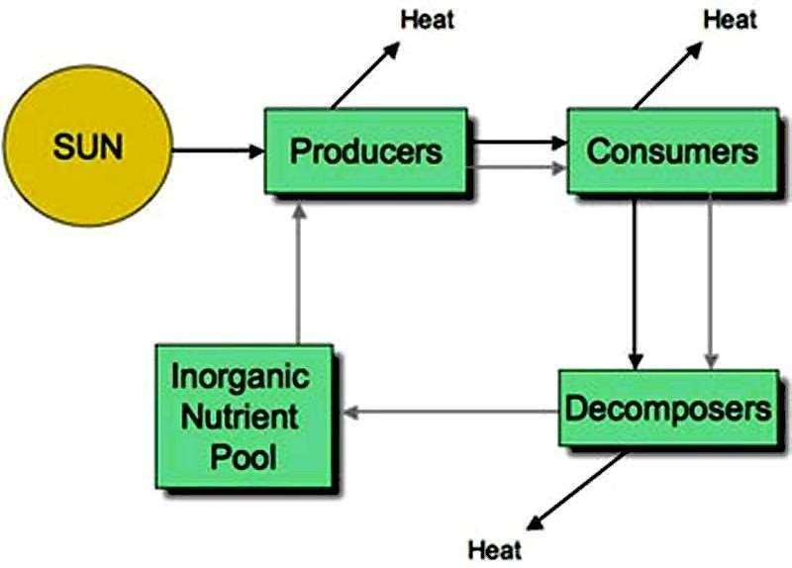

Slide 9
https://www.youtube.com/watch?v=L5B-JMnBIyQ

Slide 10
HOME ASSIGNMENTS
How does an ecosystem represent the highest level of ecological integration?
Why is an ecosystem called active and dynamic?
Give examples of man- made ecosystems.
what do you understand by balance in nature?
Distinguish between natural and artificial ecosystems.

Slide 11
THANKING YOU
ODM EDUCATIONAL GROUP

