Slide 1


GRAMMAR
STD-VIII
SUBJECT : ENGLISH
CHAPTER NUMBER: 7
PERIOD NUMBER : 2
CHAPTER NAME :NOUN PHRASE

Slide 2
EXPECTED LEARNING OUTCOMES
GENERAL OBJECTIVES Understand the basics of grammar Being acquainted with the chapter and its tenets Understanding the idea Appreciate the beauty of grammar and use in day to day life Developing LSRW Skills
SPECIFIC OBJECTIVES/ EXTENDED OBJECTIVES develop your knowledge of expanded noun phrases understand how noun phrases can improve clarity of writing have a greater understanding of how to use noun phrases.

Slide 3
Functions of Noun Phrase
Like noun, noun phrase does the work of noun in the sentence in which it is used. Noun phrase may be used as a
Subject of sentence
Object of sentence
Subject Complement of sentence
Object Complement of sentence
Object of a Preposition

Slide 4
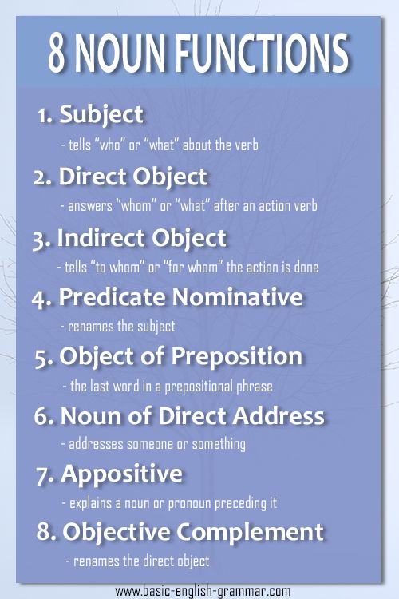
As Subject of sentence
A subject is a word, phrase, or clause that performs the action of or acts upon the verb.
Eg-
The baby cried.
Dogs and cats make excellent pets.

Slide 5
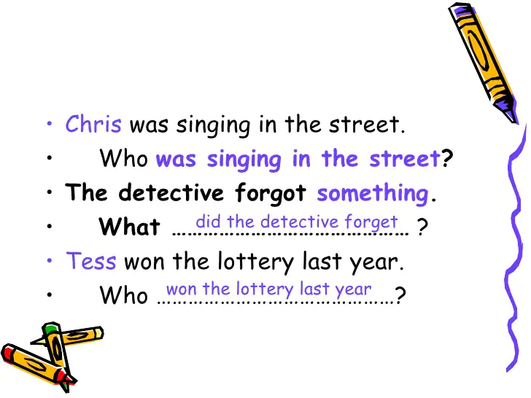
As Object of sentence
My husband bought me flowers.
(indirect object)
The children ate all the cookies.
(direct object)

Slide 6
As Subject Complement of sentence
A subject complement is a word, phrase, or clause that follows a copular, or linking, verb and describes the subject of a clause.
Ex-
My grandfather is a farmer.
Our favorite pets are dogs with short hair.
My father is a doctor.

Slide 7
As Object Complement of sentence
Object complements directly follow and modify the object.
Ex-
They made Seema the monitor of class.
America recently elected Barack Obama president.

Slide 8
As Object of a Preposition
If we ask out of what, by what, from what with the preposition we get the noun phrases as answers.
Ex-
My husband bought flowers for me.
The students studied during their spring break.
H.W- Exercise - 4 (Page -51)

Slide 9
THANK YOU
ODM EDUCATIONAL GROUP

