Slide 1


GRAMMAR
STD-VIII
SUBJECT : ENGLISH
CHAPTER NUMBER: 7
PERIOD NUMBER : 1
CHAPTER NAME :NOUN PHRASE

Slide 2
EXPECTED LEARNING OUTCOMES
GENERAL OBJECTIVES Understand the basics of grammar Being acquainted with the chapter and its tenets Understanding the idea Appreciate the beauty of grammar and use in day to day life Developing LSRW Skills
SPECIFIC OBJECTIVES/ EXTENDED OBJECTIVES develop your knowledge of expanded noun phrases understand how noun phrases can improve clarity of writing have a greater understanding of how to use noun phrases.

Slide 3
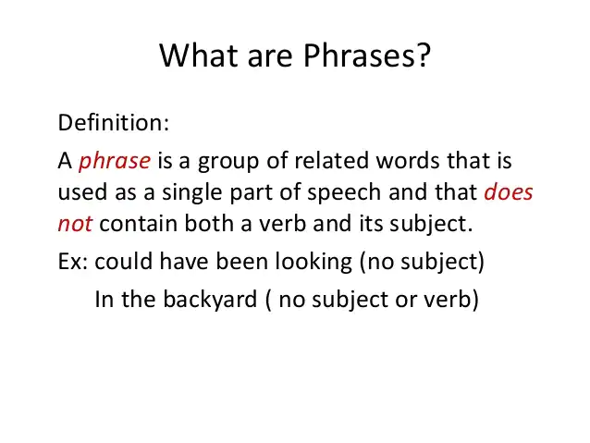

Slide 4
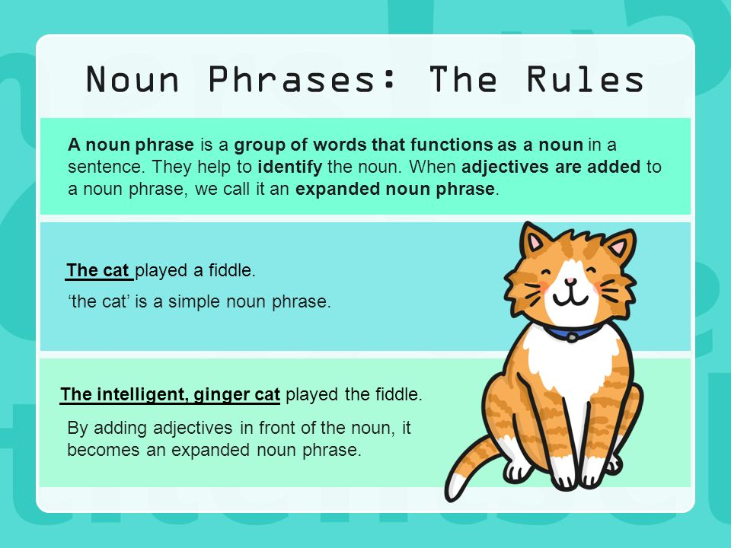
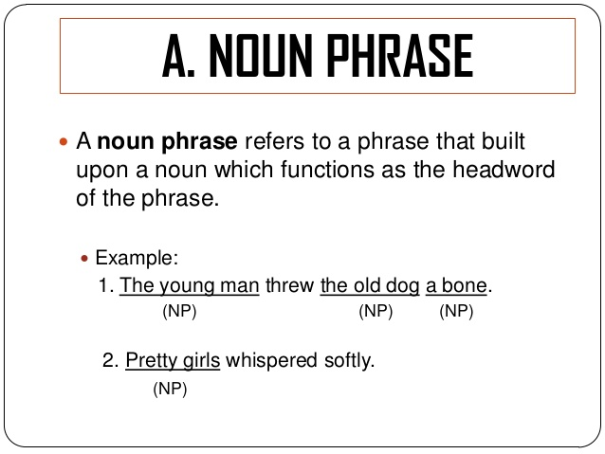
What is a Noun Phrase?

Slide 5
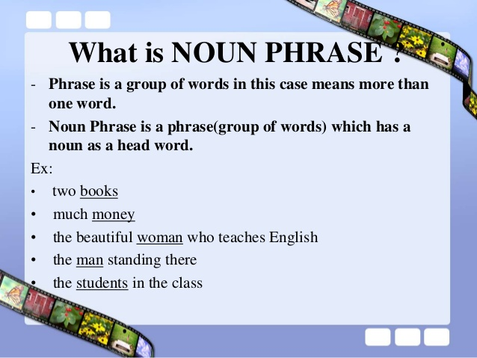
Noun Phrase contains
1. Adjectives- describe the head word
Ex- Give me the empty bag.
2. Determiners- show the type of reference the noun is making- definite, indefinite, demonstrative or possessive
Ex- Their car was parked here.

Slide 6
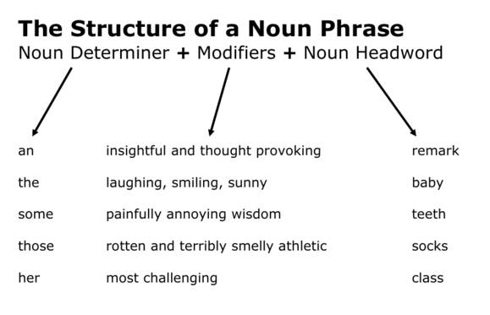
Noun Phrases modify the meaning of the noun.
Words can go before the noun
e.g. The great river
or after the noun.
e.g man of honour
H.W- Exercise - 1 (Page -48)

Slide 7
THANK YOU
ODM EDUCATIONAL GROUP

