Slide 1


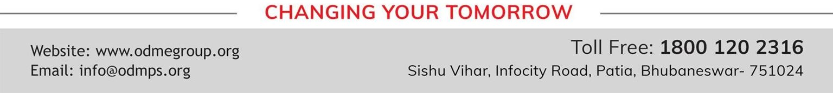
BEEHIVE
No Men are Foreign
SUBJECT : (SUBJECT NAME) ENGLISH CHAPTER NUMBER: 06
CHAPTER NAME : NO MEN ARE FOREIGN
AUTHOR NAME : JAMES KIRKUP

Slide 2
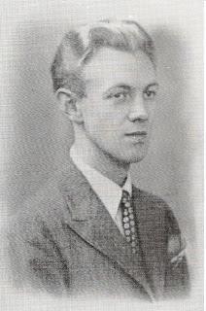
ABOUT THE POET:
JAMES KIRKUP
James Falconer Kirkup, born as James Harold Kirkup was an English poet.
He was born on 23 April 1918, in England and died on 10 May 2009 in Andorra.
He was a translator and travel writer and wrote over 30 books, including autobiographies, novels and plays.
His book ‘The Drowned Sailor’ appeared in 1947
In 1952, a poem collection named ‘A Correct Compassion’ was released.
He has to his credit 40 verse collections, 6 autobiographies, several translation Literature, including- I, Of All People(1988), A Poet Could Not But Be Gay(1991),
and Me All Over (1993).

Slide 3
INTRODUCTION TO THE POEM:
The poet wants to say that all men are same, all are equal. He wants to promote the concept of universal brotherhood. In this poem, the poet wants to tell us that everyone in this world are basically the same . They eat,live,die the same way. Everyone gets the bounties of nature like, sunshine, land etc in equal measure. We can also say that it is a peace poem. As it is proved that all are basically the same in human emotions too hence, no country can be foreign. All the people belong to one human race. We share the same ‘Mother Earth’ and upon our death, shall lie in the grave in the same Earth.

Slide 4
SUMMARY:
The poem ‘No Men are Foreign’ begins and ends with similar lines- ‘ Remember no men are strange, no countries foreign’; Remember no men are foreign , no countries strange’ . The poet wants to emphasize on the fact that all the people living on this Earth are the same but we have created distinctions by erecting borders and fences, different languages etc. While we are alive, we walk on the same Earth and upon our death , we will lie in our graves in the same Earth . He draws another similarity that we all enjoy good food during peace and starve during war and winter. We all have similar hands which we use to do a lot of hard work. All of us have eyes which remain open when we are awake and close when we are asleep. He reminds the reader that whenever we hate someone, we cheat and hate ourselves. Also, when we pick up weapons against someone, we pollute the Earth and make it impure with the huge mounds of dead bodies strewn on it.

Slide 5
POETIC DEVICES:
ALLITERATION: The repetition of consonant sound in two or more closely placed words.
The instances in the poem are: Stanza 1-’Body , breathes’ ‘b’ sound is repeated Stanza 2- war’s winter ‘w ‘sound is repeated.
METAPHOR: Stanza 1- Uniform refers to the military of different countries.
Stanza 2- war times is compared to the winter season.
REPETITION: ‘Remember ‘ word is repeated 5 times in the poem.
ENJAMBMENT: Lines of the poem run from one line to the next without using any kind of punctuation to indicate a stop. Examples are:
Stanza1: lines 2,3,and 4. stanza 2: line 3. stanza 3: lines 1,2 and 3. stanza 4: lines 1 and 2. stanza 5: lines 2 and 3.

Slide 6
THANKING YOU
ODM EDUCATIONAL GROUP

