Slide 1


BEEHIVE
MY CHILDHOOD
SUBJECT : (SUBJECT NAME) ENGLISH CHAPTER NUMBER: 06
CHAPTER NAME : MY CHILDHOOD
AUTHOR NAME : A. P. J. ABDUL KALAM

Slide 2
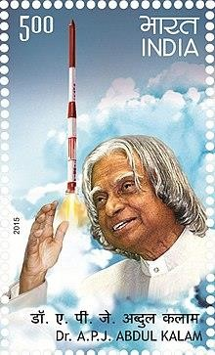
ABOUT THE AUTHOR:
Abul Pakeel Jainulabdeen Abdul Kalam, was the eleventh president of India (2002)
His projects in space, defence and nuclear technology guided India into the
twenty first century.
Abdul Kalam’s biography is titled “Wings of Fire” and the chapter ‘My Childhood’
is an excerpt from that book.
APJ talks about his upbringing, his parents and siblings. He also tells us about his
friends and all those things that influenced his childhood.
He also talks about his teachers and their influence on him along with the
communal harmony he saw around him.

Slide 3
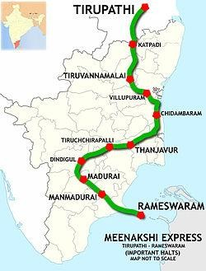
LESSON AND EXPLANATION
APJ was born into a middle- class Tamil family and his place of birth- Rameswaram is an island town in the state of Tamil Nadu , in the Bay of Bengal. Today, we know this state as Tamil Nadu but when he was born , at that time the state was known as Madras state .
He lived in a fairly large pucca house , made of limestone and brick. It was his ancestral house , built in the middle of the nineteenth century on the Mosque Street in Rameswaram.
He had three brothers and a sister , who was married to Jallaluddin. He also had a cousin Samsuddin , who had helped APJ earn the first wages of his life.

Slide 4
PARENTS :
Kalam’s father was Jainulabdeen:
He wasn’t highly educated or very rich but he had an innate wisdom , honesty and generosity.
Kalam’s father did not believe in wasting money on luxuries but provided his family with all the necessities of life ,
like food ,clothing and medicine.
Kalam inherited honesty and self-discipline from his father.
Kalam’s mother was Ashiamma :
She supported her husband in his decisions. She was a kind – hearted woman . Kalam recollects that his mother would feed meals to numerous people.
Kalam’s mother imbibed in him faith in goodness and deep kindness.

Slide 5
DIFFICULT WORDS:
Generosity of spirit : the openness and willingness to share our giftts ( both emotional and material) freely with
others.
Undistinguished : common, unexceptional, lacking distinction.
Ancestral : belonging to or inherited from an ancestor. 4.Inessential : not absolutely necessary.
Luxuries : things that provide a state of great comfort or elegance.
Erupted : broke out
Anna : former monetary unit of India equal to one sixteenth of a rupee.
Isolated : secluded , unreachable
Emergency : a serious, unexpected , often dangerous situation requiring immediate action.
Casualty : a person or a thing badly affected by an event or a situation.
Suspension : delay , stay ,stop , prevent 12.Surge of Pride : a strong rush of satisfaction.

Slide 6
THANKING YOU
ODM EDUCATIONAL GROUP

