Slide 1

WELCOME TO ODM ONLINE CLASS
CLASS-UKG
SUBJECT-MATHEMATICS
T0PIC- SHAPES
(BK PG 70 TO 74)

Slide 2

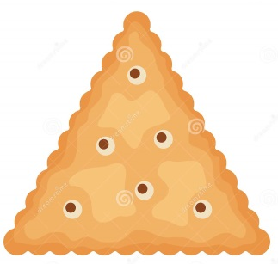

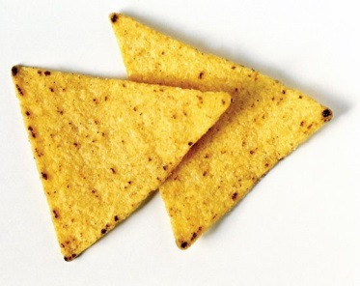

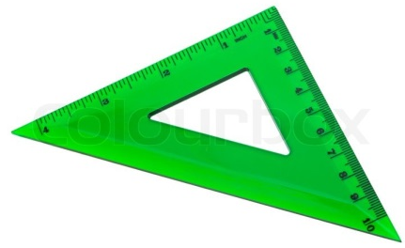

A triangle has 3 sides,
A triangle has 3 sides,
Up the mountain, Down, and back.
A triangle has three sides.

Slide 3
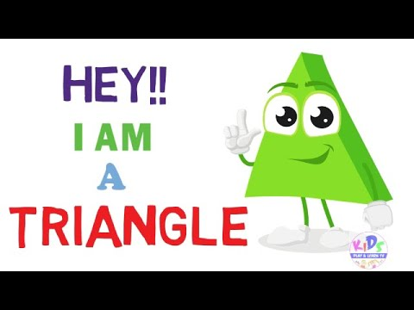
CAN YOU SAY WHO AM I ?
This is a triangle.
It has 3 sides .
It has 3 corners.

Slide 4

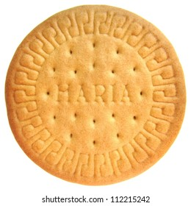
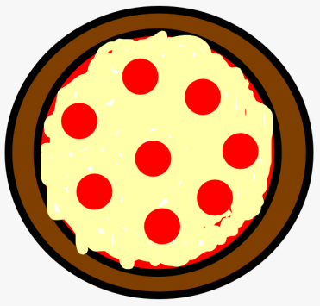



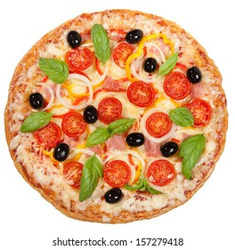
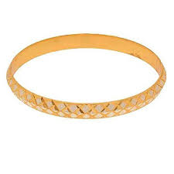
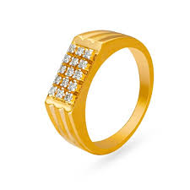
A circle is like a bangle,
A circle is like A wheel,
Round and round
It never stops.
A circle is like a clock
A circle is like a ring
Round and round
It never stops.

Slide 5

CAN YOU SAY WHO AM I ?
This is a circle
It has no sides
It has no corners
It is round.

Slide 6
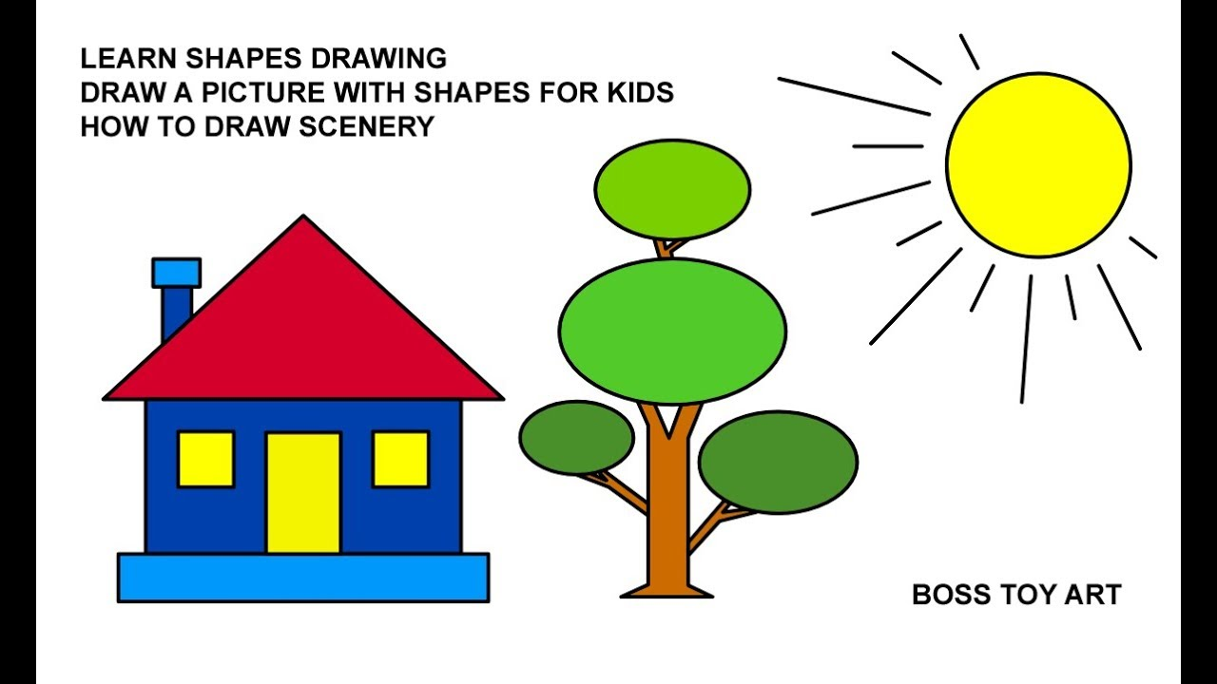
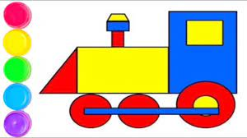
CW
Activity
Count and say the number of shapes as below-

Slide 7
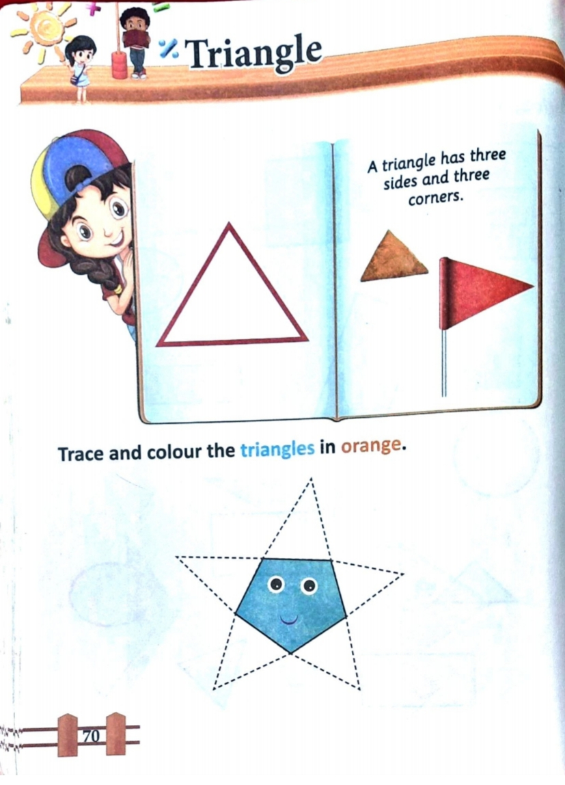
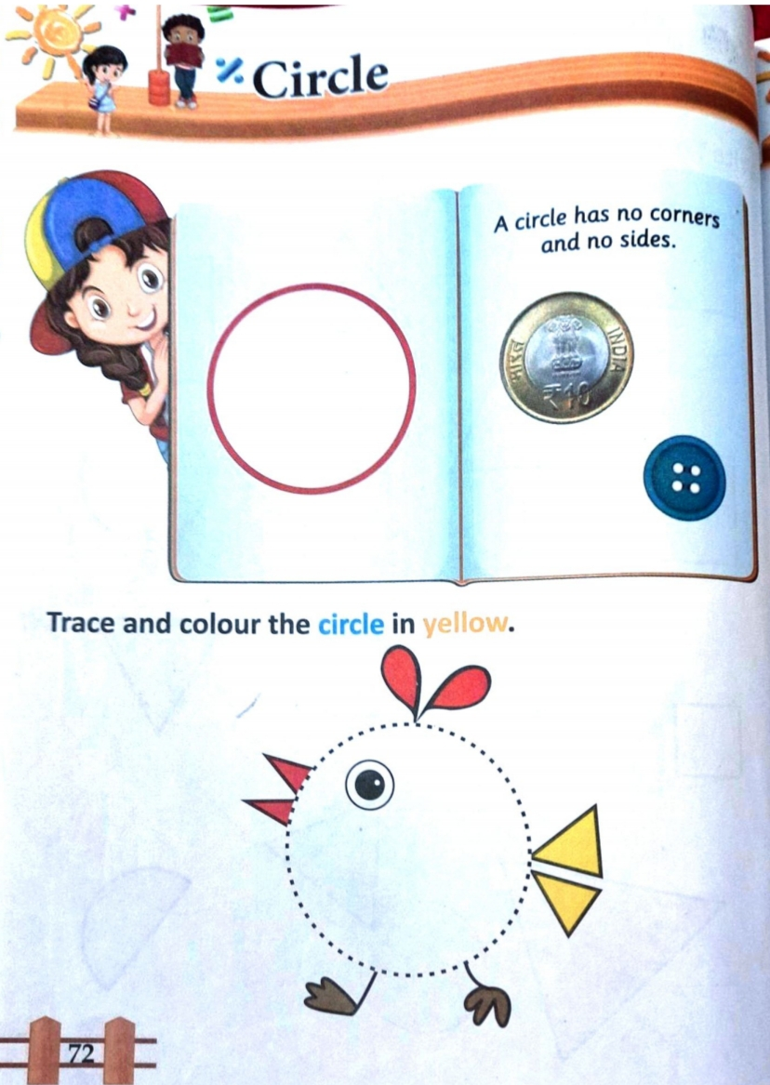
CW
18.8.21

Slide 8
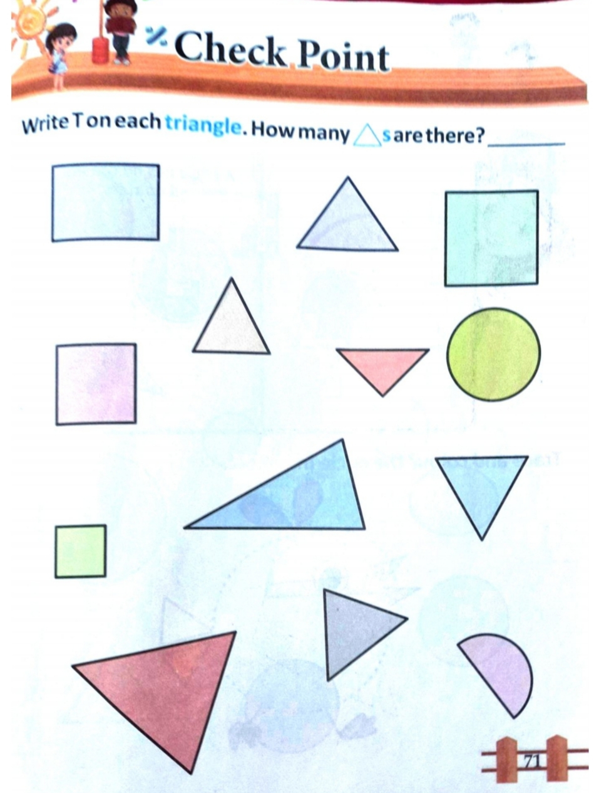
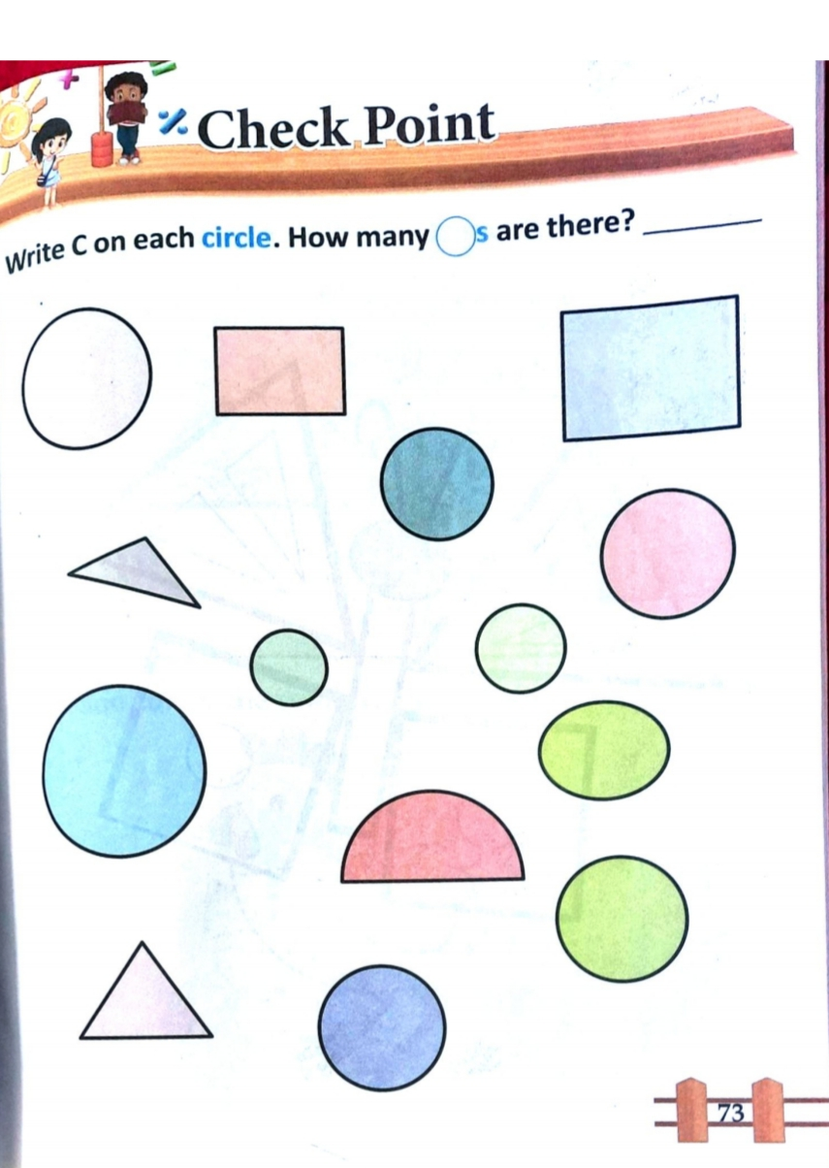
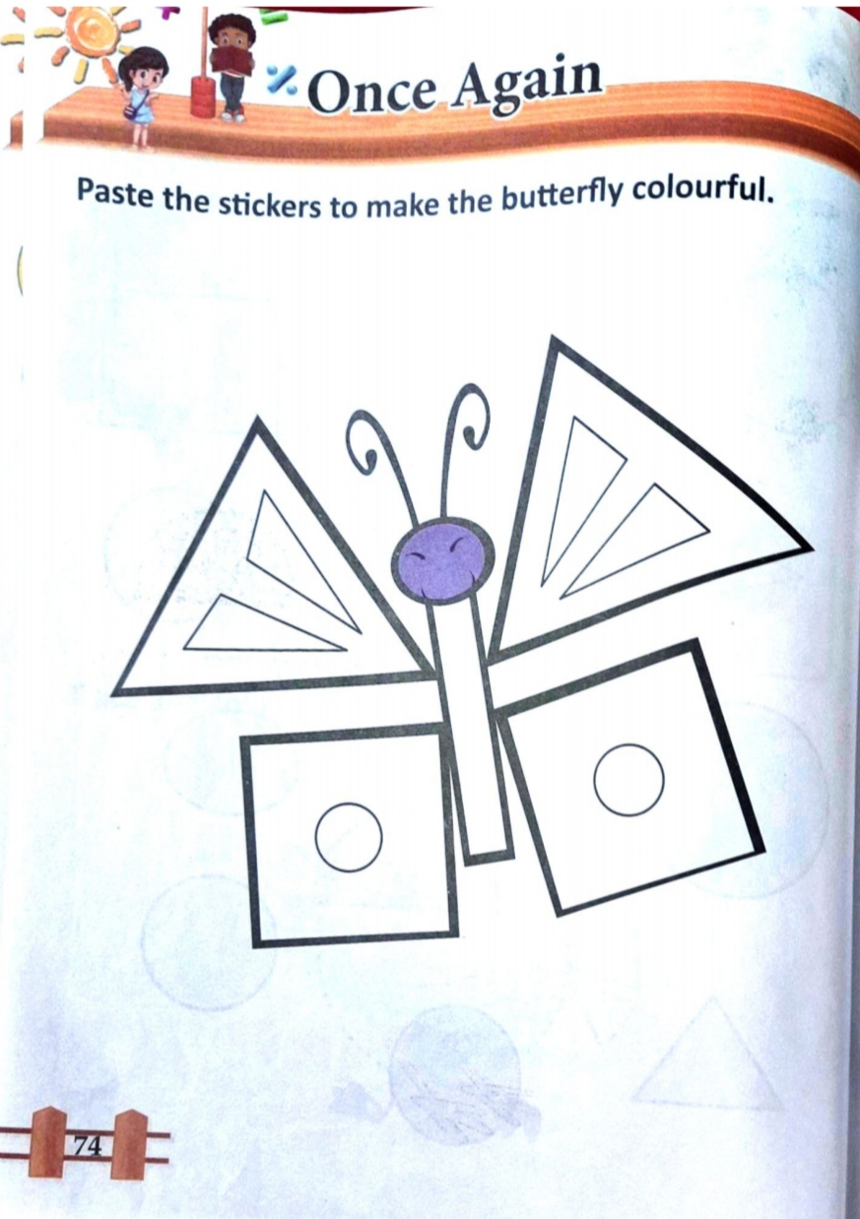
HW - 18.8.21

Slide 9

THANKING YOU
ODM EDUCATIONAL GROUP

