Slide 1

WELCOME TO ONLINE CLASS
CLASS-UKG
SUBJECT-MATHS
TOPIC-ADDITION
(BK PG-120-123)

Slide 2



I have 1 apple.
I have 2 apples.
1 apple and 2 apples make 3 apples.

Slide 3
Any thing/any one added /join/ putting together and it is increased is called - ‘ADDITION’.
‘ADDITION’ is the process of calculating
the total of two or more numbers. It is
the total sum of 2 or more numbers.
ADDITION is ‘+’ (plus) symbol.
2 + 2 = 4

Slide 4
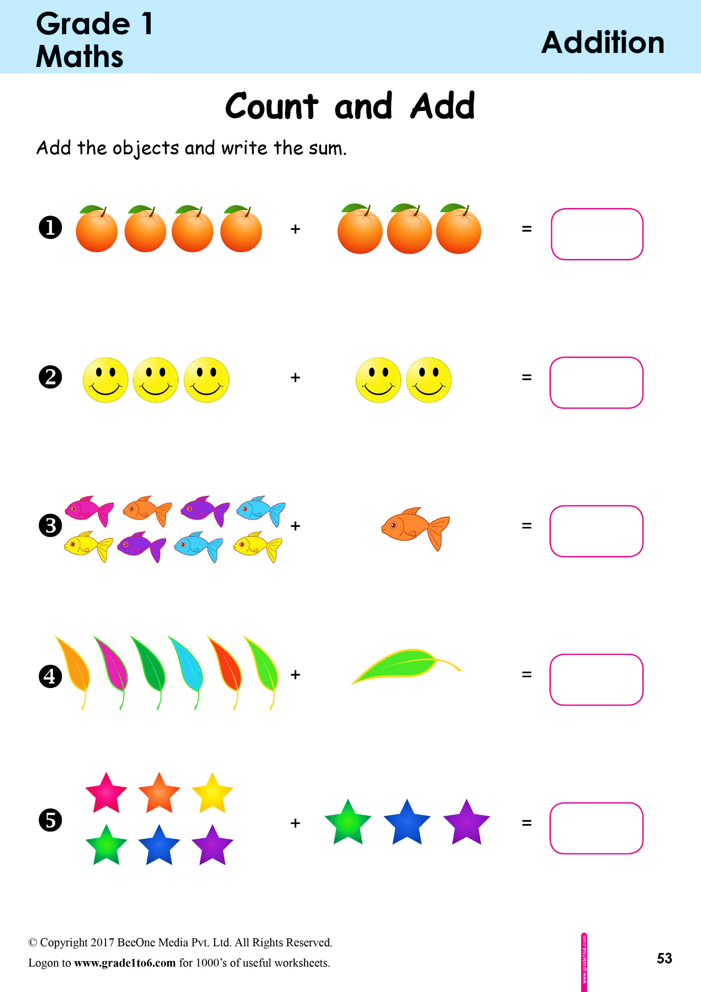
Count ,add and say the number-
+
=
7
4
3
Recap
+
=
5
3
2
+
=
9
8
1
+
=
7
6
1
+
=
9
6
3

Slide 5

Draw ,Add and say-
3 + 3 =
6
5 + 3 =
8

Slide 6
ADDITION
HORIZONTAL
VERTICAL
2 I I
+2 I I
2 + 2 = 4
I I I I I I I I
4 I I I I

Slide 7



Count and Add -
3
+ 3
3
+ 3
2
+ 2
4
6

Slide 8
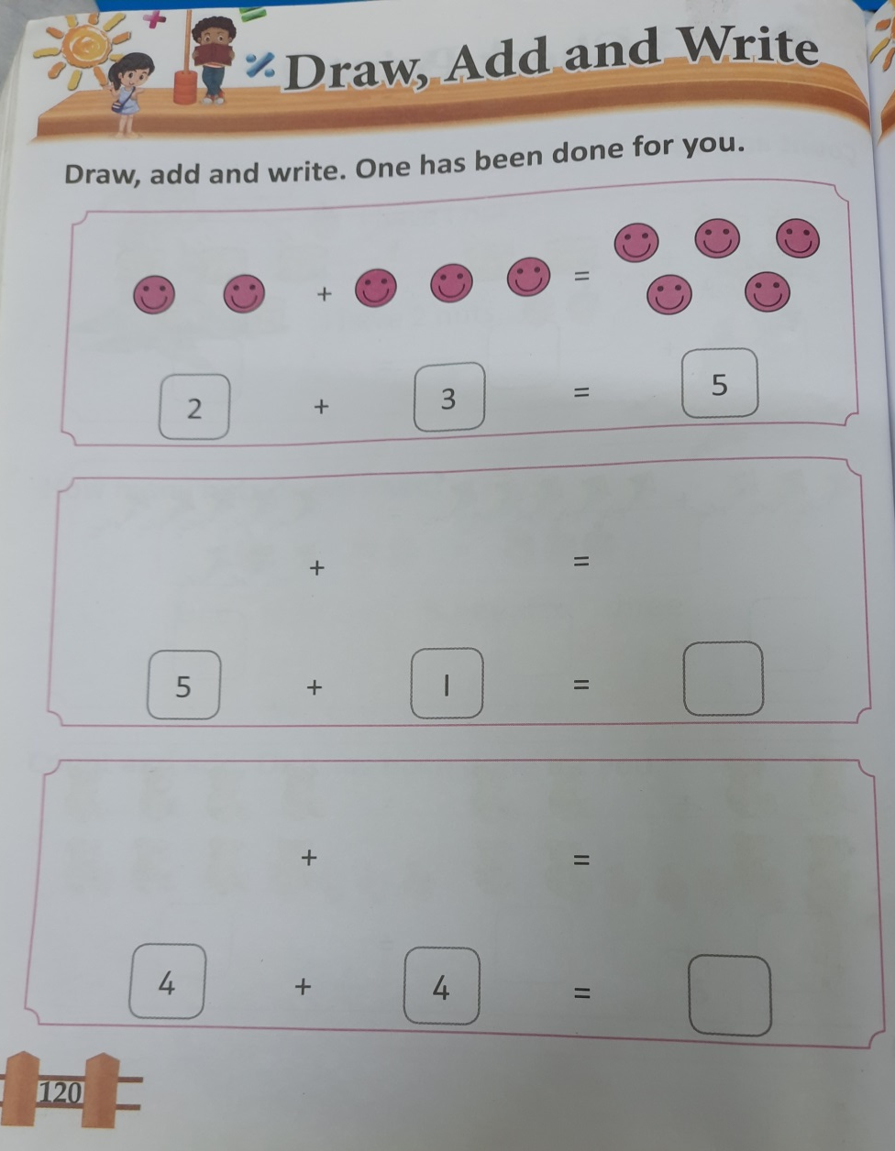
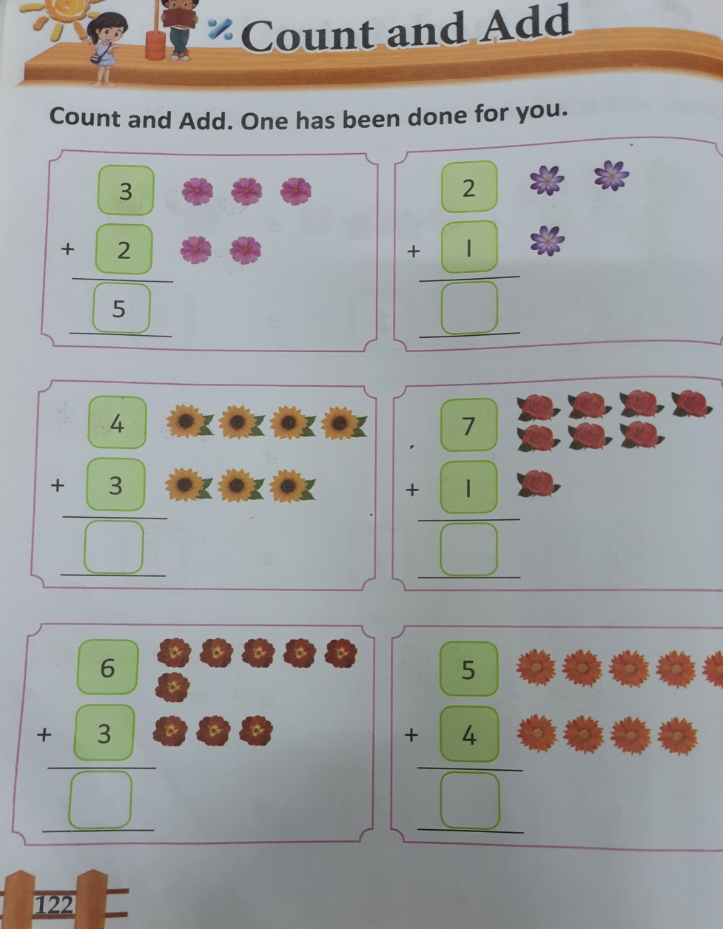
C.W
16.11.21
Do bkpg-120 & 122

Slide 9
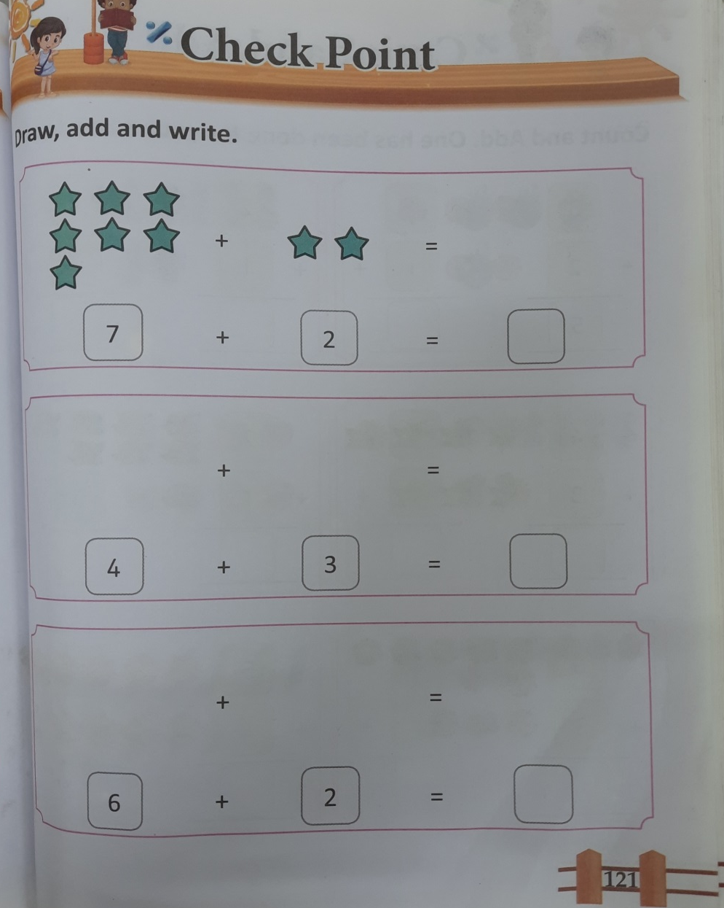
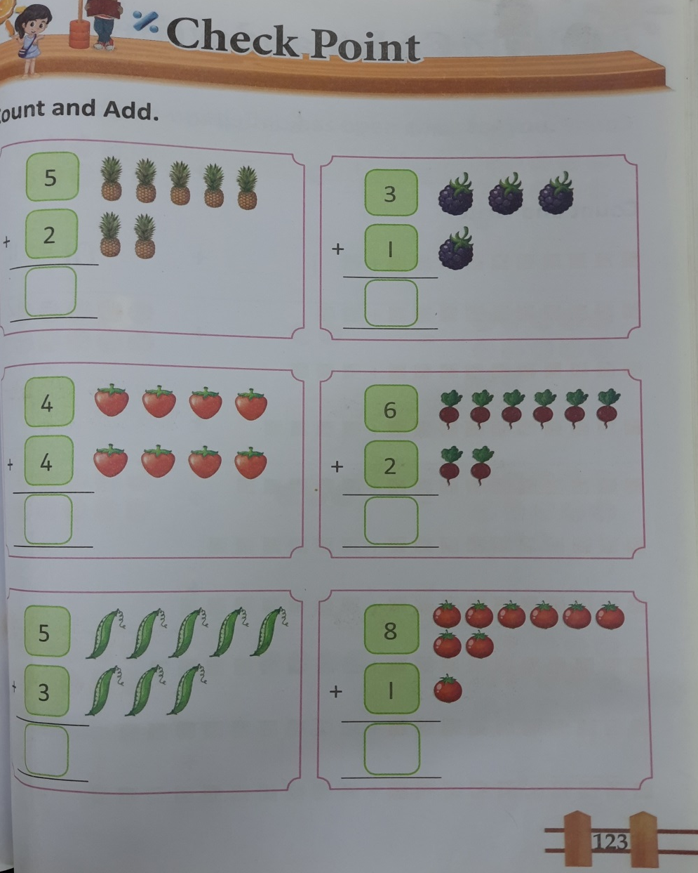
H.W
16.11.21
Do bkpg-121 & 123

Slide 10


Slide 11

THANKING YOU
ODM EDUCATIONAL GROUP

