Slide 1


WELCOME TO ODM ONLINE CLASS
CLASS-UKG
SUBJECT-MATHEMATICS
T0PIC- SHAPES
(BK PG 66 TO 69)

Slide 2
SHAPES
TODAY’S TOPIC-
RECTANGLE
SQUARE

Slide 3

WHAT IS A SHAPE ?
SHAPE IS THE OUTER LAYER
OR
OUTLINE OF AN OBJECT.

Slide 4
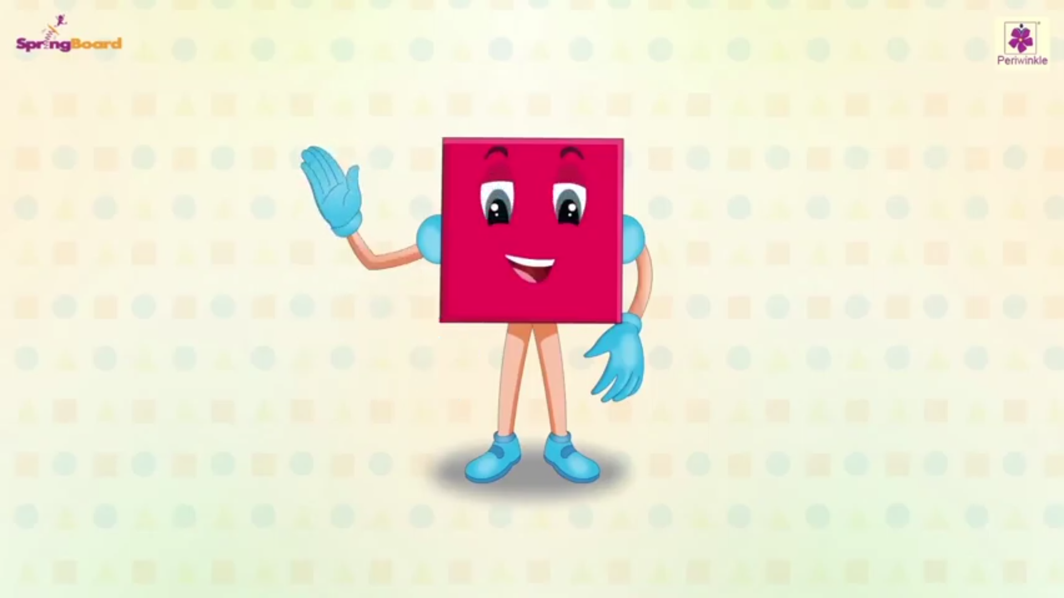
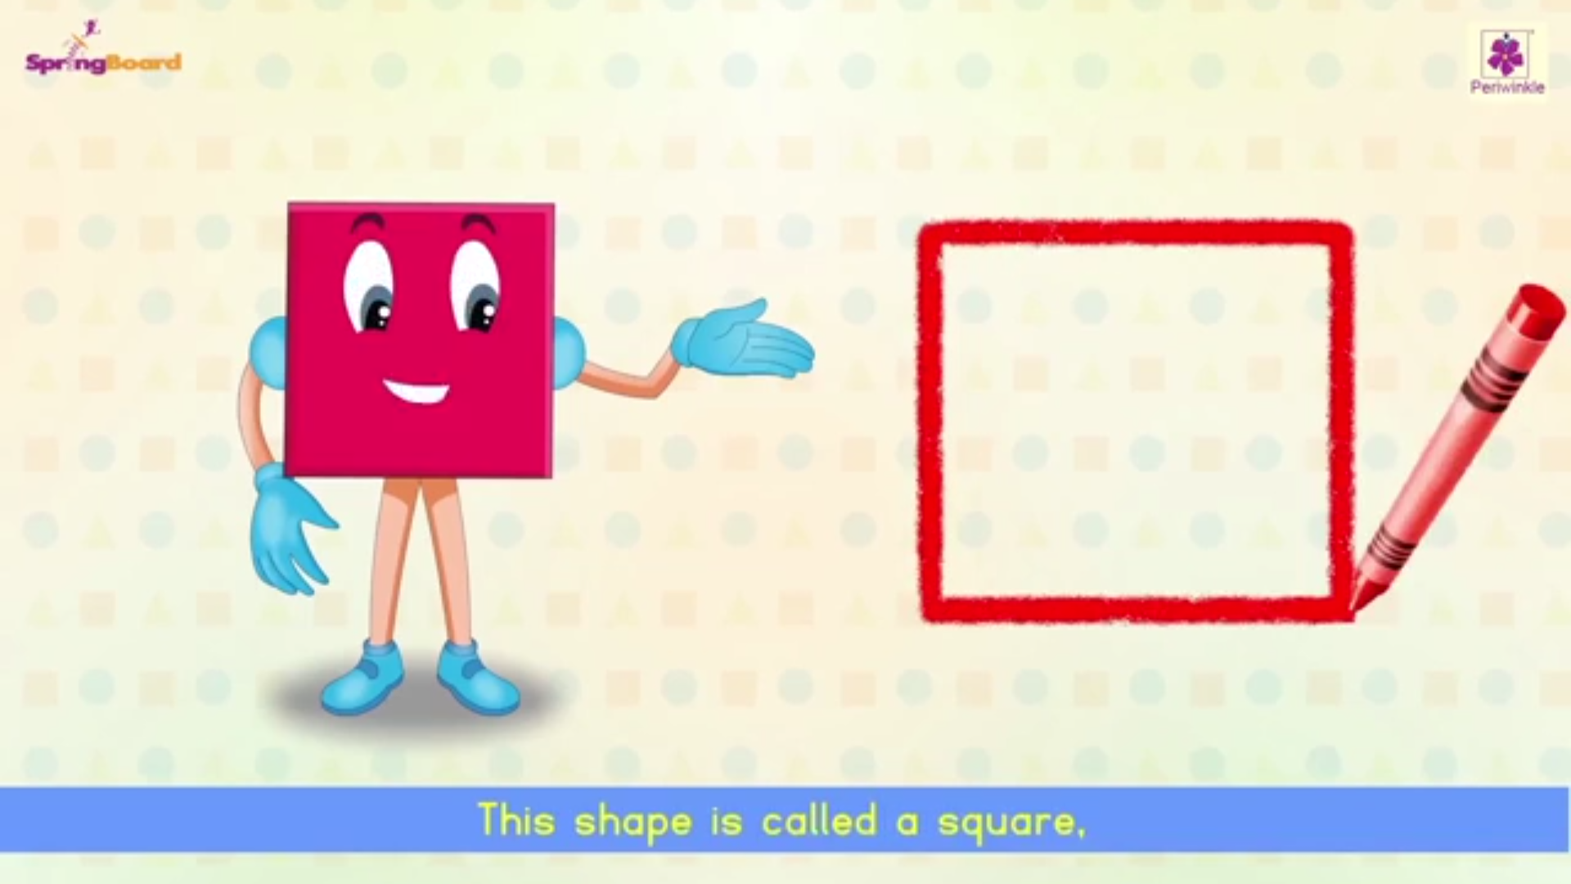
CAN YOU SAY ?
I AM A
SQUARE
Who am I ?

Slide 5

CORNER 1
SIDE 2
CORNER 2
I am a SQUARE.
I have 4 sides.
All my sides are equal.
I have 4 corners.
SIDE 1
SIDE 3
CORNER 4
CORNER 3
SIDE 4

Slide 6

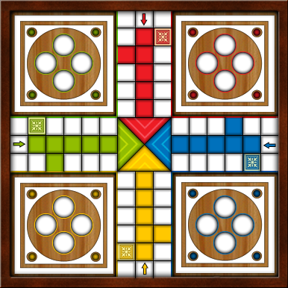
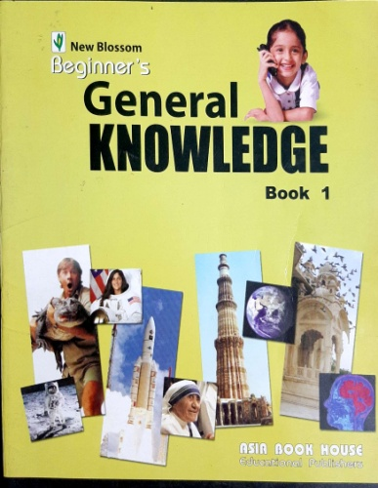

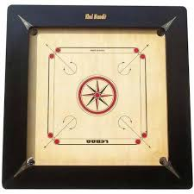
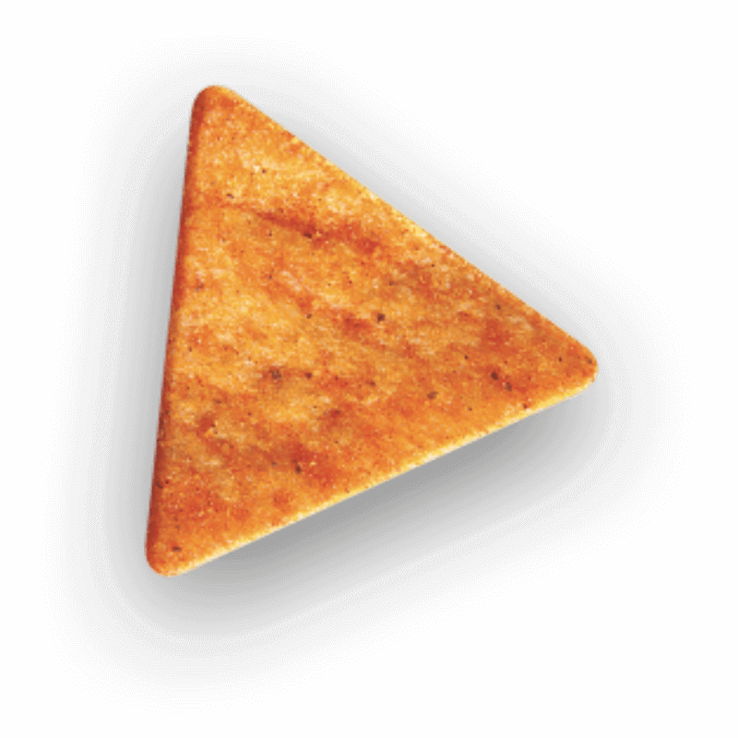

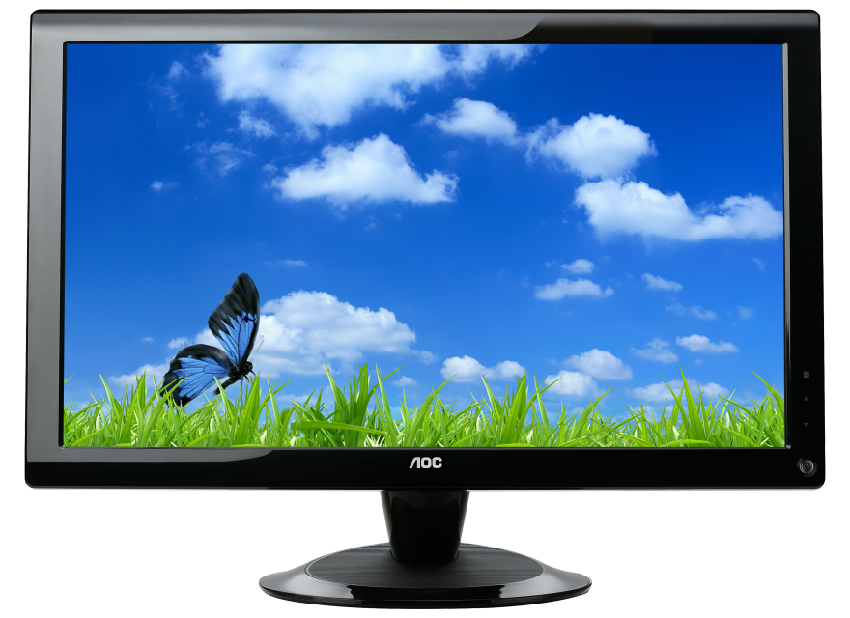
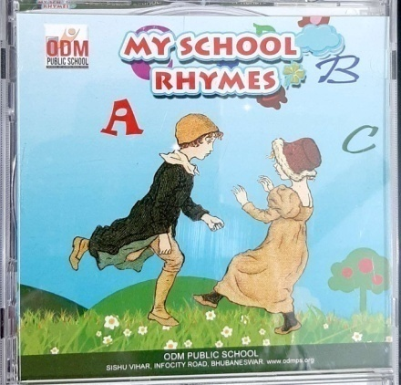
TICK THE OBJECTS THAT ARE SQUARE.

Slide 7
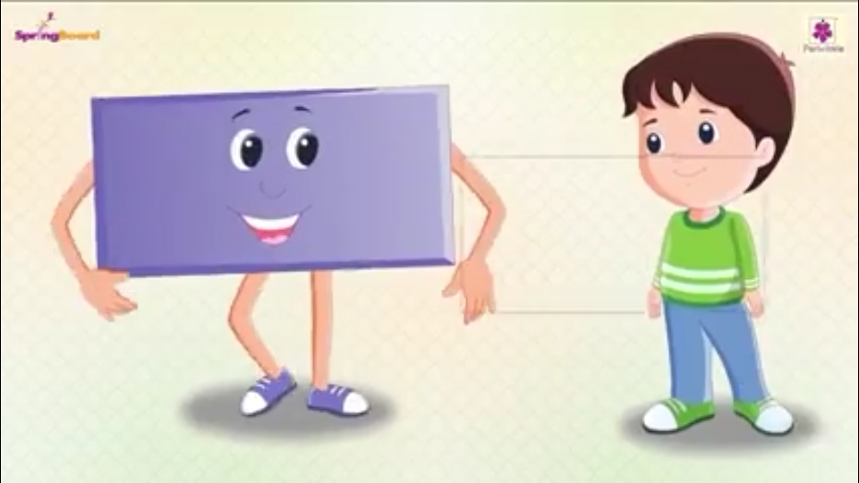
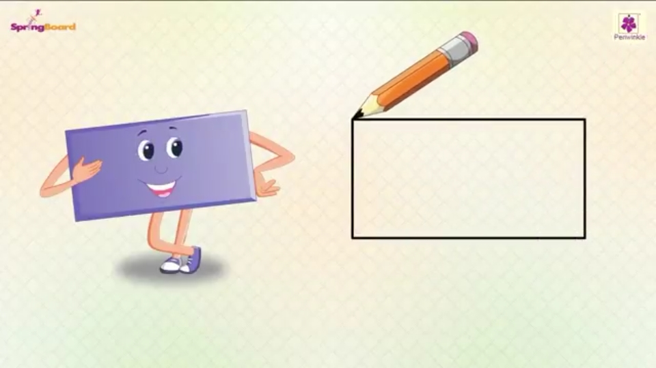
CAN YOU SAY ?
I AM A
RECTANGLE
Who am I ?

Slide 8
A RECTANGLE CAN BE
LONG OR TALL.
LONG
TALL

Slide 9
CORNER 1
2
CORNER 2
I am a RECTANGLE.
I have 4 sides.
I have 2 short sides.
I have 2 long sides.
My 2 opposite sides are equal.
I have 4 corners.
LONG SIDE
1
3
SHORT SIDE
SHORT SIDE
CORNER 4
LONG SIDE
CORNER 3
4

Slide 10
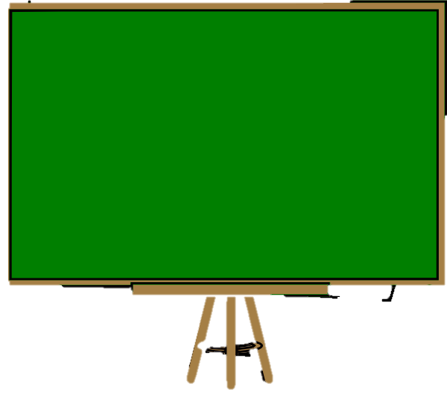
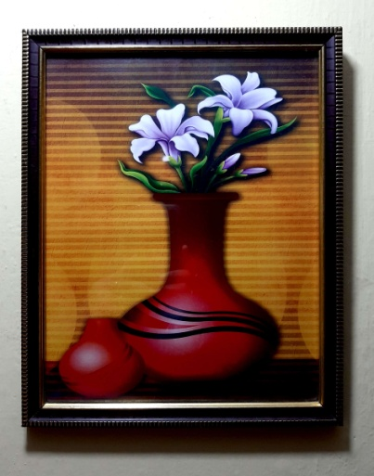

IDENTIFY THE OBJECTS & THEIR SHAPES.
Objects look like the shape of a rectangle.
LCD TV
Blackboard
Book
Photo frame
Plain paper

Slide 11
COLOUR THE SQUARES ORANGE AND RECTANGLES BLUE
CW
17.8.21

Slide 12
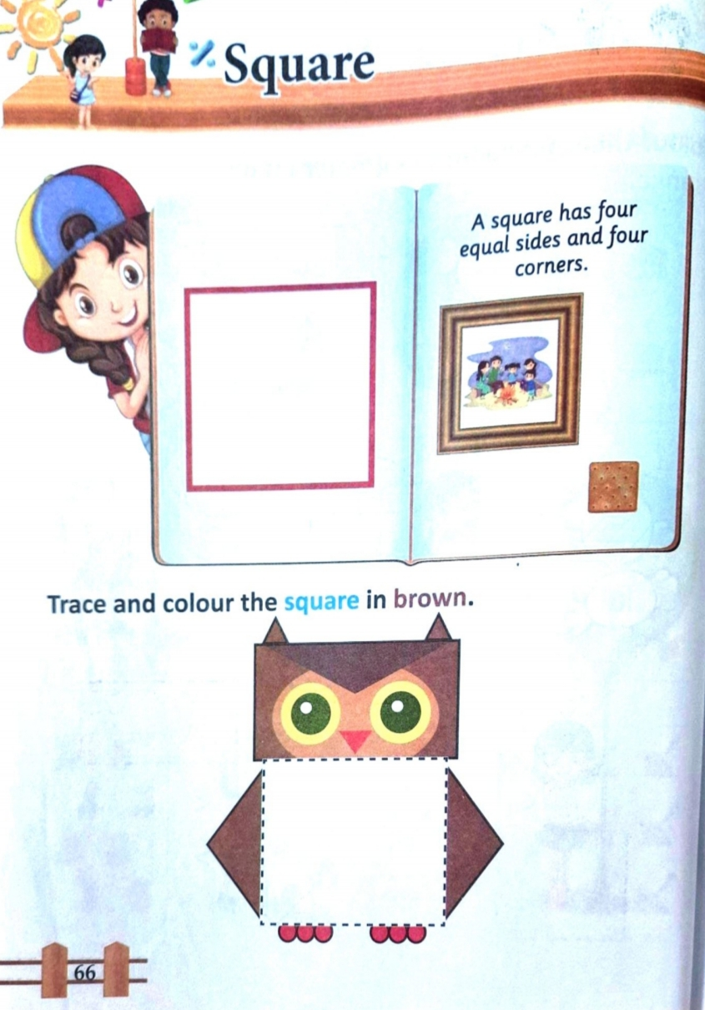
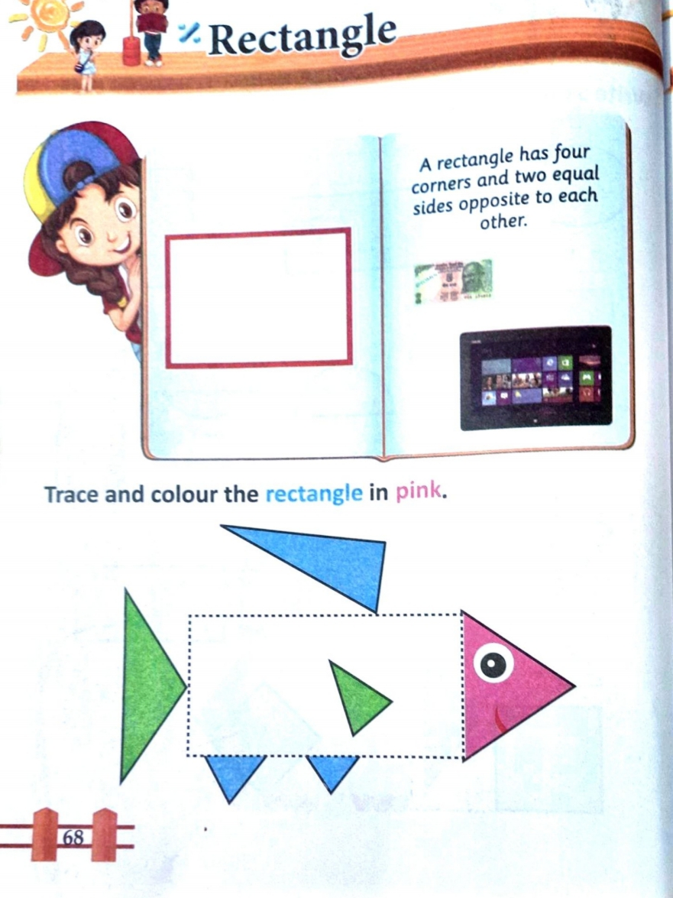
CW
17.8.21

Slide 13
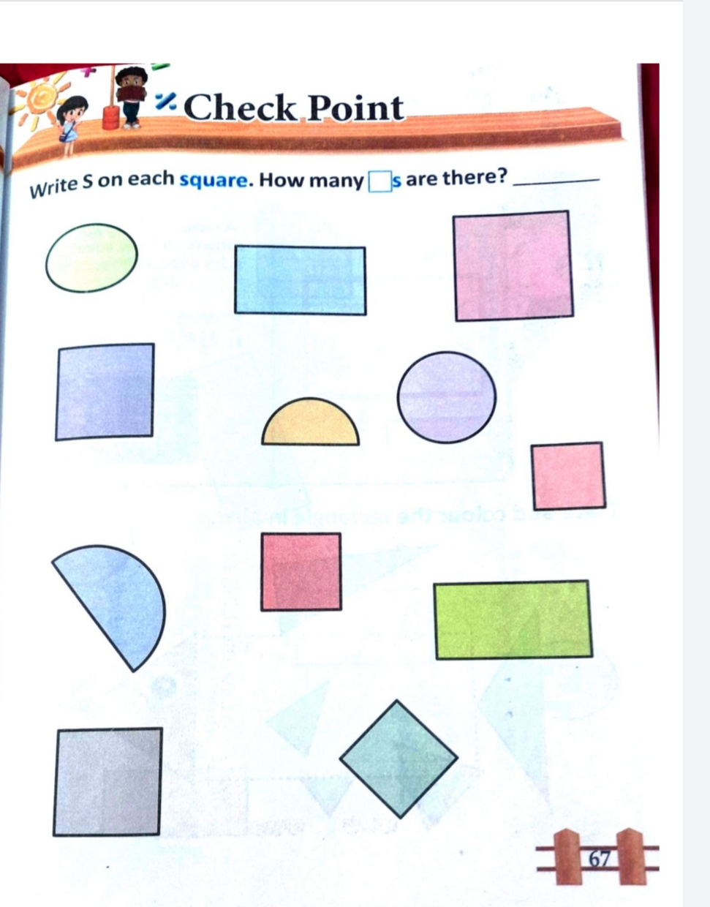
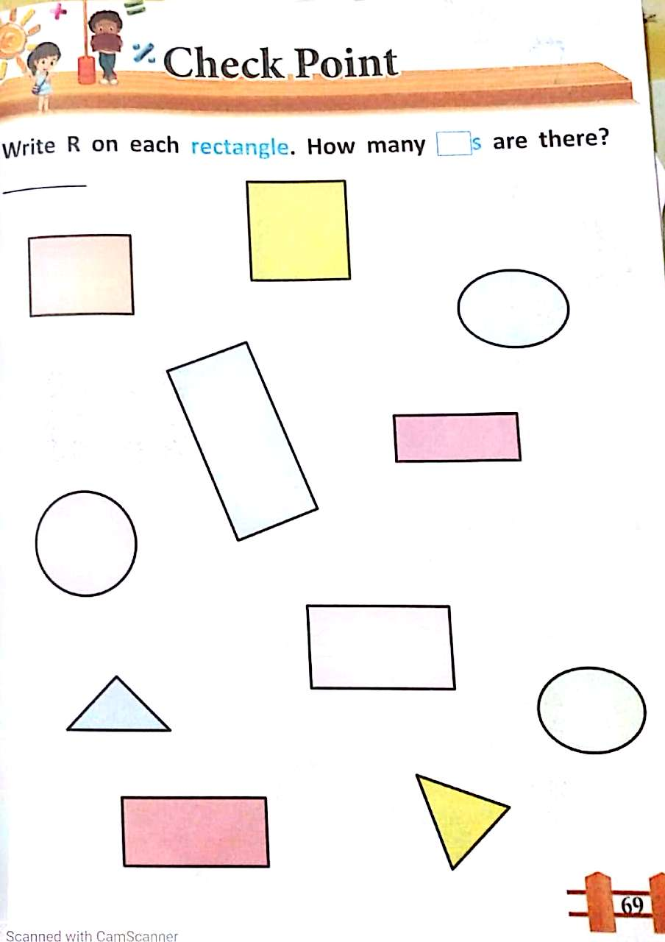
HW
17.8.21

Slide 14
FUN ACTIVITY
Find the two missing things in the house and Put the correct shape in the proper place of the house.

Slide 15
THANKING YOU
ODM EDUCATIONAL GROUP

