Slide 1


CLASS : UKG
SUBJECT : MATHS
CHAPTER : 20
TOPIC : SUBTRACTION
SUB TOPIC : ONCE AGAIN

Slide 2
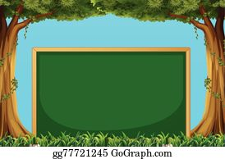

Today’s topic
Subtraction
Note book work

Slide 3

LET’S HAVE A RECAP
What is subtraction?
Subtraction means TAKE AWAY a number of things from a group.
We use the symbol MINUS ( - ) for Subtraction.

Slide 4



Cross out, count and write
5 - 3 =
2

Slide 5








EXAMPLE 1
3
7 - 4 =

Slide 6

EXAMPLE 2
1
8 - 7 =

Slide 7

Hi children .Let’s write in note bk.

Slide 8
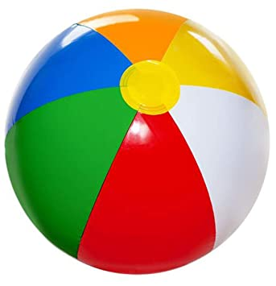
CW
Let’s do in note book.
06/12/21
CROSS OUT, COUNT AND WRITE
x
x
x
5
_
2
3
=

Slide 9

x
x
x
_
4
3
=
1

Slide 10

x
x
x
x
7 - 4 =
3

Slide 11
HW
Subtract and match.
06/12/21
7 - 5
1
4 - 1
6
5 - 4
4
9 - 3
2
3
8 - 4

Slide 12
THANKING YOU
ODM EDUCATIONAL GROUP

