Slide 1

WELCOME TO THE ON LINE CLASS
CLASS-UKG
SUBJECT-MATHS
TOPIC- COUNTING IN 2s
(bkpg-105-108)

Slide 2


Recap-
COUNT BY 2S is called skip counting by 2 steps.
Skip counting by 2s means jumping on every
second object.

Slide 3
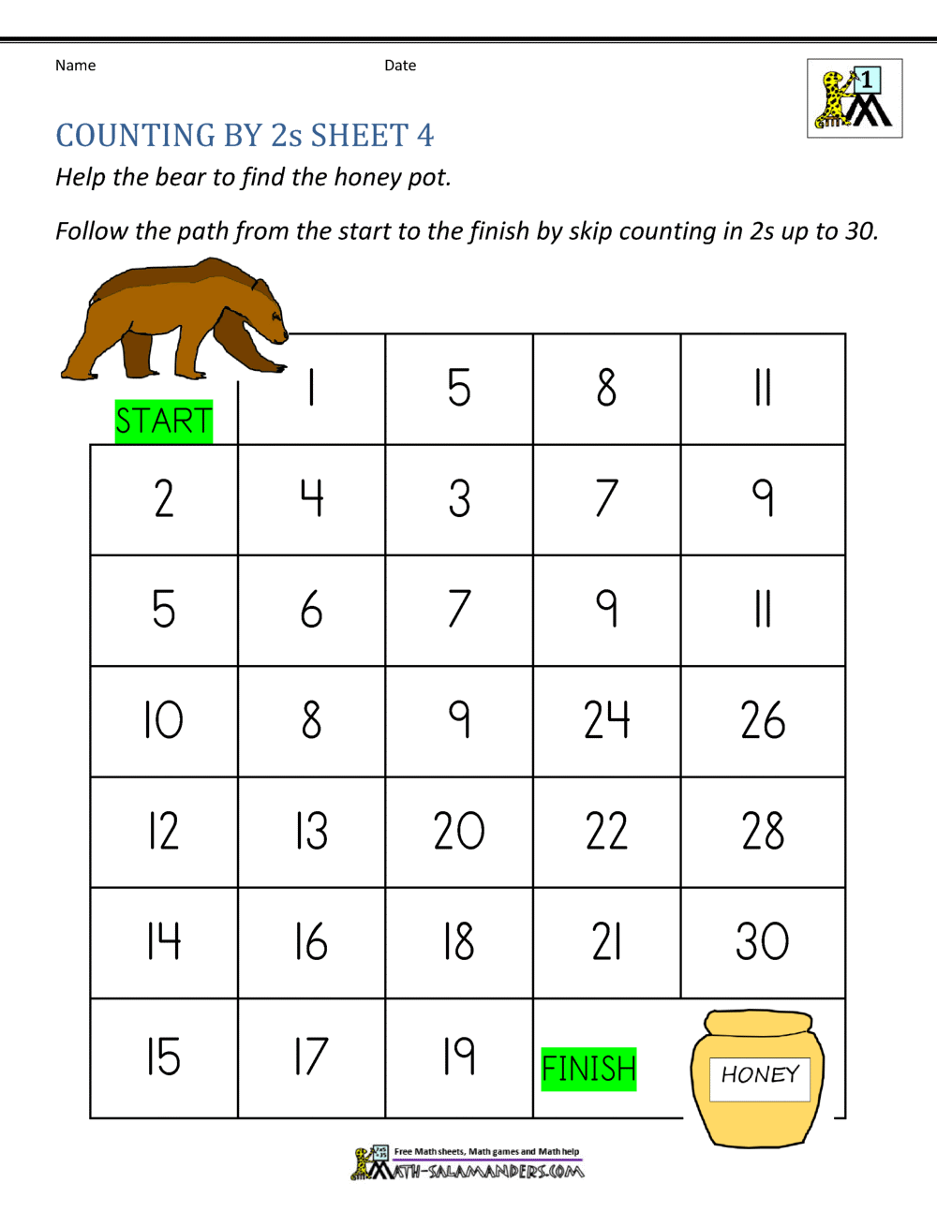
Help the bear to find the honey pot. Follow the path from the start to the finish by skip counting in 2s up to 30.
Oral
9.11.21

Slide 4
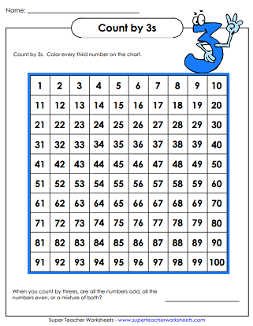
Count in 2s and colour the numbers-(bkpg-105)
CW
9.11.21

Slide 5
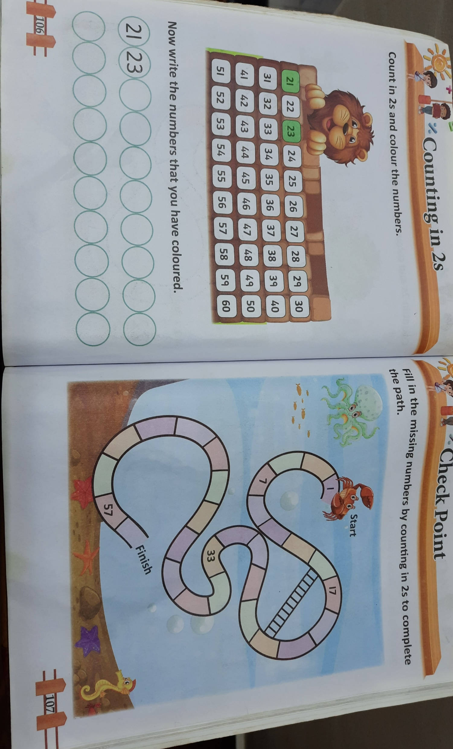
CW
9.11.21

Slide 6
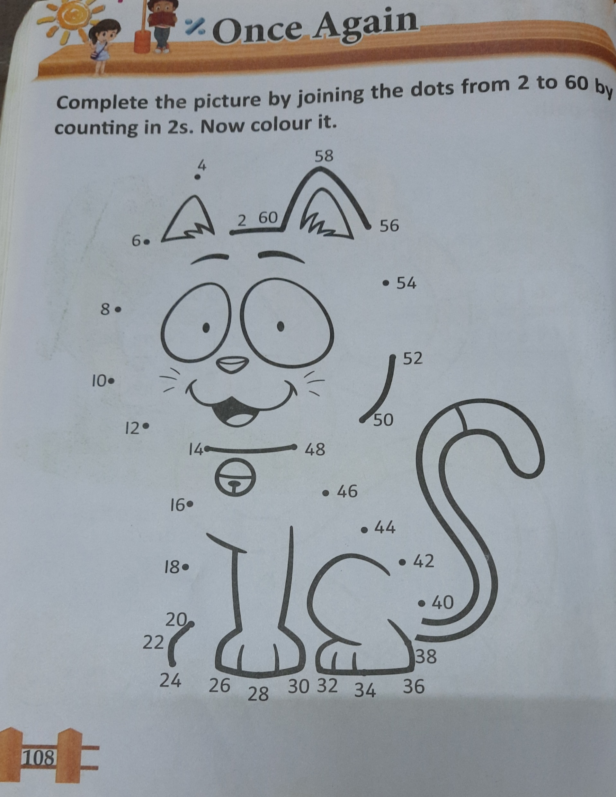
HW-Do bk pg-106 &108

Slide 7

THANKING YOU
ODM EDUCATIONAL GROUP

