Slide 1

WELCOME TO ONLINE CLASS
CLASS- UKG
SUBJECT-MATH
TOPIC-COUNTING IN 2s
(BKPG-109 – 111)

Slide 2

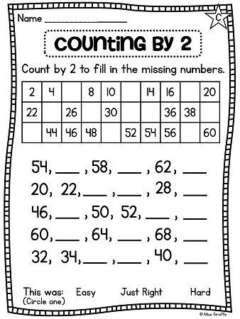
Count in 2s and say the numbers.
1-
2-
3-

Slide 3
Oral-Count in 2s and say the number-
56
60
64
24
26
30
48
54
56
66
70
62
36
38
42

Slide 4
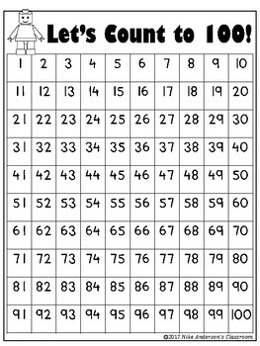
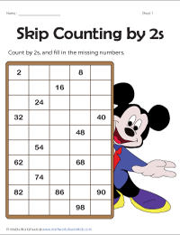
Count in 2s and colour the numbers.(bkpg-109)
CW
11.11.21

Slide 5
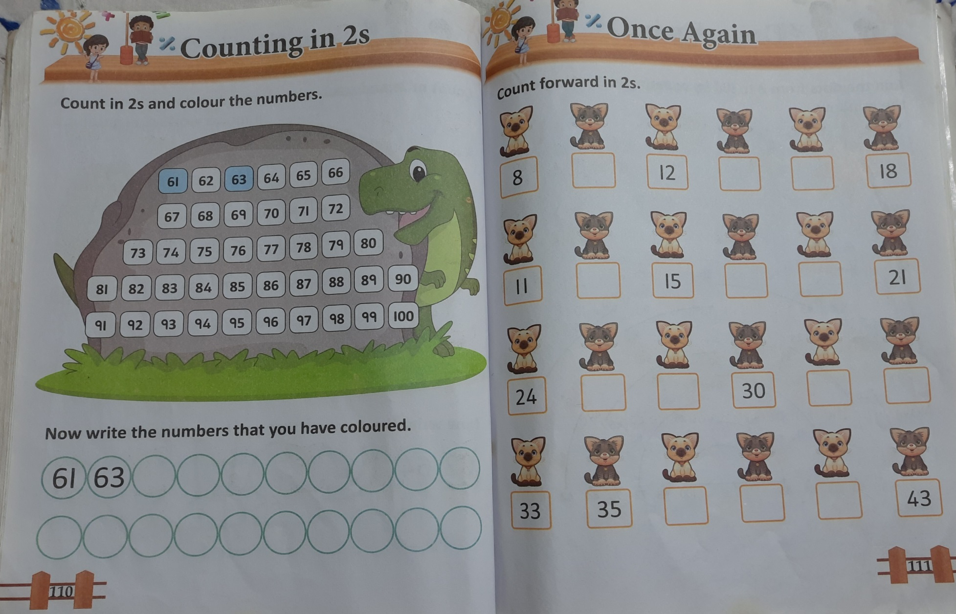
H.W
11.11.21

Slide 6
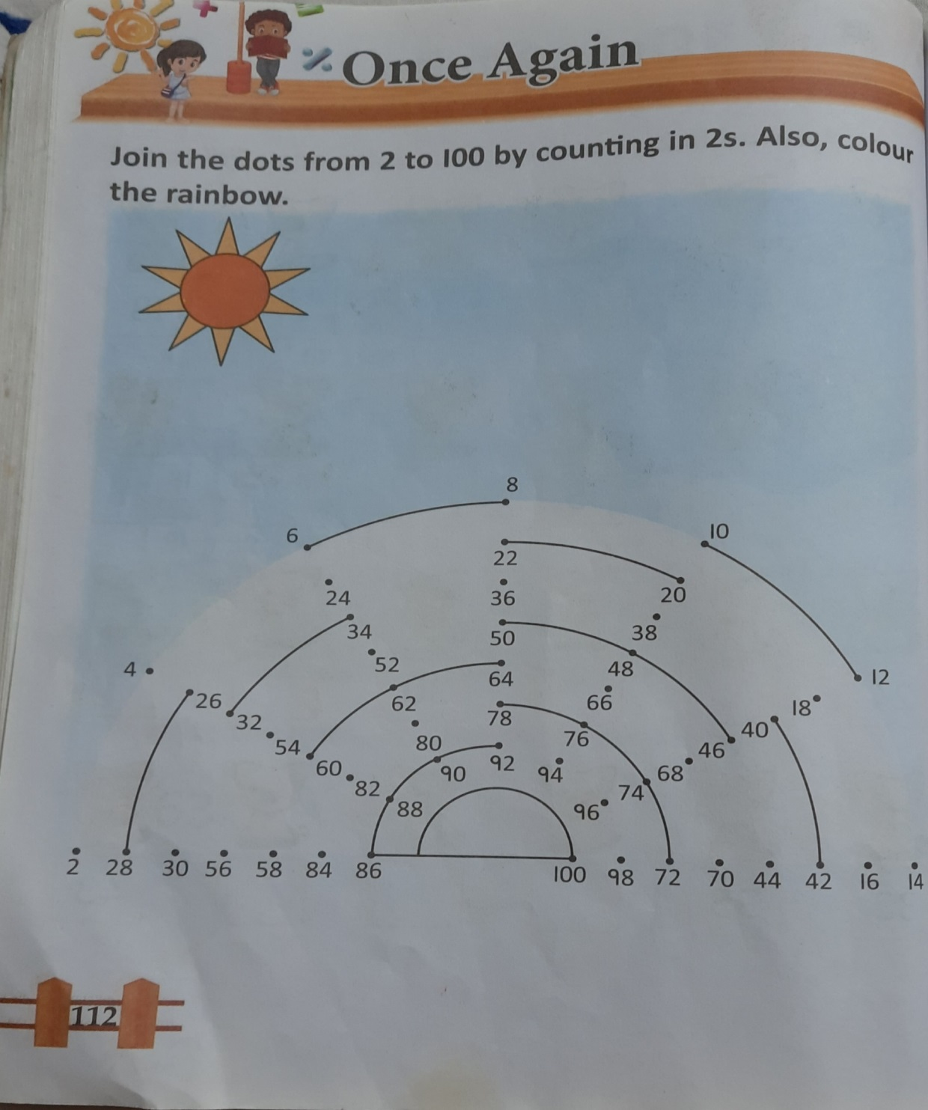
H.W
11.11.21

Slide 7

THANKING YOU
ODM EDUCATIONAL GROUP

