Slide 1

WELCOME TO THE ON LINE CLASS
CLASS-UKG
SUBJECT-MATHS
TOPIC- COUNTING IN 2s
(NOTEBOOK WORK)

Slide 2

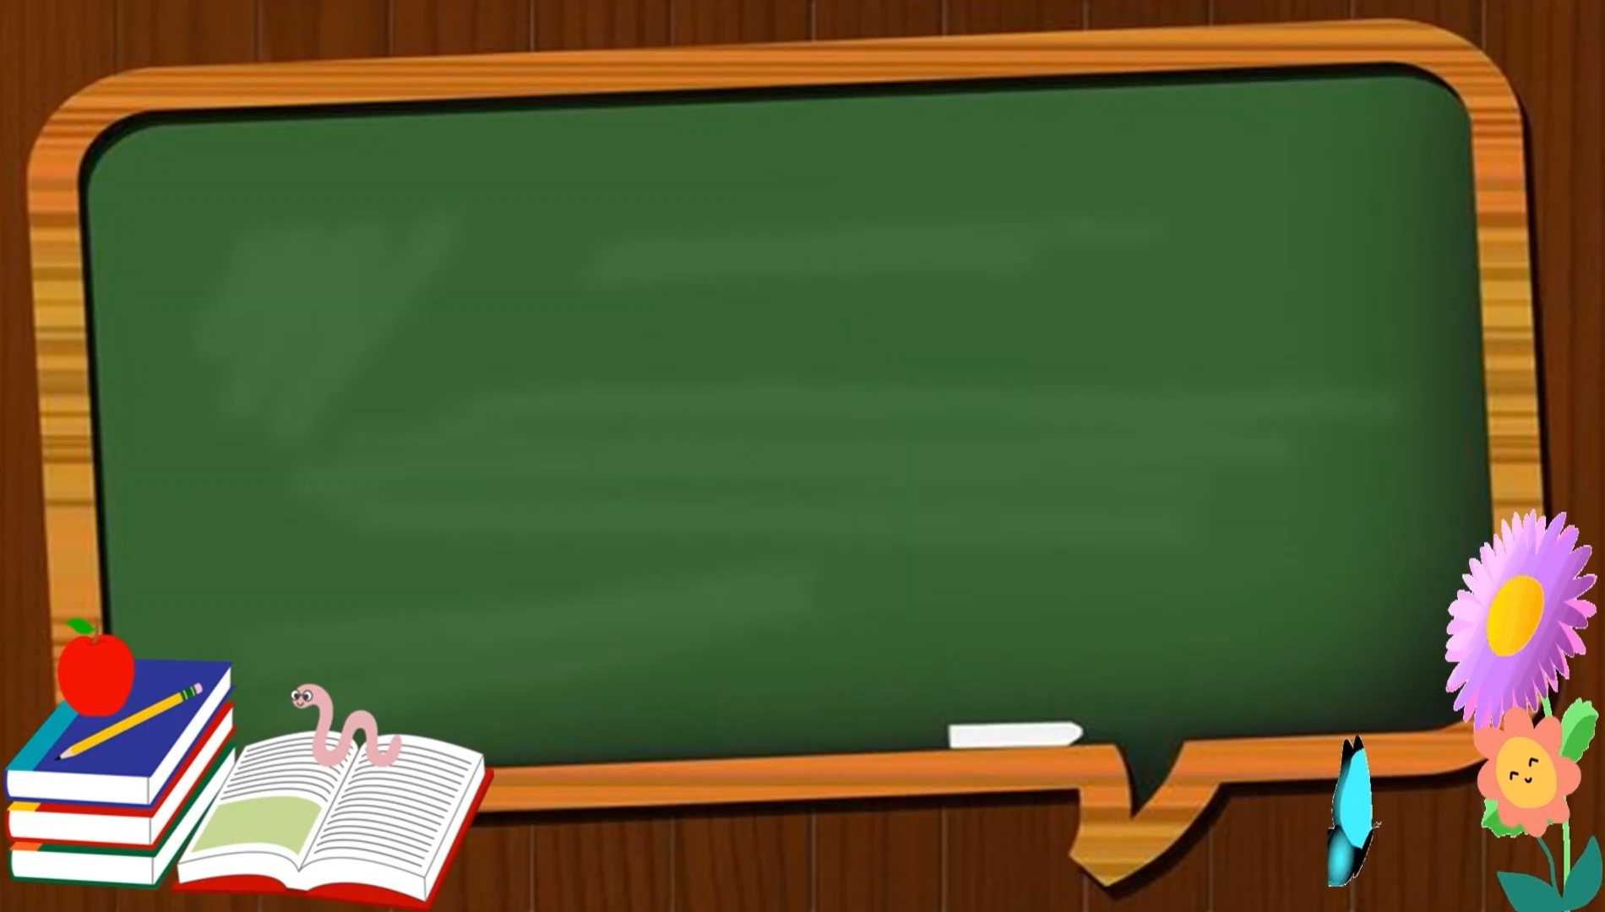
Recap-
COUNT BY 2S is called skip counting by 2 steps.
Skip counting by 2s means jumping on every
second object.

Slide 3
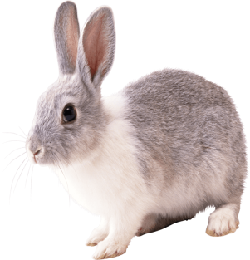
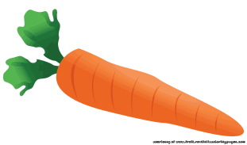
COUNT BY 2s AND HELP THE BUNNY TO JUMP AND REACH NEAR TO THE CARROT.
1
2
3
4
5
6
7
8
9
10
11
12
13
14
15
16
17
18
1
3
5
7
9
11
13
15
17

Slide 4
COUNT BY 2s AND COLOUR THE NUMBERS STARTING FROM 41
45
49
41 | 42 | 43 | 44 | 45 | 46 | 47 | 48 | 49 | 50
51 | 52 | 53 | 54 | 55 | 56 | 57 | 58 | 59 | 60
41
43
47
51
53
55
57
59
COUNT BY 2s AND COLOUR THE NUMBERS STARTING FROM 22
22
21 | 22 | 23 | 24 | 25 | 26 | 27 | 28 | 29 | 30
31 | 32 | 33 | 34 | 35 | 36 | 37 | 38 | 39 | 40
24
26
28
30
32
34
36
38
40

Slide 5
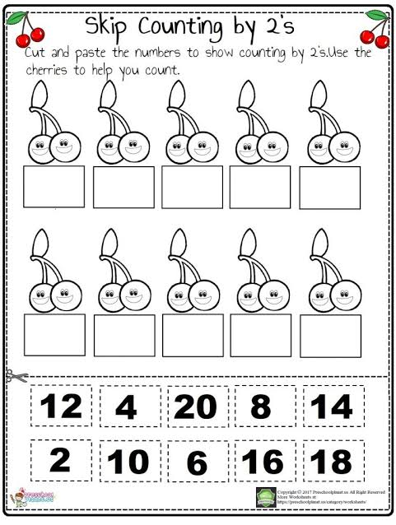
COUNT BY 2S AND FILL IN THE BOXES .
2
4
6
8
10
12
14
16
18
20

Slide 6
COUNT BY 2s AND FILL IN THE BOXES.
CW
10.11.21
1 | 3 | 5
6 | 8 | 10
2 | 4 | 6
7 | 9 | 11
12 | 14 | 16

Slide 7
HW
10.11.21
COUNT BY 2s AND COLOUR THE NUMBERS STARTING FROM 2
1 | 2 | 3 | 4 | 5 | 6 | 7 | 8 | 9 | 10
11 | 12 | 13 | 14 | 15 | 16 | 17 | 18 | 19 | 20
21 | 22 | 23 | 24 | 25 | 26 | 27 | 28 | 29 | 30
31 | 32 | 33 | 34 | 35 | 36 | 37 | 38 | 39 | 40
41 | 42 | 43 | 44 | 45 | 46 | 47 | 48 | 49 | 50

Slide 8

THANKING YOU
ODM EDUCATIONAL GROUP

