Slide 1


MOTION
CHAPTER NO.8 SUB: PHYSICS

Slide 2


LEARNING OBJECTIVE
Students will be able to
•Know equations of motion
•Prove of Equation of motion graphically.

Slide 3
Equations of Motion
A relation between the initial and final velocities, time interval and acceleration of a moving body is called
an equation of motion.
Consider a body moving with an initial velocity u and final velocity v, uniform acceleration a, time t and
displacement S.
Then the equations of motion are given as follows:
v = u + at,
S = u.t + ½ at²,
v ² = u ² + 2aS

Slide 4

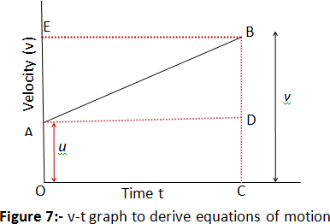
Equation for velocity time relation
Consider the velocity-time graph of an object that moves under uniform acceleration as shown below in the figure 7.
From this graph, you can see that initial velocity of the object is u (at point A) and then it increases to v (at point B)
in time t. The velocity changes at a uniform rate aa.
Again from figure it is clear that time t is represented by OC, initial velocity u by OA and final velocity of object after time t by BC.
From graph as given in figure 7 it is clear that BC=BD+DC=BD+OA.
So we have v=BD + u (1)
We should now find out the value of BD. From the velocity-time graph (Fig. 7), the acceleration of the object is
given by
which gives, BD=at
putting this value of BD in equation 1 we get
v = u + at
which is the equation for velocity time relation.

Slide 5
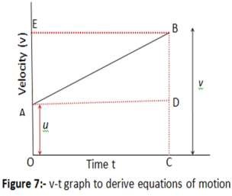
Equation for position time relation
Let us consider that the object has travelled a distance s in time t under uniform acceleration a. In Fig. 7, the
distance travelled by the object is obtained by the area enclosed within OABC under the velocity-time graph AB.
Thus, the distance s travelled by the object is given by
s = area OABC (which is a trapezium)
s= area of the rectangle OADC + area of the triangle ABD
So,
s=OA×OC + ½ ×AD × BD
Substituting OA=u , OC=AD=t and BD=at, we get
s=(u × t)+1/2×(t × at) or,
s = ut + 1/2 at²
which is the equation of position time relation

Slide 6

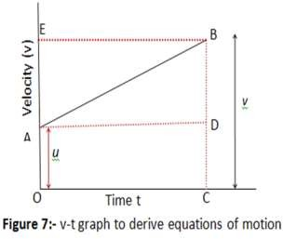
Equation for position velocity relation
Again consider graph in figure 7. We know that distance travelled s by a body in time t is given by the area under line AB which is area of trapezium OABC. So we have
Since OA+CB=u + v and OC=t ,
we thus have
s=(u + v)t × ½ ……………1 From velocity time relation t=(v−u ) ×1/a ………………2
putting this t in equation for s we get
s=(u+ v)/2 × (v−u /a) or we have v²=u²+2as
which is equation for position-velocity relation.

Slide 7

HOME ASSIGNMENT
Q.A train is travelling at a speed of 90 km/ h. Brakes are applied so as to produce a uniform acceleration of – 0.5 m/ sq. s. Find how far the train will go before it is brought to rest.

Slide 8

THANKING YOU
ODM EDUCATIONAL GROUP

