Slide 1


MOTION
CHAPTER NO.8 SUB: PHYSICS

Slide 2


LEARNING OBJECTIVE
Students will be able to
Represent the graph between velocity –time & distance – time
Study the characteristics of graph between velocity –time &
distance – time

Slide 3
Graphical representation of motion
A graph is a pictorial representation of the relation between two sets of data of which one set is
of dependent variables and the other set is of independent variables.
To describe the motion of an object, we can use line graphs. In this case, line graphs show
dependence of one physical quantity, such as distance or velocity, on another quantity, such as
time.

Slide 4
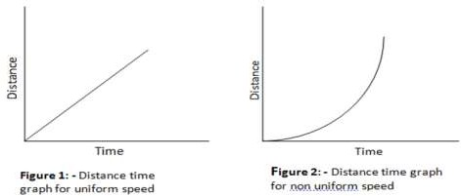
Distance - Time Graphs
The change in the position of an object with time can be represented on the distance-time graph.
In this graph, time is taken along the x-axis and distance is taken along the y-axis.
The distance time graph for a body moving at uniform speed is always a straight line as distance travelled by the
body is directly proportional to time as shown below in the figure 1.
The distance time graph for a body moving with non-uniform speed is a curve and is shown below in the figure 2.

Slide 5
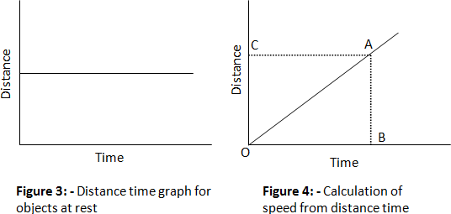
The distance time graph is parallel to time axis when the object is at rest and is shown below in figure 3

Slide 6
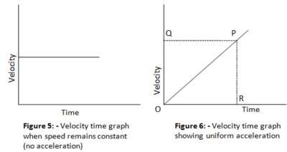
Velocity - time graphs
The variation in velocity with time for an object moving in a straight line can be represented by a velocity-time graph.
In this graph, time is represented along the x-axis and the velocity is represented along the y-axis.
The product of velocity and time give displacement of an object moving with uniform velocity. The area enclosed by velocity-time graph and the time axis will be equal to the magnitude of the displacement.
If a body moves with a constant velocity, then velocity time graph for this body would be straight line parallel to
time axis as shown below in the figure 5

Slide 7

HOME ASSIGNMENT
What is the nature of the distance-time graphs for uniform and non-uniform motion
of an object?
What can you say about the motion of an object whose distance-time graph is a straight line parallel to the time axis?

Slide 8

THANKING YOU
ODM EDUCATIONAL GROUP

