Slide 1


MOTION
CHAPTER NO.8 SUB: PHYSICS MOTION

Slide 2


LEARNING OBJECTIVE
Students will be able to
•Define concept of speed &average speed
•Define velocity
•Define acceleration

Slide 3
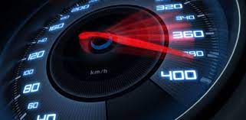
Speed:
Speed is a scalar quantity. The SI unit of speed is m/s.
The distance travelled by a body per unit time is called the speed of the body.
Speed = Distance travelled/Time taken.
.

Slide 4
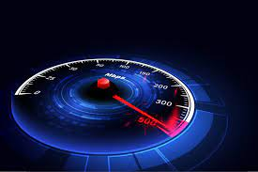
Velocity:
The rate of change of displacement of a body is called its velocity. Velocity can also be defined as displacement per unit time.
In other words, the velocity of a body is the distance travelled by the body in unit time and in a given direction.
The SI unit of velocity is m/s.
Velocity = Displacement/Time taken.

Slide 5
Differences between Speed and Velocity
Speed is defined as the rate of change of distance, whereas velocity is defined as the rate of
change of displacement.
Speed is a scalar quantity whereas velocity is a vector quantity.
Speed is always positive whereas velocity can be positive, zero or negative.

Slide 6
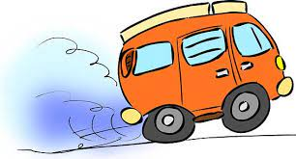
Acceleration:
The rate of change of velocity of a body is called its acceleration.
The SI unit of acceleration is m/s² .
Acceleration is a vector quantity.
Acceleration = Change in velocity/Time.
a= v-u /t
where v=final velocity
u=initial velocity
t= time taken
Acceleration is regarded as positive if the velocity of the object is increasing and is considered to be negative if the velocity is decreasing.
The negative acceleration is called retardation or deceleration.

Slide 7
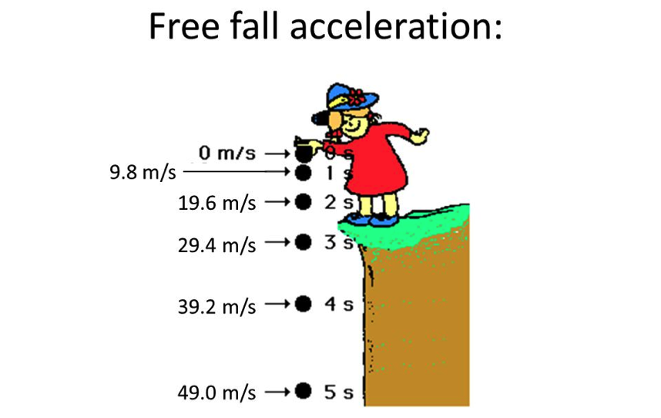
Acceleration due to Gravity:
If a body is released from a height its velocity gradually increases during its fall, i.e., it has an acceleration. This is due to gravity and hence called acceleration due to gravity.
It is generally denoted by the letter g.
The acceleration due to gravity is defined as the increase in velocity of a freely falling body due to gravity in one second.
Its value on Earth's surface is 9.8 m/s².

Slide 8


HOME ASSIGNMENT
Distinguish between speed and velocity.
Under what condition(s) is the magnitude of average velocity of an object equal to its average speed?
What does the odometer of an automobile measure?

Slide 9

THANKING YOU
ODM EDUCATIONAL GROUP

