Slide 1


MOTION
CHAPTER NO.8 SUB: PHYSICS MOTION

Slide 2


LEARNING OBJECTIVE
The students will be able to
Define different types of motion.
Define uniform and non-uniform motion.

Slide 3
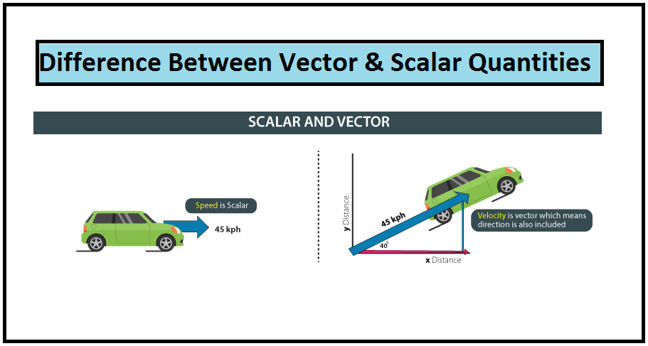
Scalar and Vector Quantities
A physical quantity which has only magnitude but no specific direction is called a scalar
quantity.
Examples: length, distance, area, mass, time, energy, etc.
A physical quantity which has both magnitude and direction is called a vector quantity.
Examples: displacement, velocity, acceleration, force, weight, etc.

Slide 4
Types of Motion
Translatory Motion:
The motion in which all the particles of a body move through the same distance in the same time is called
translatory motion.
Example: An athlete running on a straight path, a car running on a curved road.
Rotatory Motion:
The motion in which a body moves about a fixed axis without changing the radius of its motion is called rotatory
motion.
Example: A ceiling fan.
Oscillatory Motion:
The to and fro motion described by an object as a whole, along the same path, without any change in the shape of
the object is called oscillatory motion.
Example: The pendulum of a clock, a child on a swing.
Vibratory Motion:
This is a kind of oscillatory motion in which the moving object undergoes a change in shape or size. In this motion,
the body does not move as a whole.
Example: The plucked string of a guitar.

Slide 5
Periodic Motion:
A repetitive motion which repeats itself at regular intervals of time is called the periodic motion.
Example: Earth revolving around the Sun.
Non-periodic motion:
A repetitive motion which repeats itself at irregular intervals of time is called non-periodic motion. Example: Tides in a sea.
Multiple Motion:
Sometimes an object can display combinations of different types of motion. Example
A moving car which moves straight on the road displays rectilinear motion but at the same time the wheels of the car which are moving in circles display circular motion. So a moving car displays both rectilinear and circular motion.

Slide 6
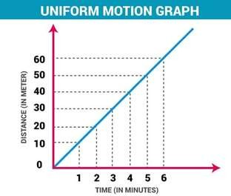
Uniform Motion: A body is said to have a uniform motion if it covers equal distances in equal intervals of time.
This uniform motion is defined as the motion of an object in which the object travels in a straight line and its velocity remains constant along that line as it covers equal distances in equal intervals of time, irrespective of the duration of the time.
Example of Uniform Motion:
If the speed of a car is 10 m/s, it means that the car covers 10 meters in one second. The speed is constant in every second.
Movement of blades of a ceiling fan.

Slide 7
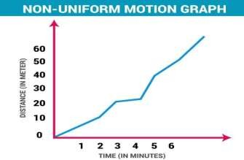
Non-uniform Motion: A body is said to have a non-uniform motion if it covers unequal distances in equal intervals
of time.
This non uniform of motion is defined as the motion of an object in which the object travels with varied speed and it
does not cover same distance in equal time intervals, irrespective of the time interval duration.
Example of Non Uniform Motion:
If a car covers 10 meters in first two seconds, and 15 meters in next two seconds.

Slide 8
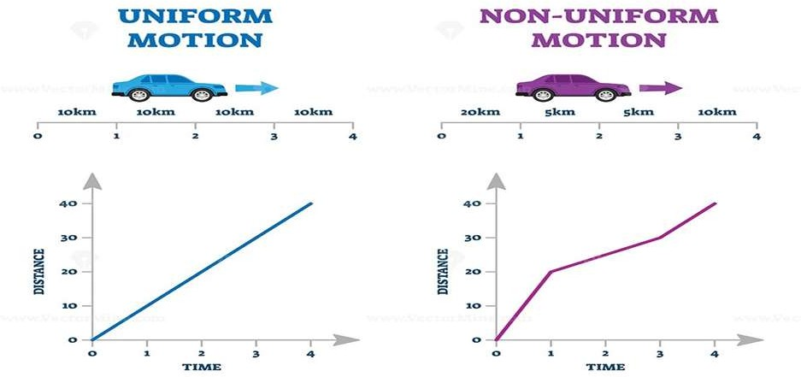

Slide 9
Uniform and non uniform motion
https://www.youtube.com/watch?v=VFfF3F-G9Uk&t=65s

Slide 10

HOME ASSIGNMENT
What is uniform motion?
What is non uniform motion ?

Slide 11

THANKING YOU
ODM EDUCATIONAL GROUP

