Slide 1


MOTION
CHAPTER NO.8 SUB: PHYSICS MOTION

Slide 2


LEARNING OBJECTIVE
Students will be able
Define rest and motion
Identify objects in motion and rest
Define distance and displacement

Slide 3

Rest and motion Rest
A body is said to be at rest if it does not change its position with respect to its immediate surroundings and
with respect to time.
Example
The chairs of the dining table are at rest unless and until they are moved, and the flower vase, table, and the blackboard in the class room are all at the position of rest.

Slide 4
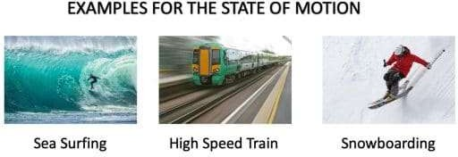
Motion
A body is said to be in motion if it changes its position with respect to its immediate surroundings and
with respect to time.
Example
The blades of a rotating fan, the hands of a working wall clock, a moving car, a spinning top and satellites are all in motion..

Slide 5
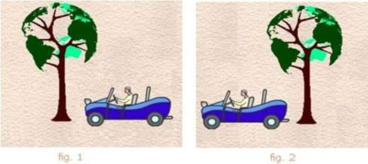
Rest and motion are relative
An object can be in motion relative to one set of objects while at rest relative to some other set of objects. Thus, rest and motion are relative terms.
Examples: Person sitting in a bus is in rest according to his fellow passengers, inside the bus, but he is in motion according to the person standing on bus station observing the moving bus. So this is just the matter of frame of reference in which we are observing.

Slide 6
Scalar and Vector Quantities
A physical quantity which has only magnitude but no specific direction is called a scalar
quantity.
Examples: length, distance, area, mass, time, energy, etc.
A physical quantity which has both magnitude and direction is called a vector quantity.
Examples: displacement, velocity, acceleration, force, weight, etc.

Slide 7
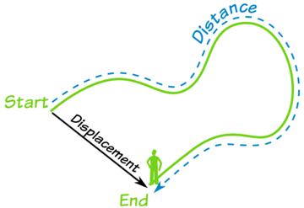
Distance and Displacement
Distance
The actual length of the path covered by a moving body, irrespective of the direction, is called the
distance travelled by it.
The distance covered by an object is described as the total path length covered by an object between two endpoints.
Distance is a numerical quantity.
Distance is a scalar quantity, as it has only magnitude and no direction.
The SI unit of distance is the metre (m).

Slide 8

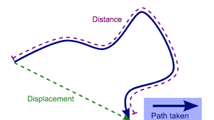
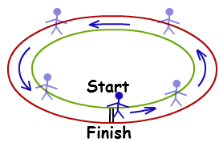
Displacement
The shortest possible distance covered by a body between two points in a particular direction is known as its displacement.
Displacement is a vector quantity, as it has both magnitude and direction.
The SI unit of displacement is the meter (m).
Zero Displacement – When the first and last positions of an object are same, the displacement is zero.

Slide 9
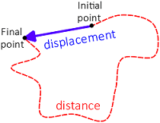
Differences between distance and displacement:
Distance is the length of the actual path travelled by a body, whereas displacement is the
shortest distance between the initial and final positions of a body.
Distance is a scalar quantity whereas displacement is a vector quantity.
Distance is always positive, whereas displacement can be negative, zero or positive.
Distance never decreases with time. For a moving body, it is never zero. Displacement can
decrease with time. For a moving body, it can be zero.

Slide 10

HOME ASSIGNMENT
1. An object has moved through a distance. Can it have zero displacement? If yes, support your answer with an example.
2.A farmer moves along the boundary of a square field of side 10 m in 40 s. What will be the magnitude of displacement of the farmer at the end of 2 minutes 20 seconds from his initial position?

Slide 11

THANKING YOU
ODM EDUCATIONAL GROUP

