Slide 1


WHEN,WHERE AND HOW
SUBJECT : HISTORY (MODEL LESSON)
CHAPTER NUMBER: 1
CHAPTER NAME : WHEN, WHERE AND HOW

Slide 2
WHEN, WHERE AND HOW
LEARNING OBJECTIVES
Students will be able to know about the methods of historical inquiry, how evidence is to make historical claims.
To know about the accounts created during a given time period by people.
It also provides the record of social, scientific and political thought and achievement during a past time period.
https://www.youtube.com/watch?v=vgmNkYUL_Cw

Slide 3
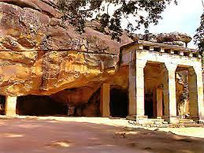
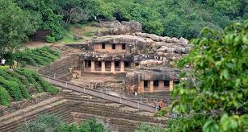
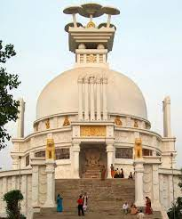
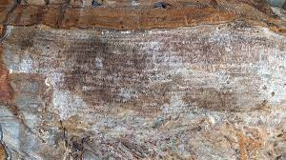
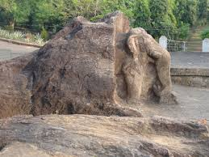
WHEN, WHERE AND HOW
IDENTIFY THE PICTURES

Slide 4

WHEN,WHERE AND HOW
INTRODUCTION

Slide 5
WHEN, WHERE AND HOW
PREHISTORY AND HISTORY
Prehistory | History
It is the study of events that happened before humans learnt to write. | It is a written account of events of the past.
Sources for the study of Prehistory:- Archaeology Archaeological sites Artifacts | Sources for the study of History:- Manuscripts Inscriptions Coins and seals Monuments

Slide 6
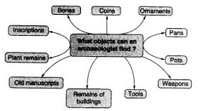
WHEN, WHERE AND HOW
SOURCES OF HISTORY
Sources for the study of history :-
Main source of information for Prehistory is Archaeology.
Archaeology is the study of the remains of human life in the past.
An archaeologist is a person who studies the remains of buildings made of stone and brick, paintings and sculpture.
They also explore and excavate to find tools, weapons, pots, pans, ornaments and coins (human-made objects found at archaeological sites are called artifacts).
They also look for bones of animals, birds, and fish to find out what people ate in the past.

Slide 7
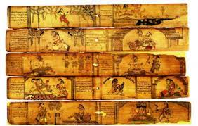
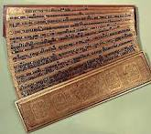
WHEN, WHERE AND HOW
SOURCES OF HISTORY
History is studied from written sources such as Manuscripts, inscriptions, monuments, coins and seals.
Manuscripts- Hand written documents are called manuscripts. They were written on stone or clay tablets.
In India, these were written in Sanskrit, Prakrit or Pali and Tamil in South India on dried palm leaves, or on the specially prepared bark of a tree known as the birch, which grows in the Himalayas and thinly beaten copper plates.
In Middle East and Europe people wrote on Parchment (dried skin of goats and sheep)
https://www.youtube.com/watch?v=og4JN5lS3bE

Slide 8
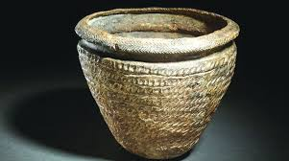
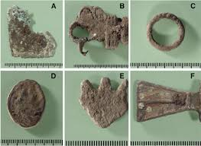
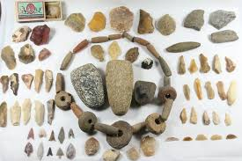
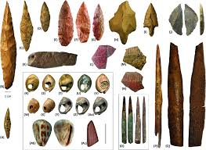
WHEN, WHERE AND HOW
SOURCES OF HISTORY/ ARTEFACTS

Slide 9
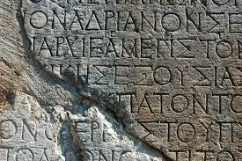
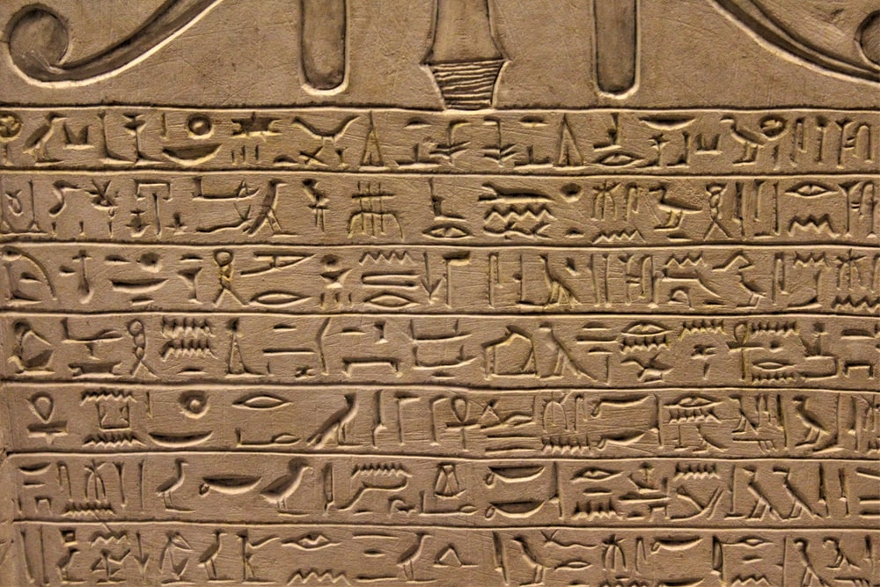
WHEN, WHERE AND HOW
SOURCES OF HISTORY
Inscriptions (Decipherment, Epigraphy
Inscriptions-They are writings engraved on hard surfaces like rocks, pillars, stones or metal and the walls of temples, palaces, forts etc.
In the past , kings wanted their orders inscribed so that people could see, read and obey them, they used inscriptions for this purpose.
Decipherment- The process of reading and understanding the scripts used in inscriptions.
Epigraphy- The study of inscriptions. Example- The edicts of Emperor Ashoka carved into caves, iron pillars and rocks.

Slide 10
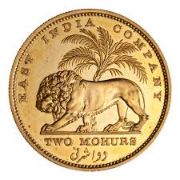
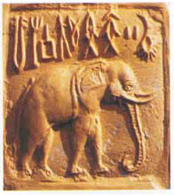
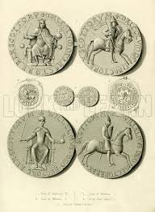
WHEN, WHERE AND HOW
SOURCES OF HISTORY
Coins: Issued by the ruler of a country to enable people to buy goods and services.
Name of the king and the year in which the coin was issued were engraved on the coins.
Other engraving includes Battle scenes, faces of kings and queens or scenes from the life of the ruler.
Numismatics- The study of coins.
Seals: contains inscription, ex- Indus Valley Civilization seals showing animals and figures of Gods (early form of Shiva), figure of a yogi -Pashupati, the lord of animals.

Slide 11
WHEN, WHERE AND HOW
QUESTIONS
What is archaeology?
Who are called as archaeologists?
What are the sources of prehistory?
What are the sources of history?
Define manuscripts.
Define inscriptions.
What do you mean by decipherement?
What is numismatic and epigraphy.

Slide 12
THANKING YOU
ODM EDUCATIONAL GROUP

