Slide 1

WELCOME TO ON LINE CLASS
CLASS-UKG
SUBJECT-MATHS
TOPIC-REVISION
(POSITIONS)

Slide 2
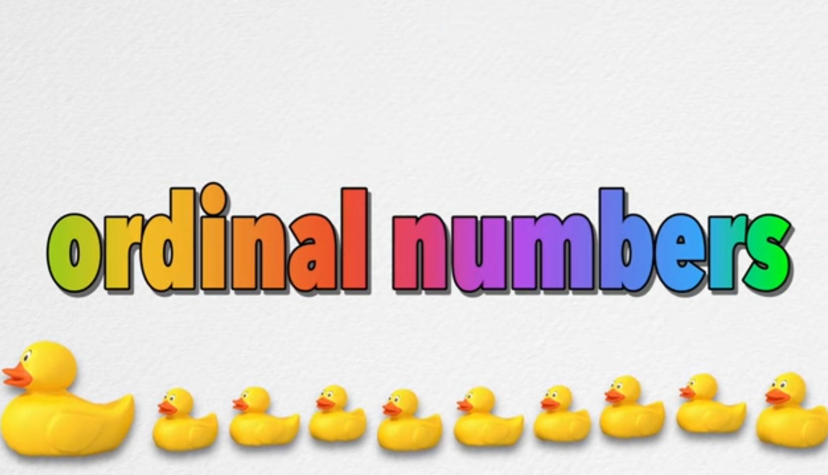
POSITIONS
recap

Slide 3
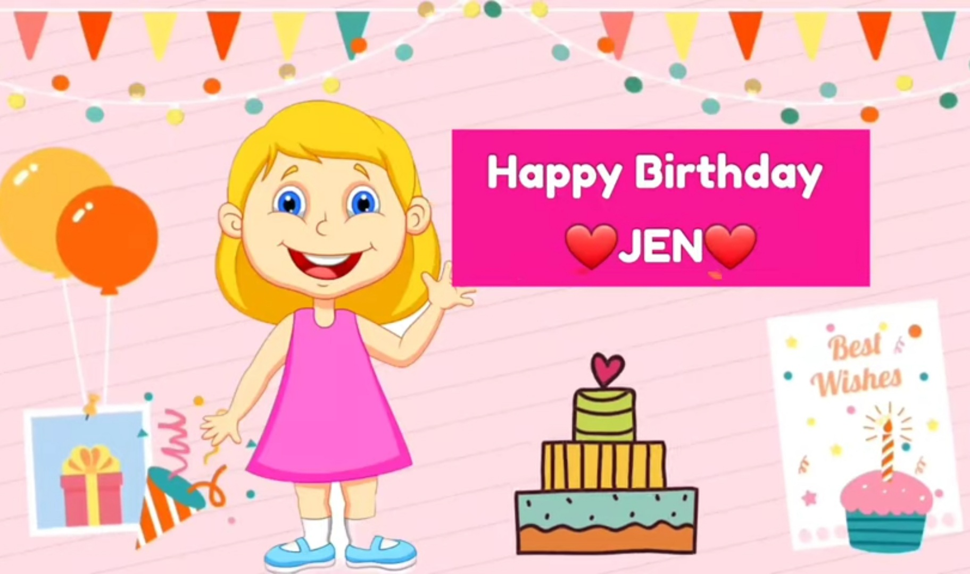

Slide 4

Jen has invited her friends to give an ice cream treat.
Let’s see the positions of her friends in the line.
10
9
8
7
6
tenth
5
4
3
ninth
2
1
eighth
seventh
sixth
fifth
fourth
third
second
first

Slide 5
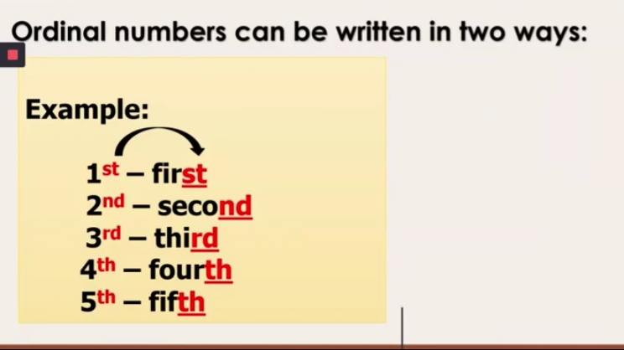
POSITIONS CAN BE WRITTEN IN TWO WAYS.
EXAMPLE-
First – 1st
Second- 2nd
Third – 3rd
Fourth- 4th
Fifth – 5th
EXAMPLE-
Sixth – 6th
Seventh – 7th
Eighth -8th
Ninth – 9th
Tenth – 10th

Slide 6
GUESS THE WORD
The 1st letter is M
The 2nd letter is O
The 3rd letter is U
The 4th letter is S
The 5th letter is E
S
E
___ ____ ____ ____ ____
M
O
U

Slide 7
Circle the correct name as per the position.
CW
23/9/21
2nd - First Second
8th - Eighth Fifth
4th - Sixth Fourth
9th - Tenth Ninth
3rd - Third Seventh

Slide 8










HW
23/9/21
Tick the correct position of the given objects.
1 st
Flower- First Third
Candle- Tenth Sixth
Fish- Fifth Eighth
Kite- First Ninth
Balloon- Seventh Third

Slide 9

THANKING YOU
ODM EDUCATIONAL GROUP

