Slide 1


CLASS : UKG
SUBJECT :MATHS
CHAPTER : 19
CHAPTER NAME- ADDITION
TOPIC : STORY SUM (BOOK PAGE-131TO 134)

Slide 2
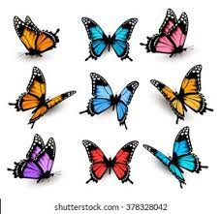
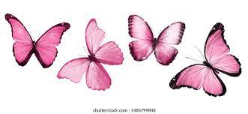
RECAP:
Count , write and add.
9
+
4
13
butterflies
13
How many butterflies altogether?

Slide 3

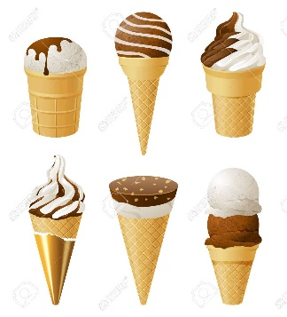
Count , write and add.
6
+
6
12
Ice creams
12
How many ice creams altogether?

Slide 4

Addition with ‘0’
As we know ‘0’ means nothing, it means any number added to 0 is equal to itself.
Therefore, you can add any number and get the same sum.

Slide 5
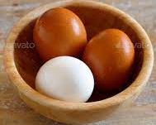
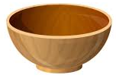
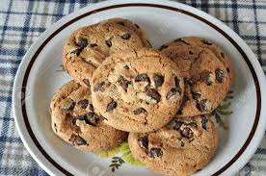
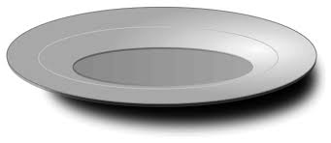
Count and add.
3
0
3
5
0
5

Slide 6
Count and add.
7 + 0 =
7
4 + 0 =
4
9
9 + 0 =
19 + 0 =
19
21 + 0 =
13 + 0 =
21
13
17 + 0 =
25 + 0 =
17
25
15 + 0 =
15
16+ 0 =
16

Slide 7
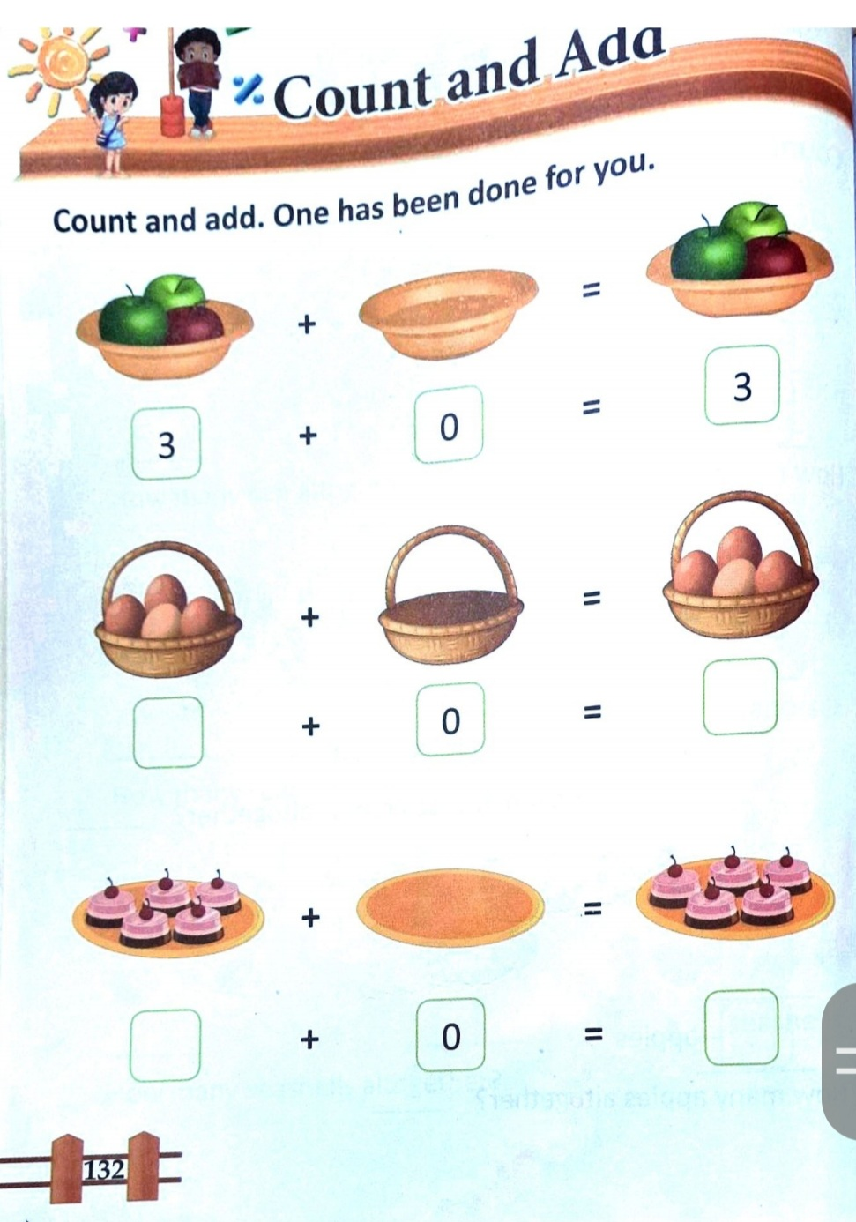
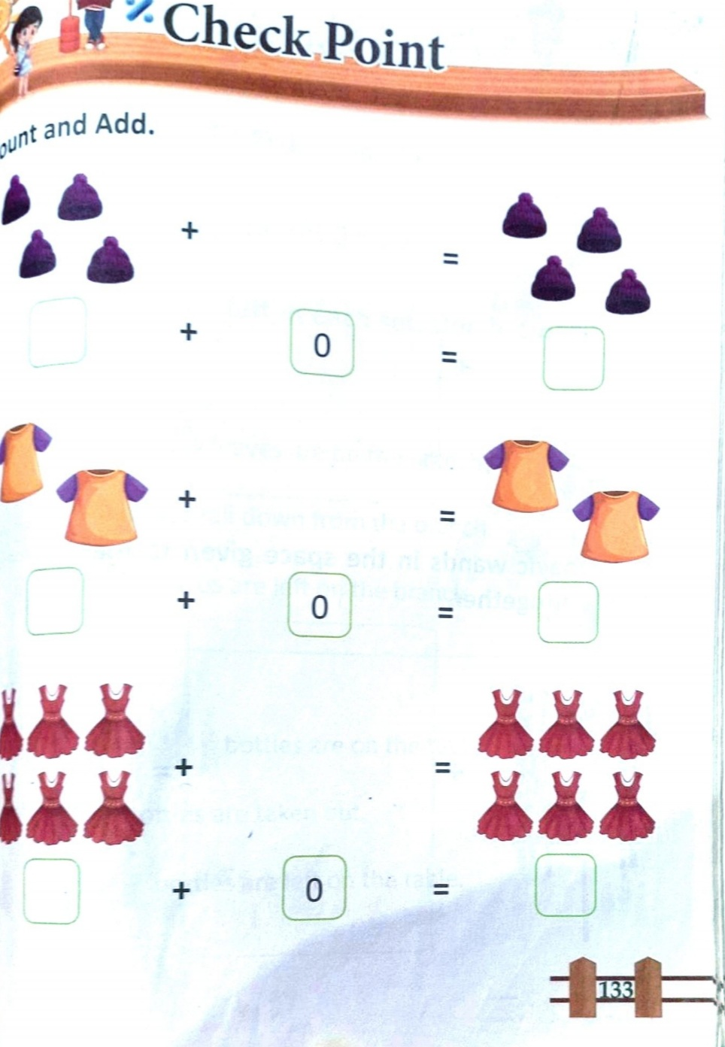
C/W
25.11.21

Slide 8
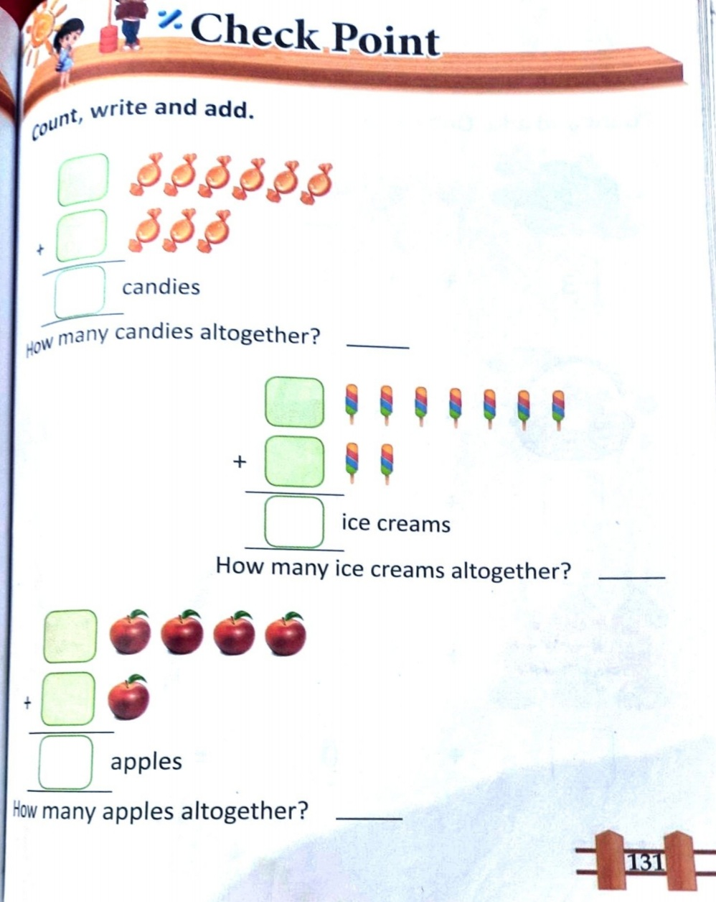
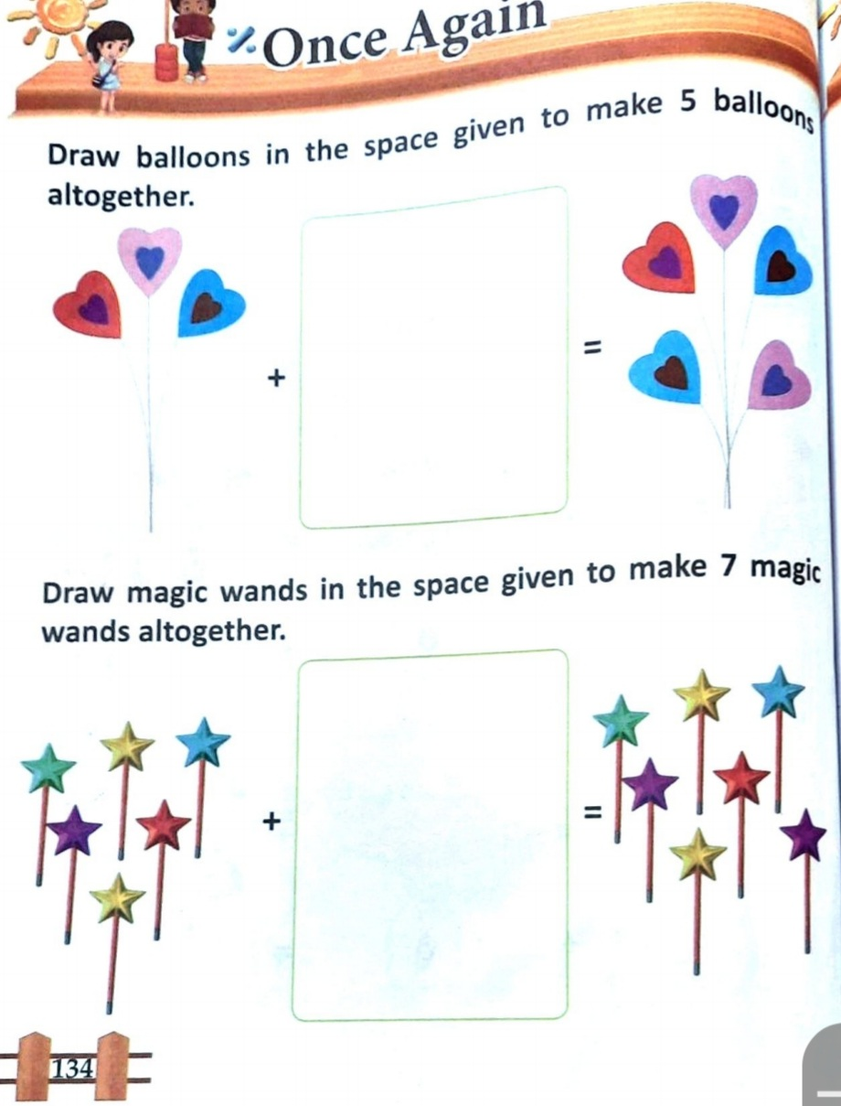
H/W
25.11.21

Slide 9
THANKING YOU
ODM EDUCATIONAL GROUP

