Slide 1


CLASS : UKG
SUBJECT :MATHS
CHAPTER : 19
CHAPTER NAME- ADDITION
TOPIC : STORY SUMS( NOTEBOOK WORK )

Slide 2
TODAY’S TOPIC – STORY SUM
THE WORD ALTOGETHER MEANS YOU HAVE TO PUT NUMBERS TOGETHER, THEREFORE IT IS AN ADDITION OR PLUS SUM.

Slide 3

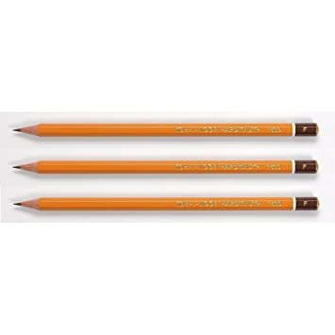

STORY SUM:
Tom has 6 yellow pencils and 4 red pencils. How many pencils Tom has altogether?
6
4
10
Altogether Tom has 10 pencils.

Slide 4
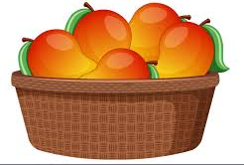
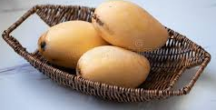
Mary has 5 mangos .
Her mother gave 3 more.
How many mangoes Mary has altogether?
5
3
8
Altogether Mary has 8 mangoes.

Slide 5

C/W
24.11.21
Count , write and add.
+
=
7
+
4
=
11
How many stars altogether?
11

Slide 6

C/W
24.11.21
How many balls are there altogether?
8
+
8
=
16
Altogether there are 16 balls.

Slide 7
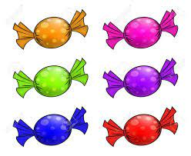
H/W
24.11.21
How many candies are there altogether?
+
=
Altogether there are ______ candies.

Slide 8
H/W
24.11.21
1- Soma has 7 apples and 5 oranges. How many fruits Soma has altogether?
2- There are 5 bees on a flower. 3 bees join them. How many bees are there in total?
3- 3 ducks in a pond. 3 ducks on the sand. How many ducks are there in total.

Slide 9



H/W
24.11.21
4- How many fish are there altogether?
Altogether there are _____ fish.
5- How many flowers are there altogether?
Altogether there are _____flowers.

Slide 10
THANKING YOU
ODM EDUCATIONAL GROUP

