Slide 1


CLASS : UKG
SUBJECT : MATHS
CHAPTER : “SUBTRACTION”
TOPIC : Cross out, count and write
(bkpg-139 – 142)

Slide 2
Recap
SUBTRACTION is-
When you take one number away from another number. For ex-the subtraction of 2 from 5 gives you an answer of 3.
(5 – 2 = 3)
The words used for subtraction are-minus,remain,left,fewer,less,take away.

Slide 3


Count, subtract and say-
8
-
4
=
4

Slide 4


Cross out, count and say-
8
5
3
9
5
4

Slide 5

Cross out, count and say to circle the correct number-
9 - 6 =
3 4 2
3

Slide 6
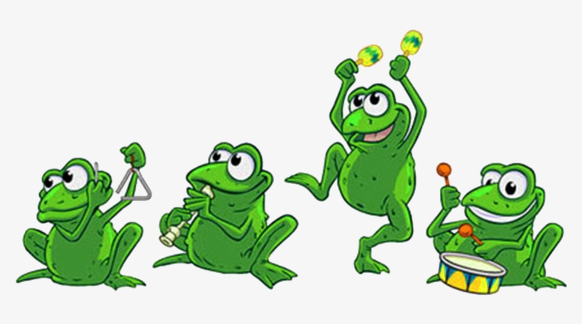

Cross out, count and say to circle the correct number-
6
5
2
8 - 6 =
2

Slide 7
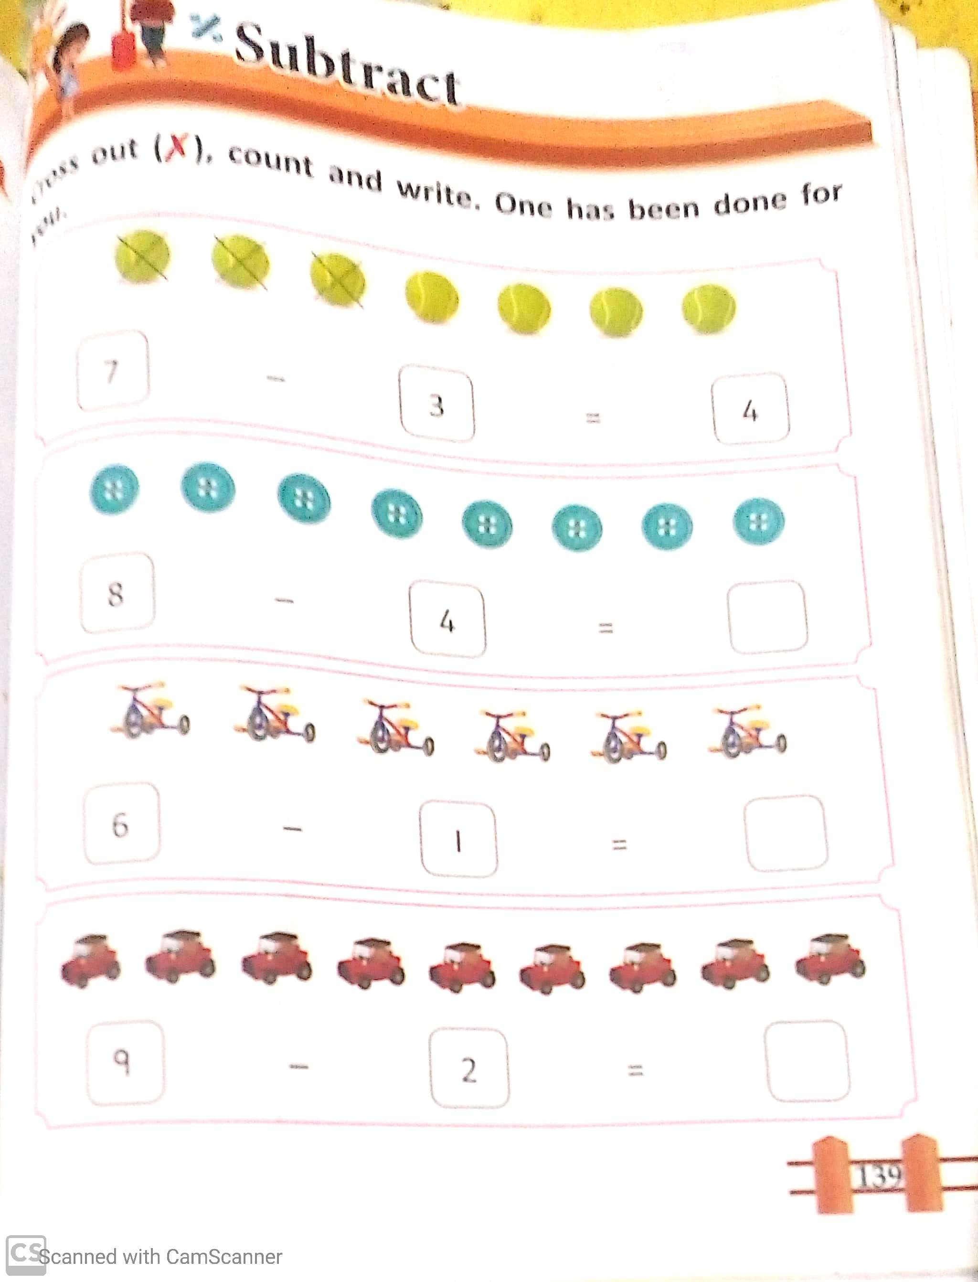
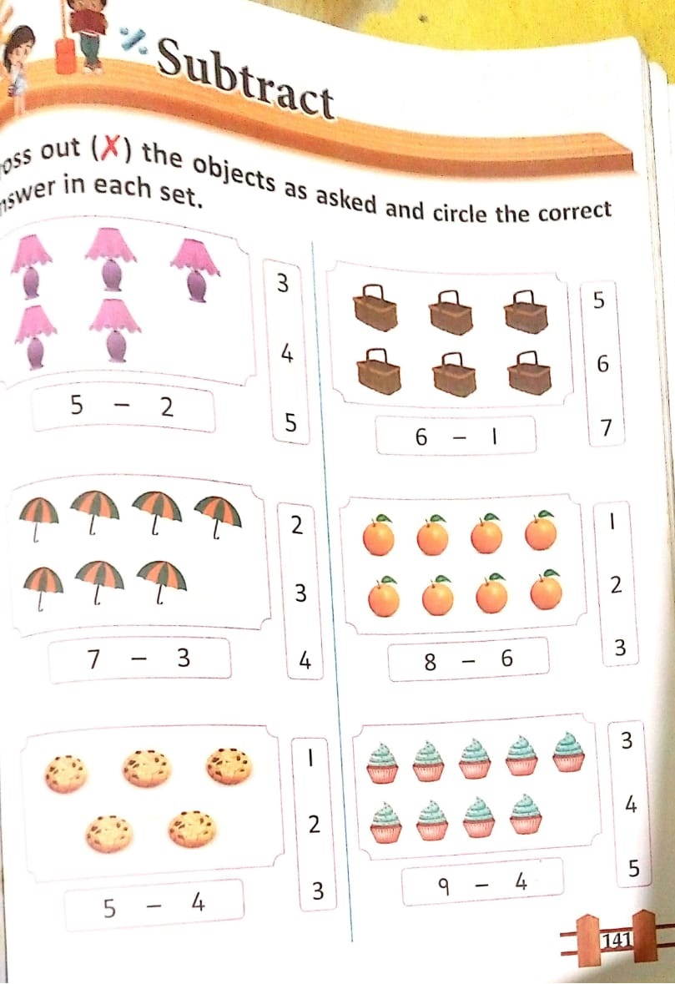
C.W
2.11.21

Slide 8
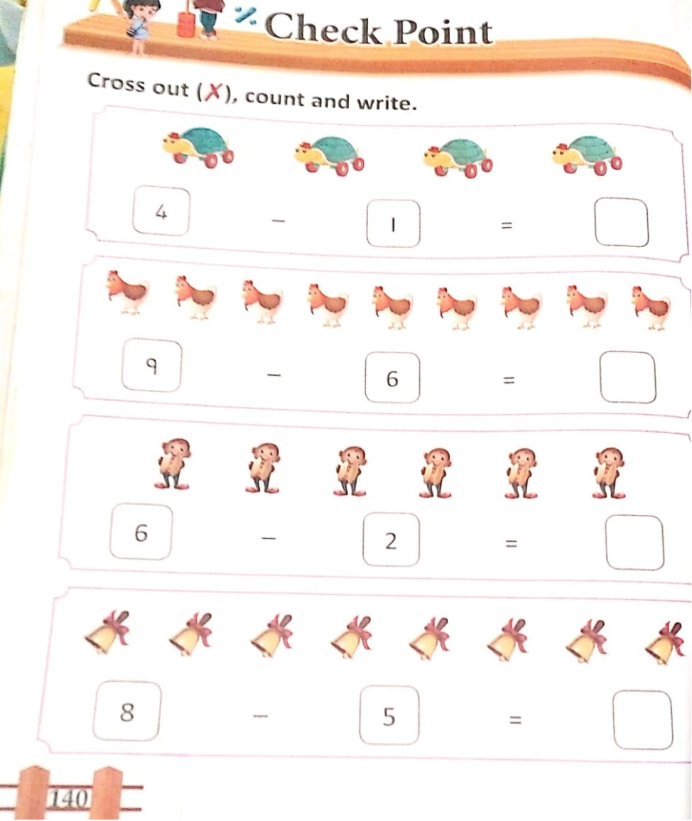
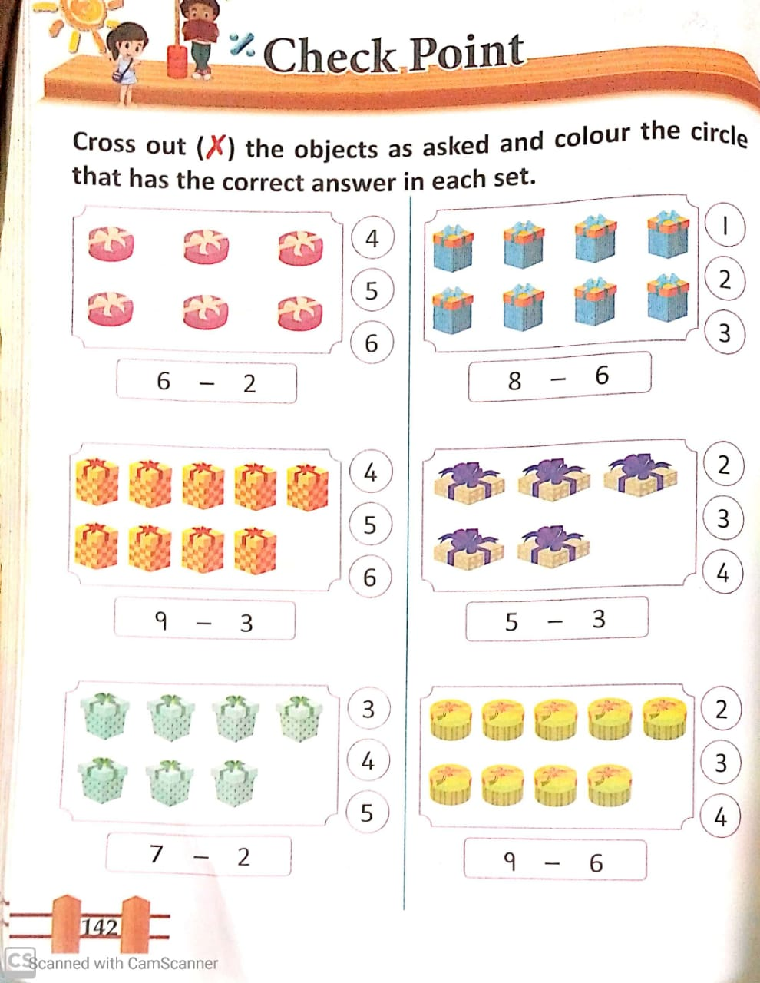
H.W
2.11.21

Slide 9
THANKING YOU
ODM EDUCATIONAL GROUP

