Slide 1


WELCOME TO ONLINE CLASS
CLASS-UKG
SUBJECT-MATHS
TOPIC-SMALLEST NUMBER
SMALL to BIG
(94,95 & 96)

Slide 2
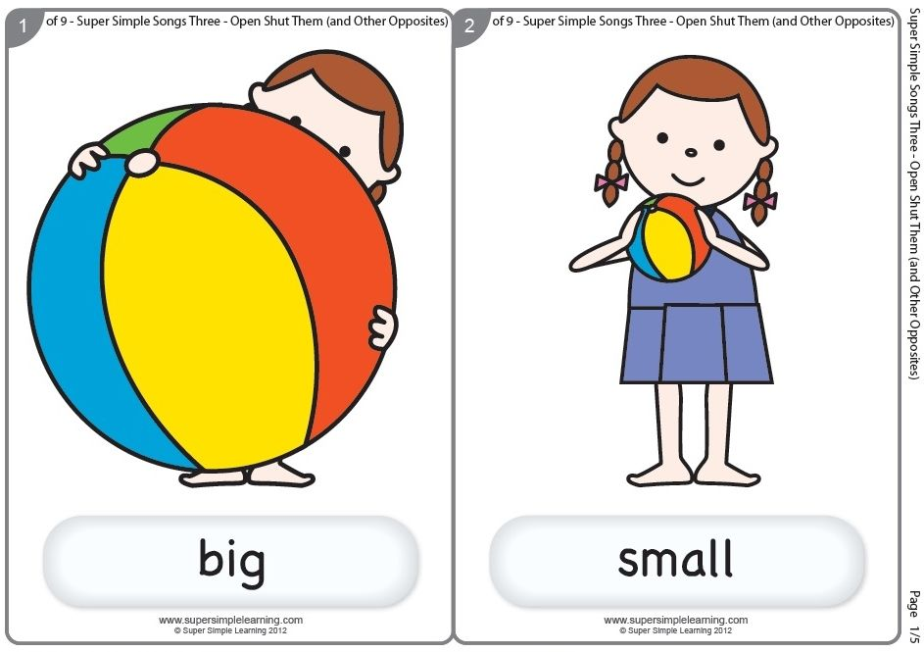
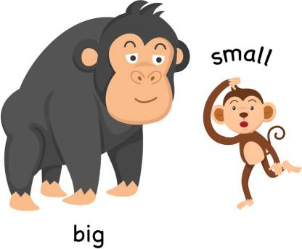

Observe the pictures-

Slide 3
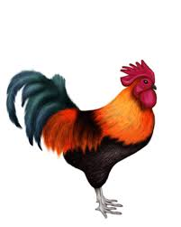
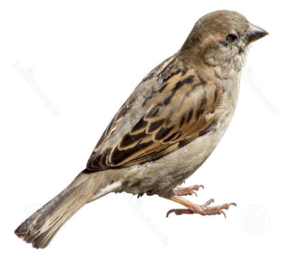

Say which one is the smallest one-
butterfly

Slide 4

Arrange the pictures small to big:

Slide 5
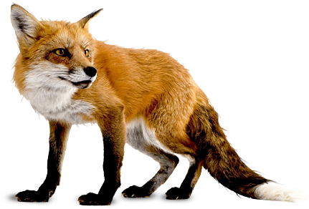
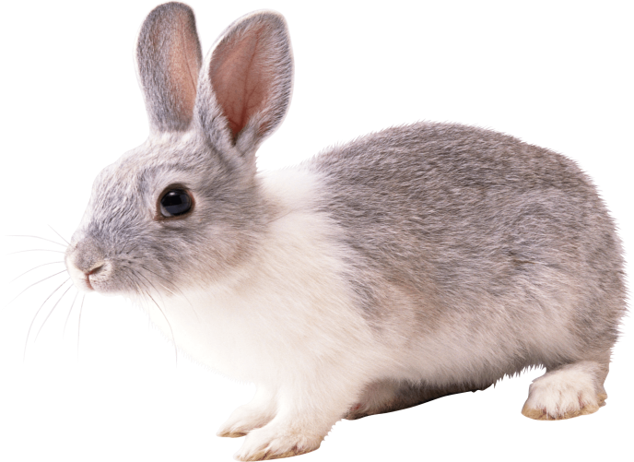
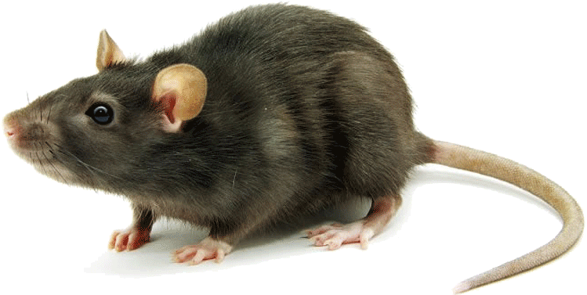
Say which one is the smallest one-
rat

Slide 6
Arrange the pictures small to big:

Slide 7
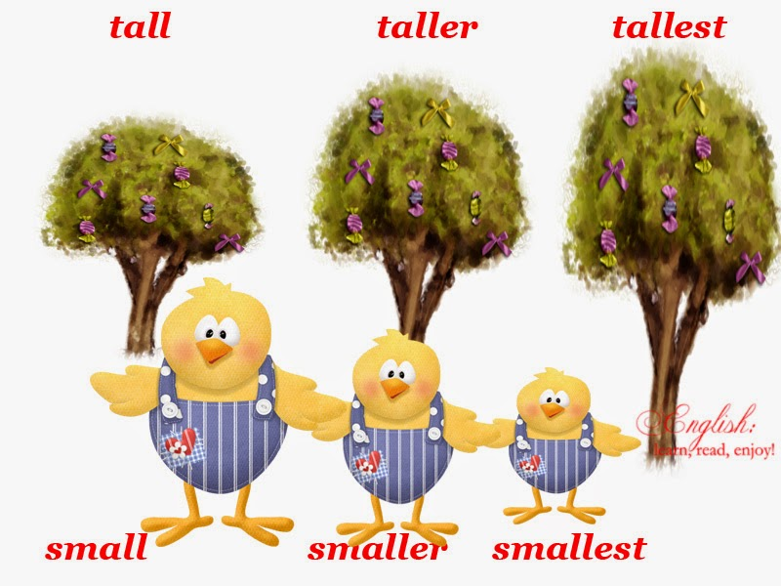


Slide 8
Count and say which number is the
smallest number-
10
7
8
7

Slide 9


Say the smallest number-
55
41
41
63

Slide 10
50
76
50
88

Slide 11
Arrange the numbers from small to big-
45 48 46 47
45
46
47
48
53 51 54 52
51
52
53
54

Slide 12
62 60 63 61
60
61
62
63
73 71 72 74
73
74
71
72

Slide 13
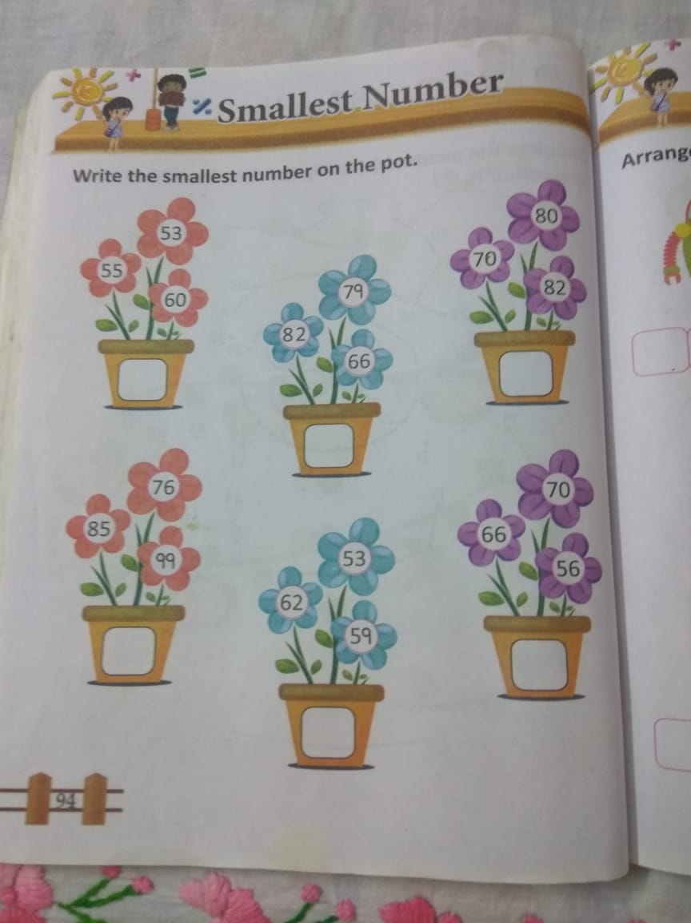
C.W
13.9.21

Slide 14
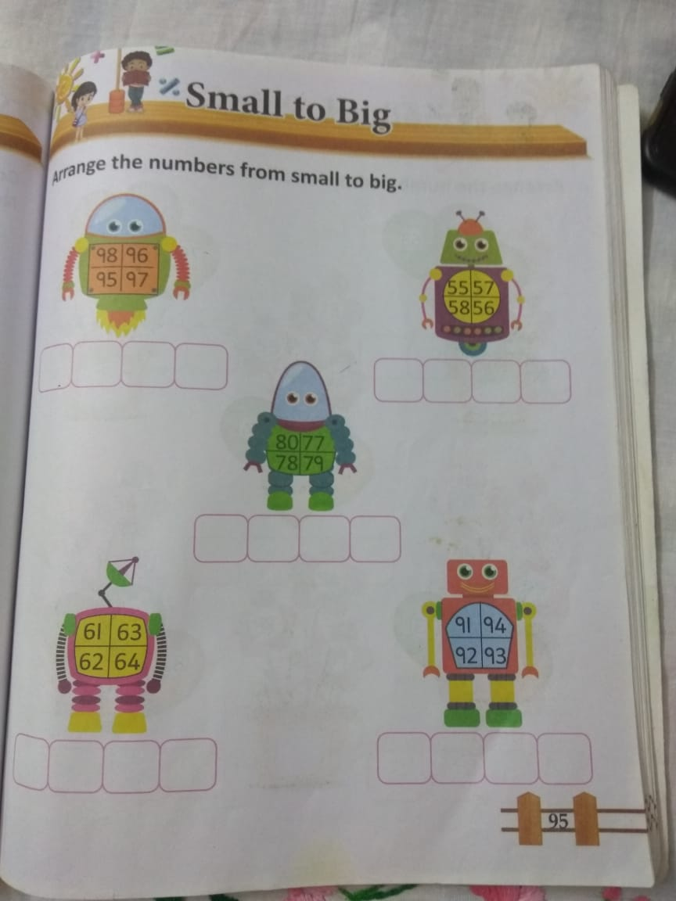
H.W
13.9.21

Slide 15
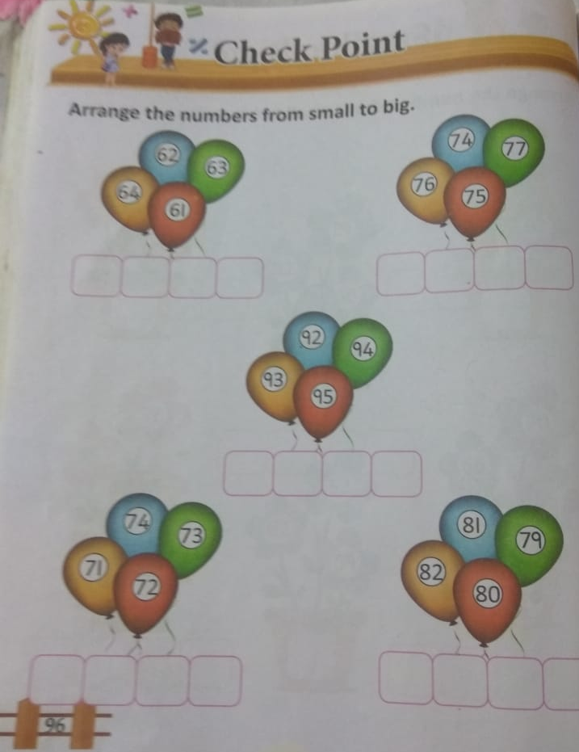
H.W
13.9.21

Slide 16

THANKING YOU
ODM EDUCATIONAL GROUP

