Slide 1



CLASS : NURSERY
DATE : 23.11.2021
SUBJECT :
MATHS
CHAPTER NUMBER-
COMPARISON
SUB-TOPIC :
IN NTBK INSIDE &OUT SIDE
Notes:
LETTER T,K

Slide 2

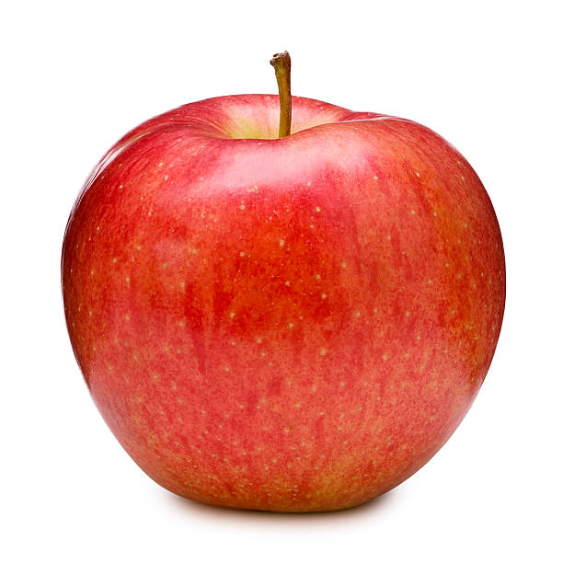
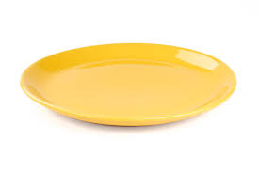

Concept of inside and out side

Slide 3
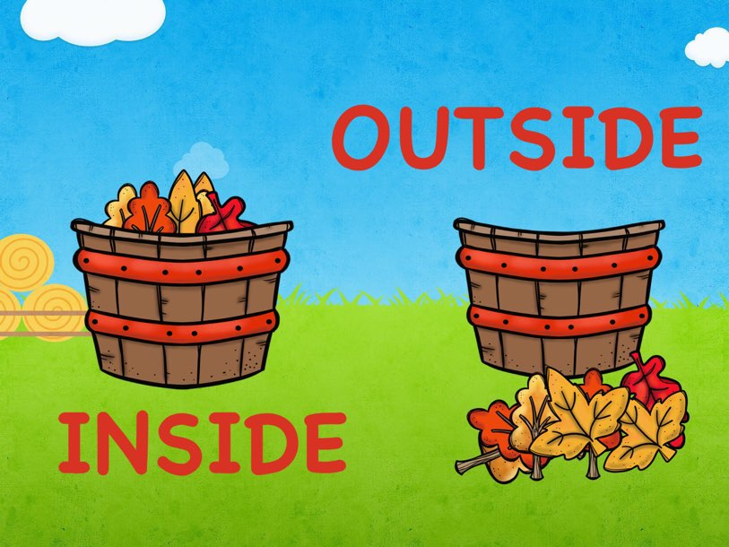

Slide 4

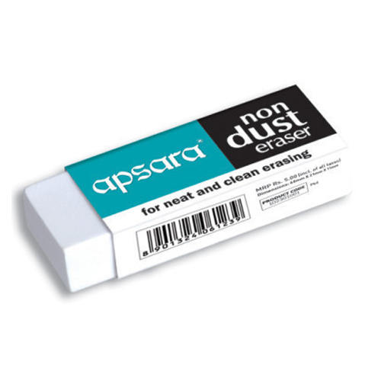
Concept of Inside and outside

Slide 5




Slide 6

IN BK PG NO-11
Inside and out side in nt bk
Notes:
Note book work

Slide 7


Colour the objects which are out side
cw
23/11/21

Slide 8

23/11/21
ASSIGNMENT
.
1.Paste the picture of inside & out side in nt bk.
Notes:
1.BK PG NO-12

Slide 9
THANKING YOU
ODM EDUCATIONAL GROUP

