Slide 1



CLASS : NURSERY
DATE : 22.11.2021
SUBJECT :
MATHS
CHAPTER NUMBER-
COMPARISON
SUB-TOPIC :
BK PG INSIDE &OUT SIDE
Notes:
LETTER T,K

Slide 2

Recapitulation

Slide 3
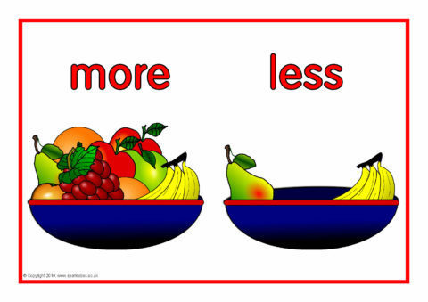

Slide 4
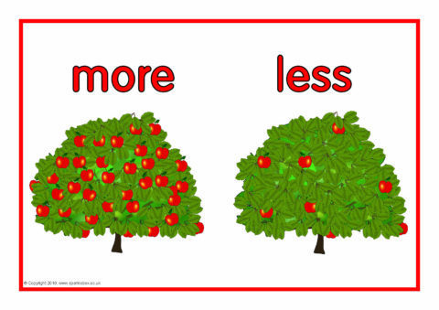

Slide 5

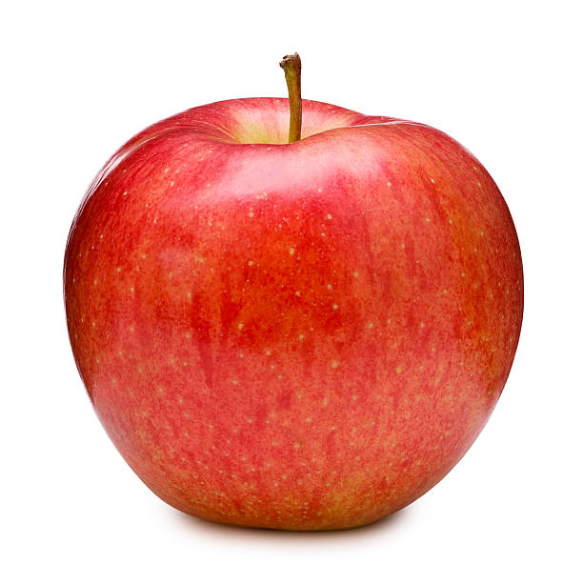
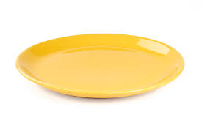

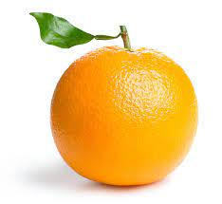
Concept of inside and out side

Slide 6
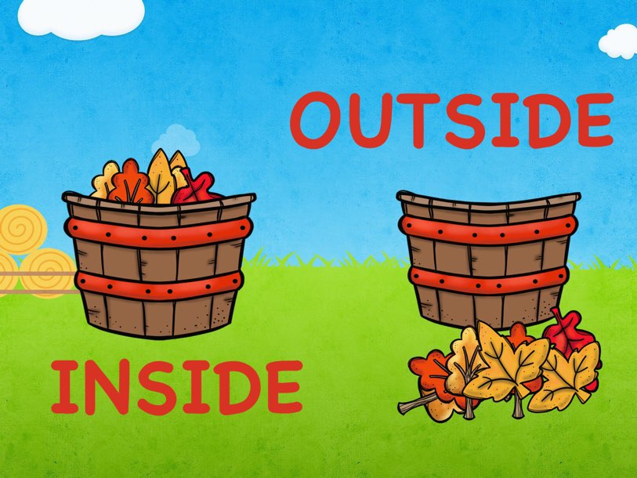

Slide 7
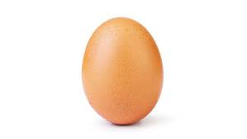
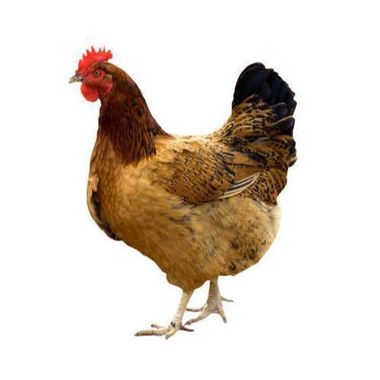
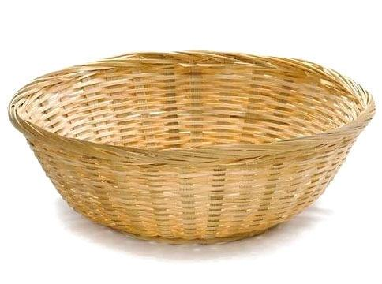

Concept of Inside and outside
Outside
Inside

Slide 8
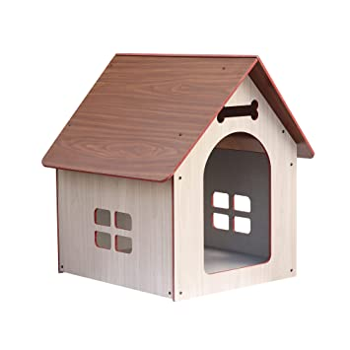

Inside
Outside

Slide 9

IN BK PG NO-14
Bk pg no-14
Notes:
Note book work

Slide 10
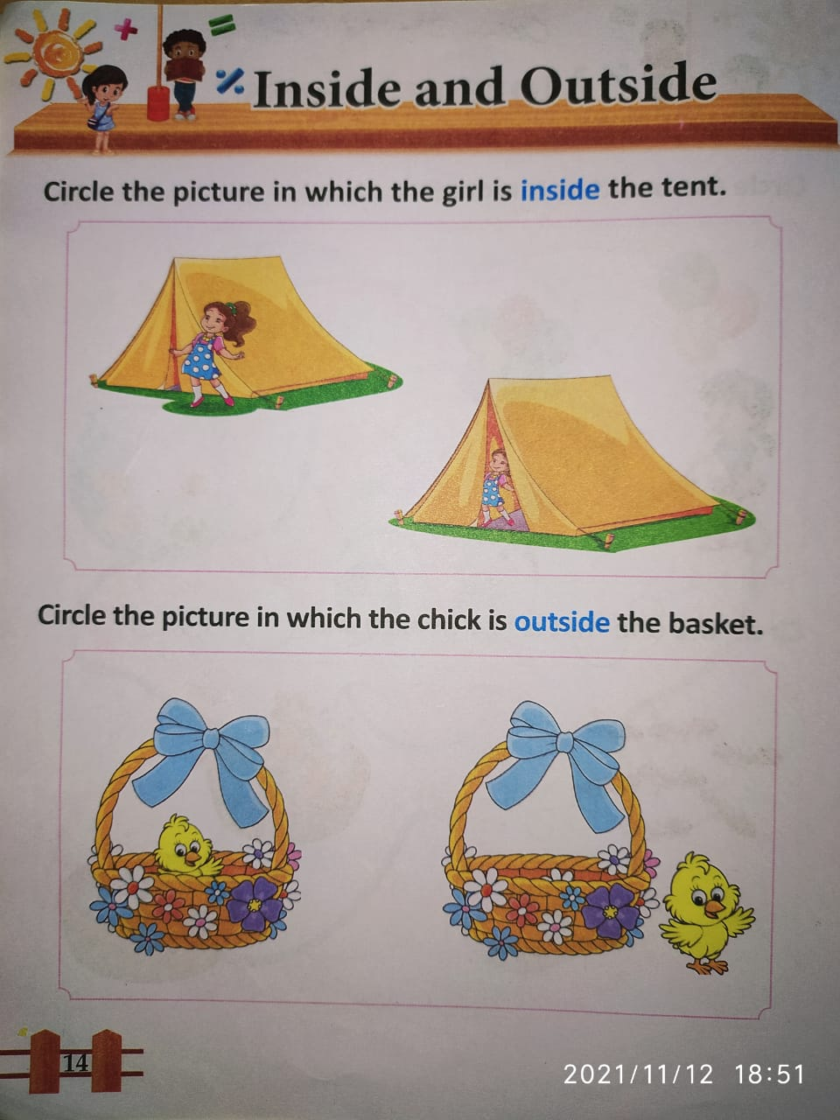
In bk pg no -14

Slide 11

22/11/21
ASSIGNMENT
.
1.Do the assignment given in a bk
Notes:
1.BK PG NO-12

Slide 12
THANKING YOU
ODM EDUCATIONAL GROUP

