Slide 1



CLASS : NURSERY
DATE : 11.11.2021
SUBJECT :
MATHS
CHAPTER NUMBER-
COMPARISON
SUB-TOPIC :
BK PG13 MORE AND LESS
Notes:
LETTER T,K

Slide 2

RECAPITULATION

Slide 3
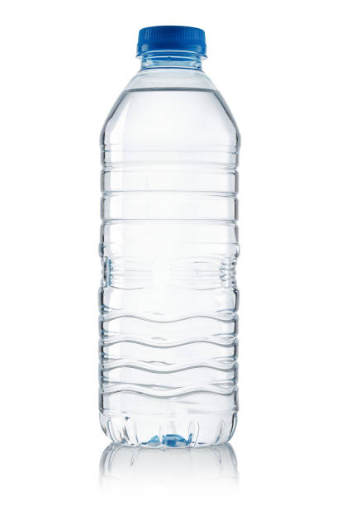
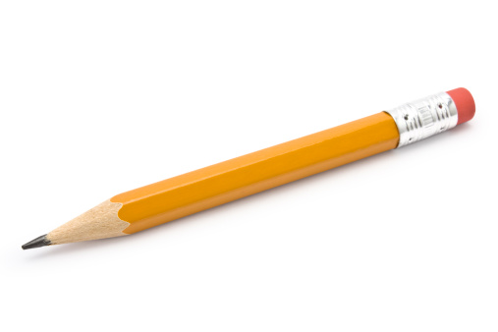
HEAVY AND LIGHT
LIGHT
HEAVY
Notes:
PENCIL BOX

Slide 4
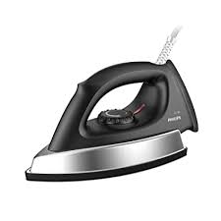
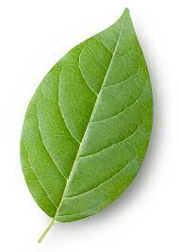
LIGHT
HEAVY

Slide 5
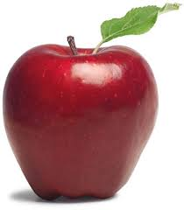
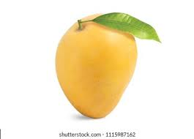
MORE AND LESS

Slide 6


Slide 7
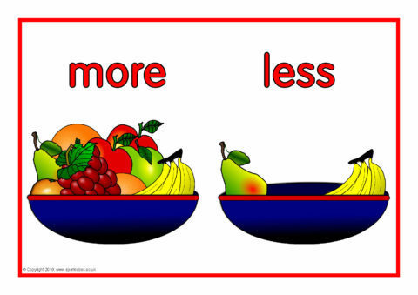

Slide 8
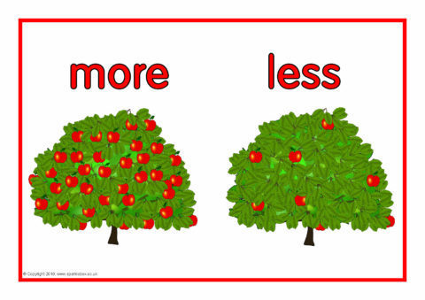

Slide 9

IN BK PG NO-11
Bk pg no-13
Notes:
Note book work

Slide 10
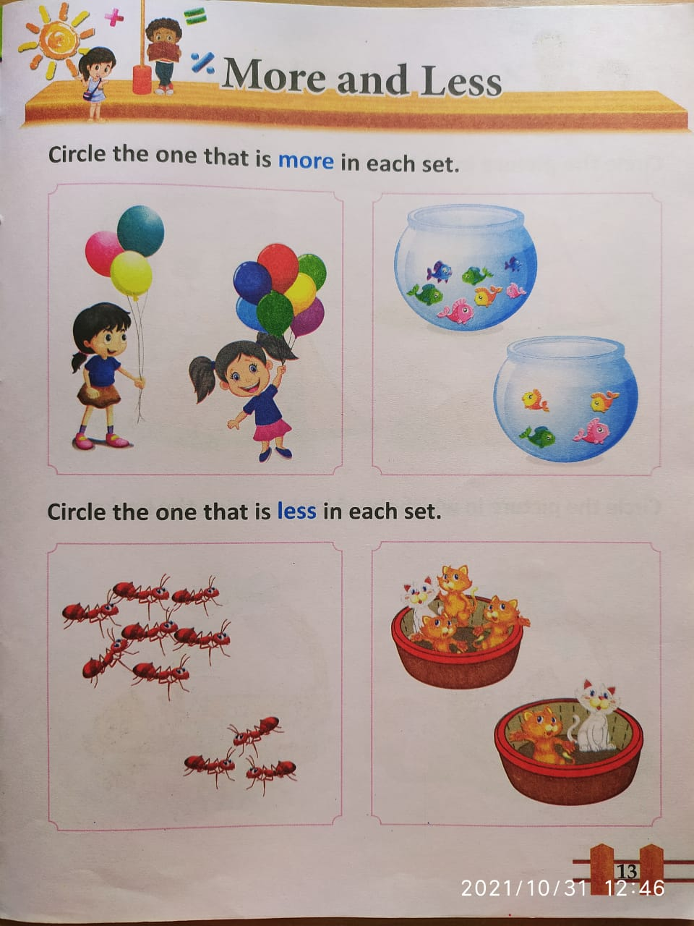
BK PG NO-13
CW
11/11/21
Notes:
CW 11/11/21

Slide 11

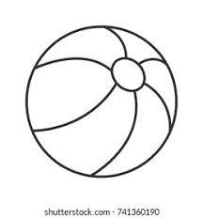
ACTIVITY (In nt bk)
HW
Tick and color the the picture having more objects
Notes:
HW

Slide 12

11/11/21
ASSIGNMENT
.
1.Do the assignment given in nt bk
Notes:
1.BK PG NO-12

Slide 13
THANKING YOU
ODM EDUCATIONAL GROUP

