Slide 1



CLASS : NURSERY
DATE : 10.11.2021
SUBJECT :
MATHS
CHAPTER NUMBER-
COMPARISON
SUB-TOPIC :
BK PG11 HEAVY & LIGHT
Notes:
LETTER T,K

Slide 2



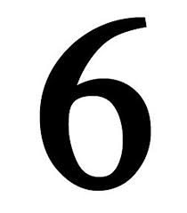





RECAPTULATION
Identify and say the given number

Slide 3
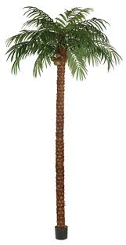

TALL &SHORT

Slide 4


Slide 5


Slide 6
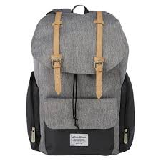
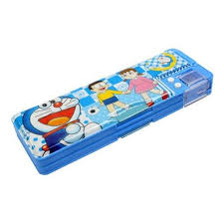
HEAVY AND LIGHT
LIGHT
HEAVY
Notes:
PENCIL BOX

Slide 7
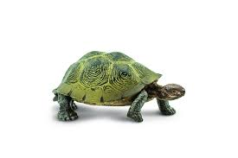

LIGHT
HEAVY

Slide 8
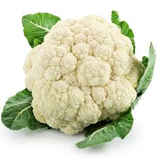

HEAVY
LIGHT

Slide 9

IN BK PG NO-11
Bk pg no-11
Notes:
Note book work

Slide 10
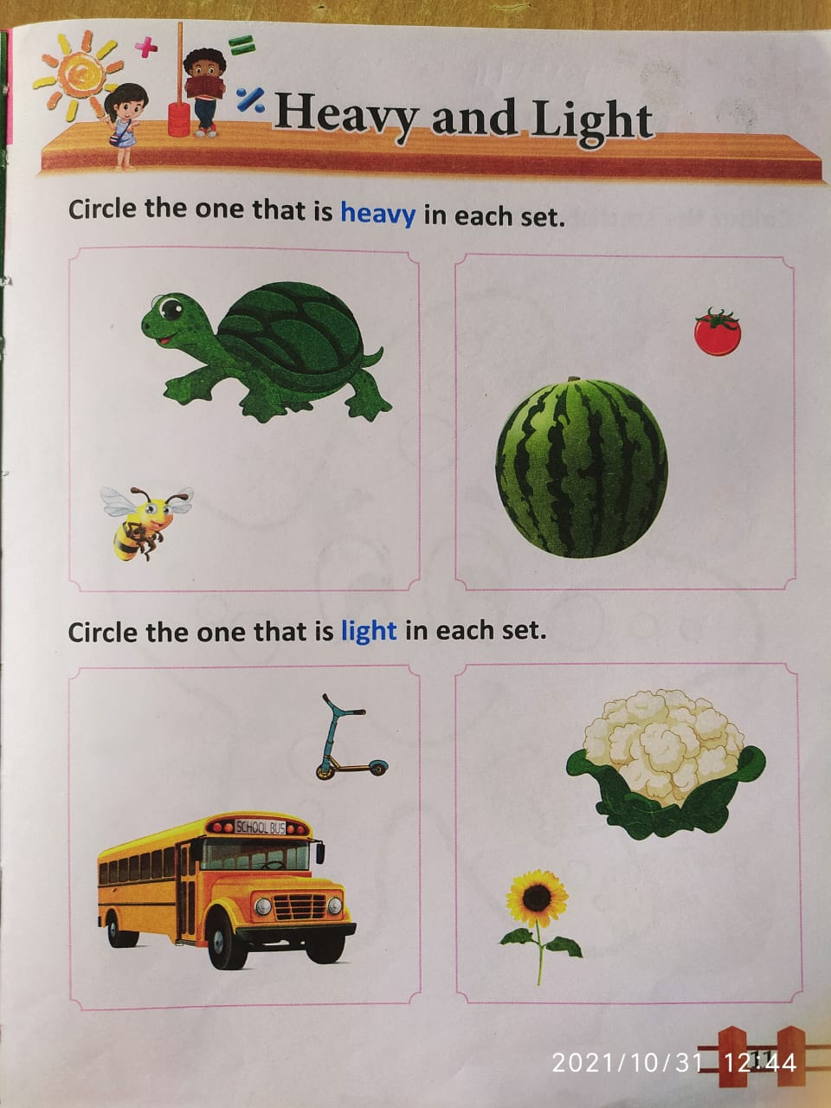
IN BK PG NO-11
CW
10/11/21
Notes:
10/11/21

Slide 11

10/11/21
ASSIGNMENT
.
1.DO BK PG NO-12
Notes:
1.BK PG NO-12

Slide 12
THANKING YOU
ODM EDUCATIONAL GROUP

