Slide 1



CLASS : NURSERY
DATE : 08.12.2021
SUBJECT :
MATHS
CHAPTER NUMBER-
COMPARISON BK PG NO15
SUB-TOPIC :
UP & DOWN
Notes:
LETTER T,K

Slide 2
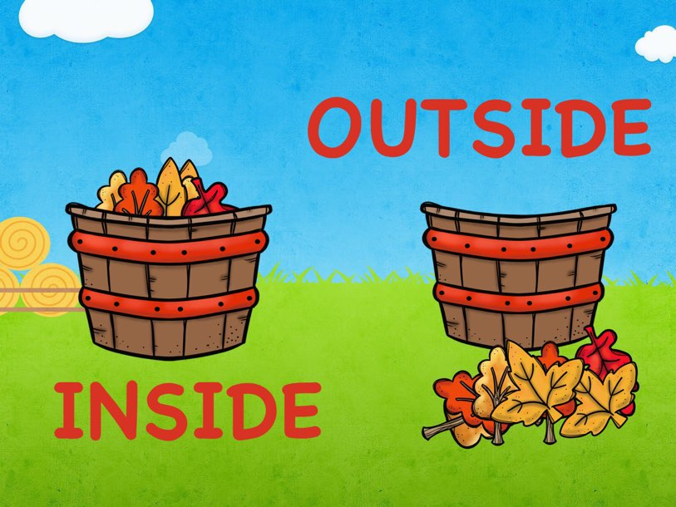

Slide 3
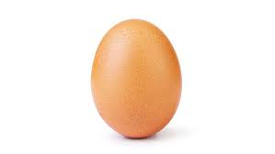
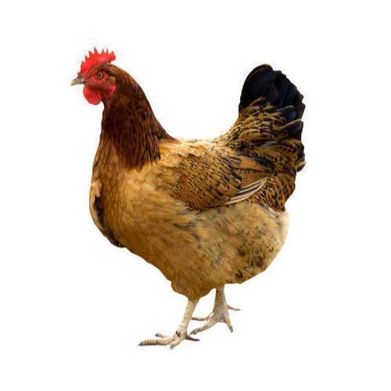
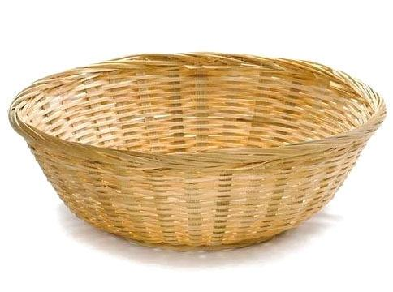

Concept of Inside and outside
Outside
Inside

Slide 4
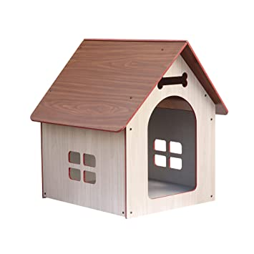

Inside
Outside

Slide 5
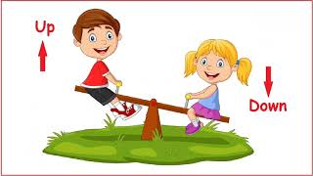

Slide 6

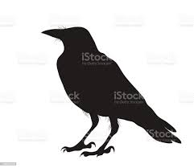

Slide 7





Slide 8

IN BK PG NO-15
Bk pg no-15 UP & DOWN
Notes:
Note book work

Slide 9
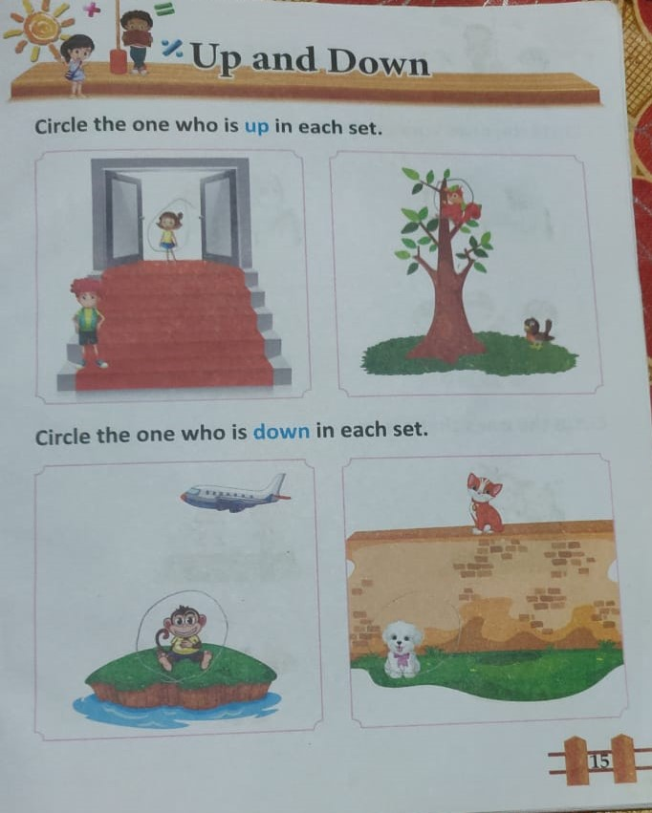
UP & DOWN BK PG NO-15
CW
08/12.21

Slide 10

08/12/21
ASSIGNMENT
.
1.Do the assignment given in a bk
Notes:
1.BK PG NO-12

Slide 11
THANKING YOU
ODM EDUCATIONAL GROUP

