Slide 1



CLASS : NURSERY
DATE : 30.11.2021
SUBJECT :
MATHS
TOPIC :
:NUMBER-13 IN NT BK

Slide 2

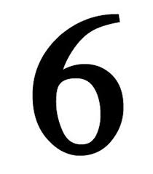






IDENTIFY THE GIVEN NUMBERS

Slide 3



Recapitulation

Slide 4
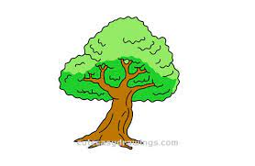
Identify and count the objects

Slide 5

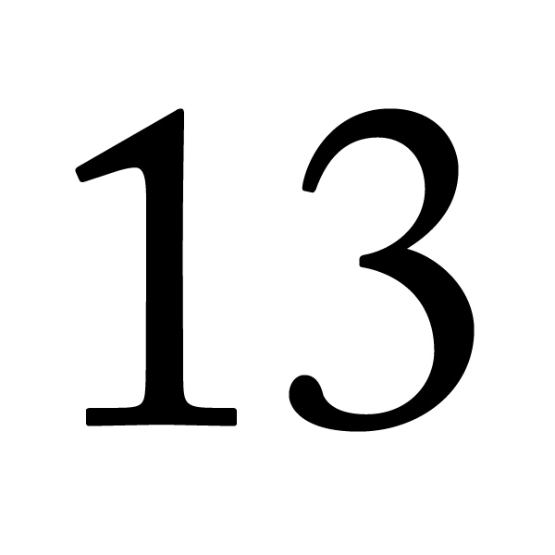

Identification of number 13

Slide 6
Counting the objects

Slide 7

HI children

Slide 8

IN BK PG NO-14
Activity in nt bk
Notes:
Note book work

Slide 9


Slide 10
Say and write

Slide 11

1 .Practice counting 1-5
ASSIGNMENT
01/12/21
1.Practice counting 11 to20
2.Do the activity given in nt bk
Notes:
2.Do bk pg no-63

Slide 12
THANKING YOU
ODM EDUCATIONAL GROUP

