Slide 1



CLASS : NURSERY
DATE : 29.11.2021
SUBJECT :
MATHS
TOPIC :
:NUMBER-13 IN NT BK

Slide 2

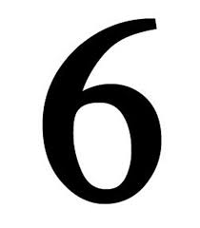






IDENTIFY THE GIVEN NUMBERS

Slide 3




Slide 4

Recapitulation

Slide 5
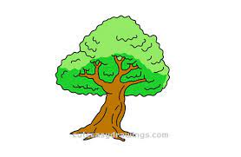
Identify and count the objects

Slide 6

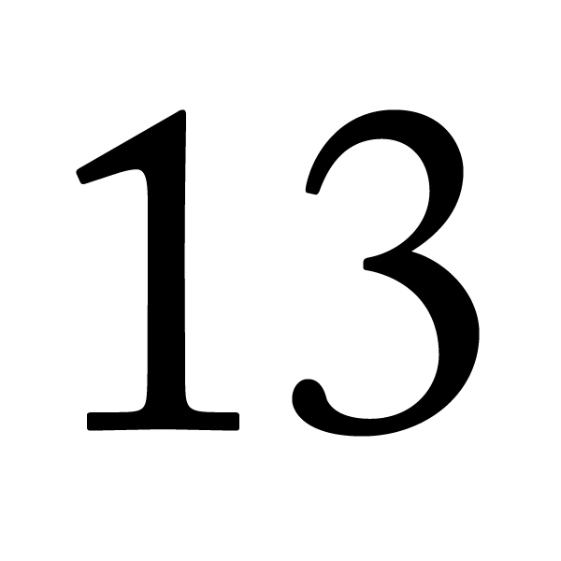

Identification of number 13

Slide 7
Counting the objects

Slide 8

HI children

Slide 9

IN BK PG NO-14
Activity in nt bk
Notes:
Note book work

Slide 10
ACTIVITY IN NT BK
CW
29/11/21
8 13 12 10 13
13 10 11 13 8
11 12 13 10 13
10 13 11 13 8

Slide 11

1 .Practice counting 1-5
ASSIGNMENT
29/11/21
1.Practice counting 11 to20
2.Do bk pg no 66,67
Notes:
2.Do bk pg no-63

Slide 12
THANKING YOU
ODM EDUCATIONAL GROUP

