Slide 1



CLASS : NURSERY
DATE : 29.07.2021
SUBJECT :
MATHS
CHAPTER NUMBER- BK PG NO -40
SUB-TOPIC :
NUMBER-4 In note bk
Notes:
comparisson

Slide 2







IDENTIFY THE GIVEN NUMBERS

Slide 3


Identification of number 4

Slide 4
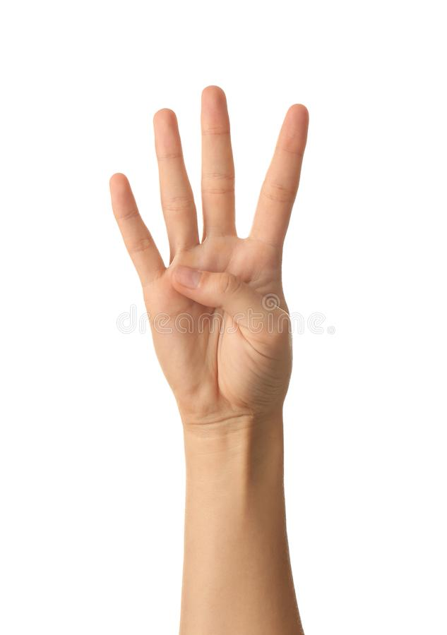

Slide 5

Counting numbers with objects

Slide 6
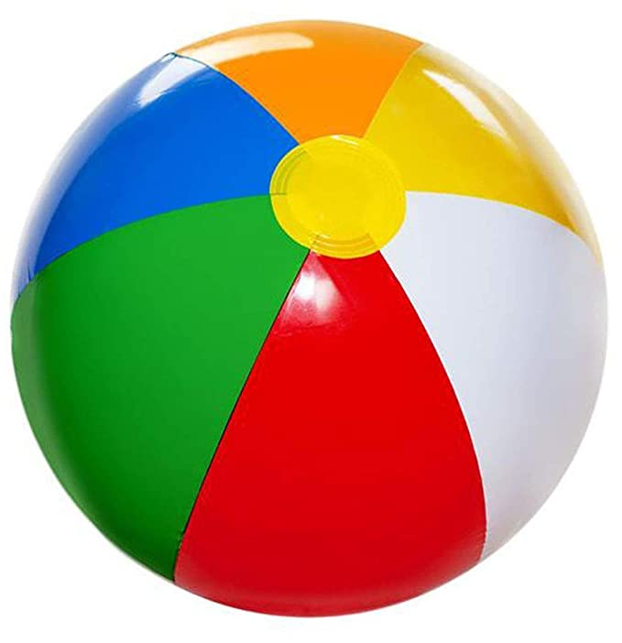

Slide 7

NUMBER-4 IN NOTE BK
CW
29/07/21
Notes:
CW

Slide 8
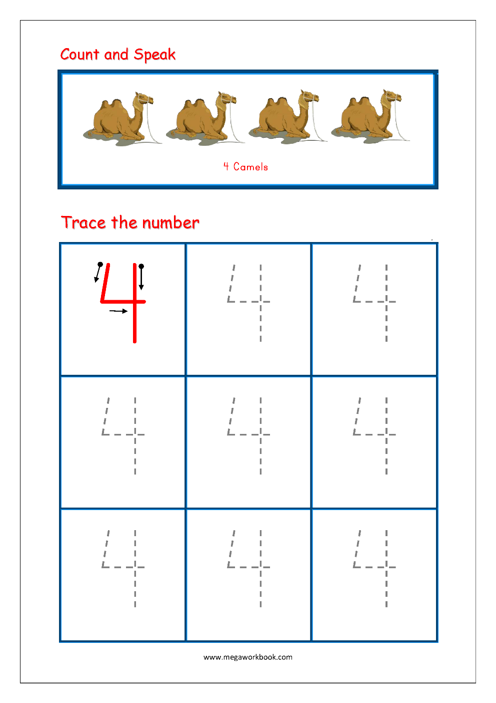
Trace and write number -4
CW
29/07/21
Notes:
28/07/21

Slide 9

1 .Practice counting 1-5
ASSIGNMENT
29/07//21
1.Practice counting 1 to10
2.Complete the work given in nt.bk
Notes:
2.practice the activity done today

Slide 10
THANKING YOU
ODM EDUCATIONAL GROUP
Notes:
CW

