Slide 1



CLASS : NURSERY
DATE : 27.07.2021
SUBJECT :
MATHS
CHAPTER NUMBER- BK PG NO -39
SUB-TOPIC :
NUMBER-4
Notes:
comparisson

Slide 2







IDENTIFY THE GIVEN NUMBERS

Slide 3
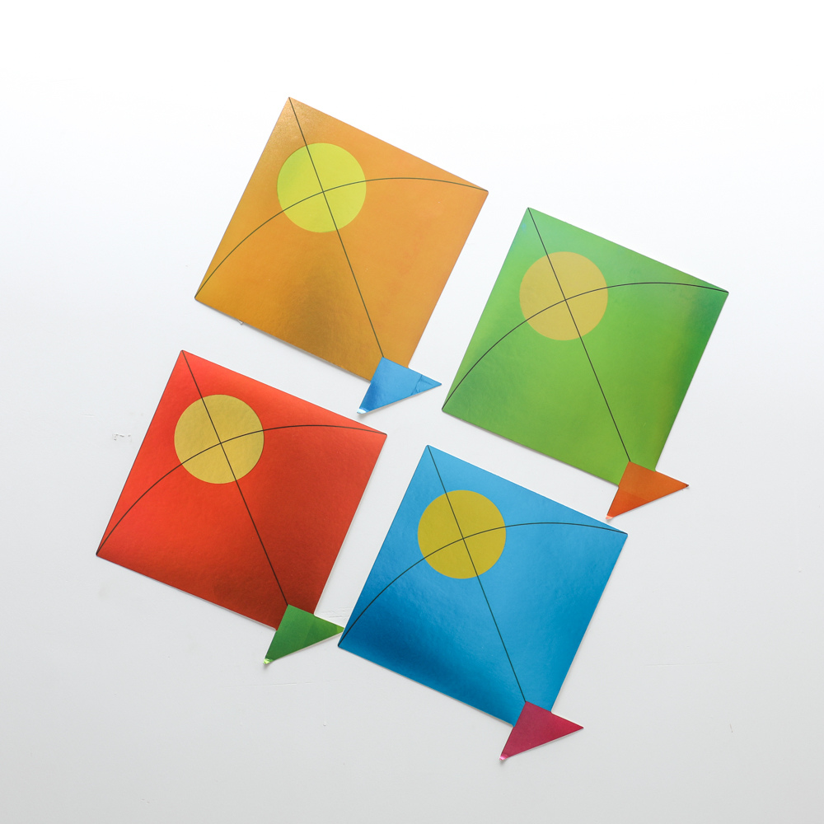
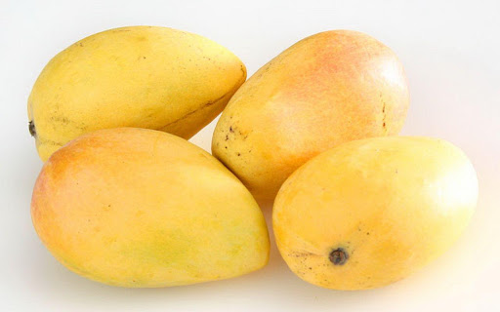


Identify and count the set of given pictures

Slide 4


Identification of number 4

Slide 5
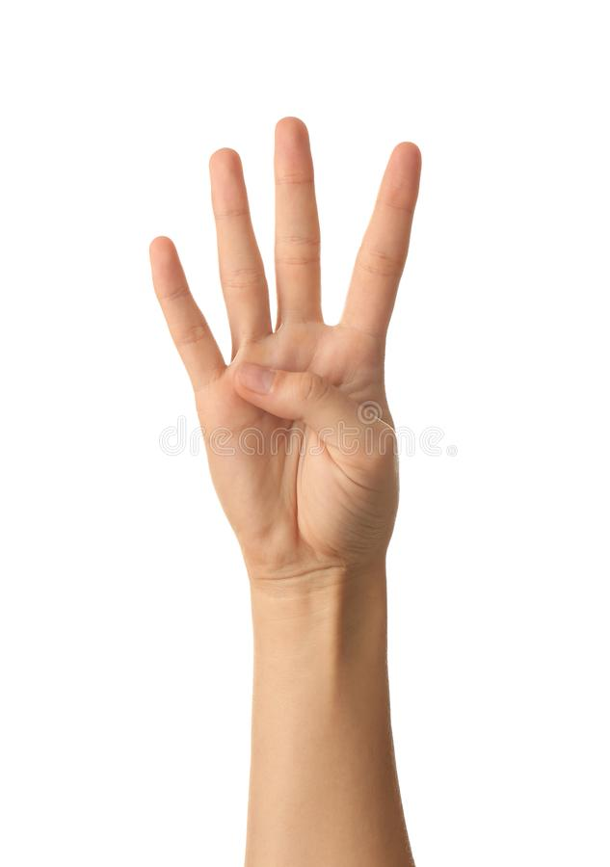

Slide 6

Counting numbers with objects

Slide 7
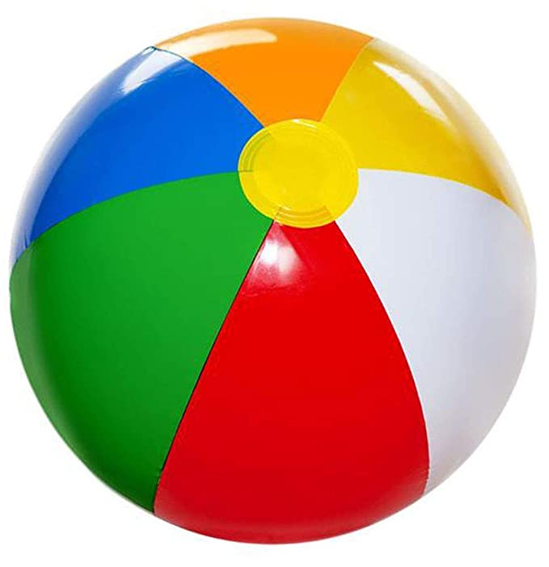

Slide 8


Slide 9

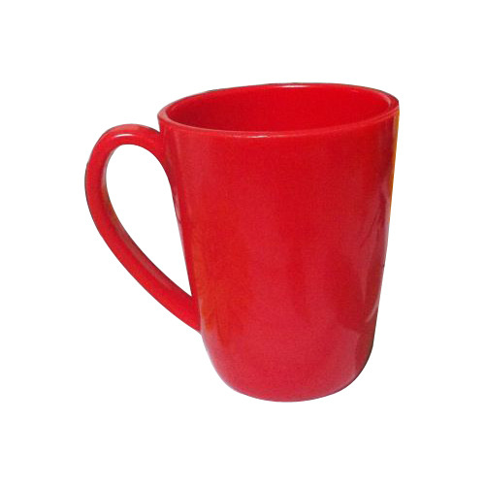
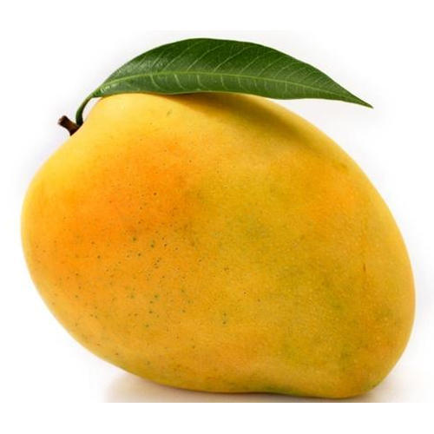
Count and encircle the correct number(Activity)
cw
27/07/21
3
4
6
1
2
5
4
3
4
2
5
1
Notes:
27/07/21

Slide 10

1 .Practice counting 1-5
ASSIGNMENT
27/07//21
1.Practice counting 1 to10
2.Practice the activity done today
Notes:
2.practice the activity done today

Slide 11
THANKING YOU
ODM EDUCATIONAL GROUP

