Slide 1



CLASS : NURSERY
DATE : 26.07.2021
SUBJECT :
MATHS
CHAPTER NUMBER- BK PG NO -39
SUB-TOPIC :
NUMBER-4
Notes:
comparisson

Slide 2







IDENTIFY THE GIVEN NUMBERS

Slide 3



Slide 4

count and say the number of object

Slide 5

NUMBER -3

Slide 6


Slide 7
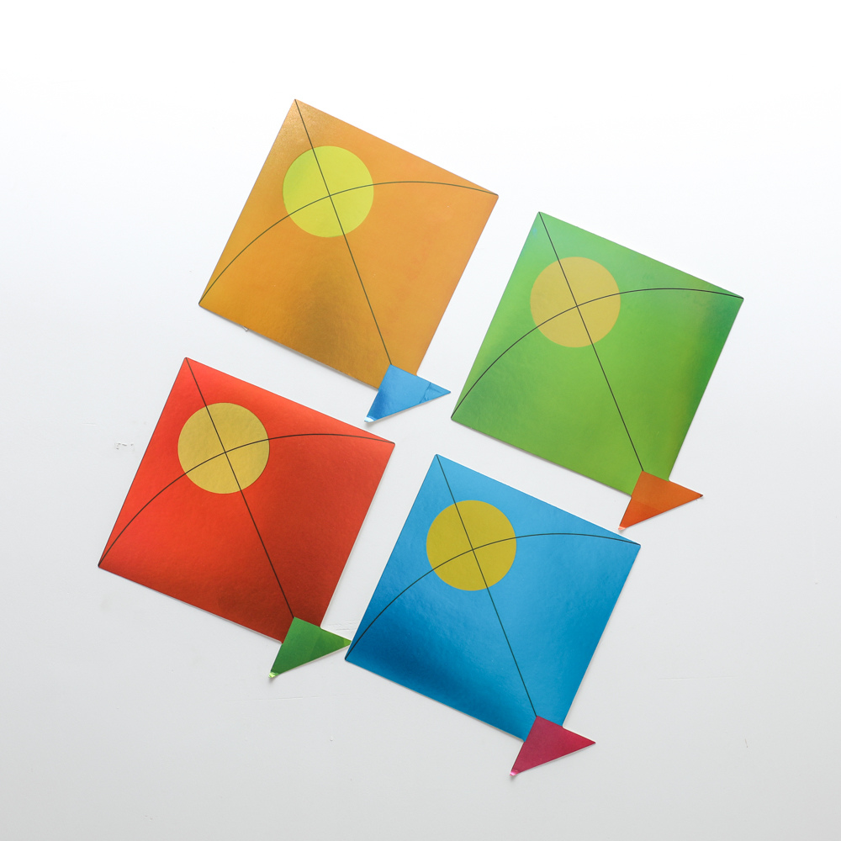
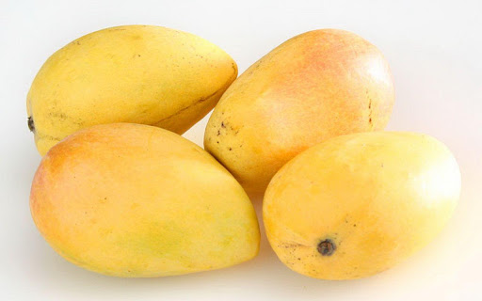


Identify and count the set of given pictures

Slide 8


Identification of number 4

Slide 9
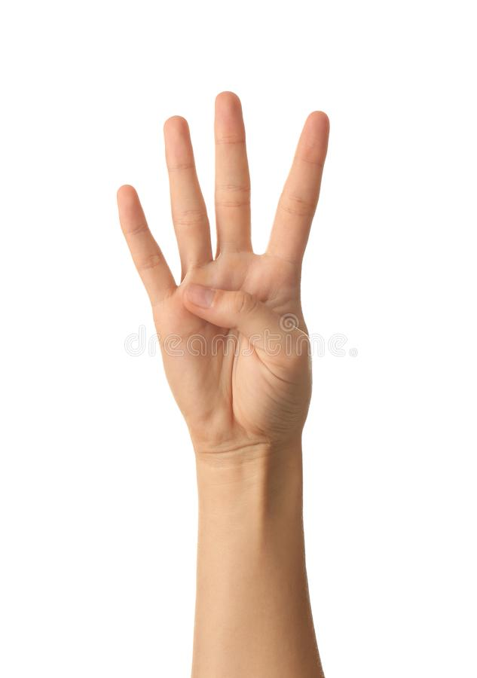

Slide 10

Counting numbers with objects

Slide 11
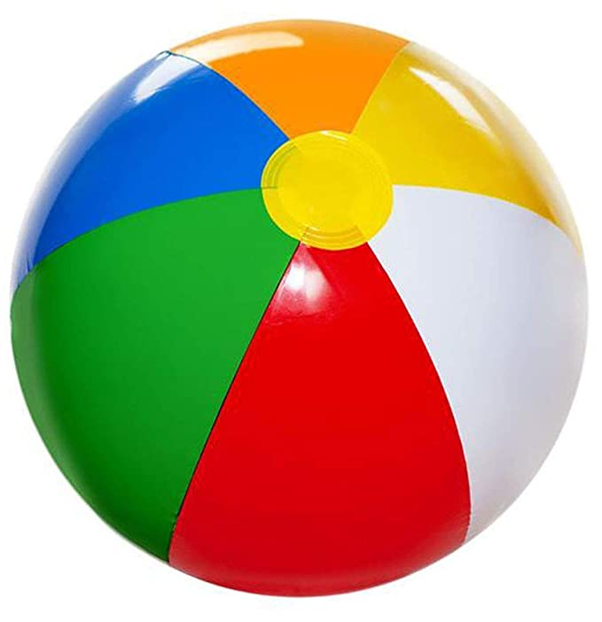

Slide 12


Slide 13
Circle and color number-4
4
5
3
4
4
1
4
3
5
4
3
4
Notes:
1

Slide 14

ASSIGNMENT
1 .Practice counting 1-5
26/07//21
1.Practice counting 1 to10
2.Practice the activity done today
Notes:
2.practice the activity done today

Slide 15
THANKING YOU
ODM EDUCATIONAL GROUP

