Slide 1



CLASS : NURSERY
DATE : 25.11.2021
SUBJECT :
MATHS
TOPIC :
Number 12 in nt bk

Slide 2

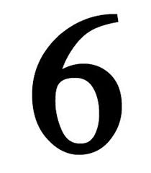






IDENTIFY THE GIVEN NUMBERS

Slide 3
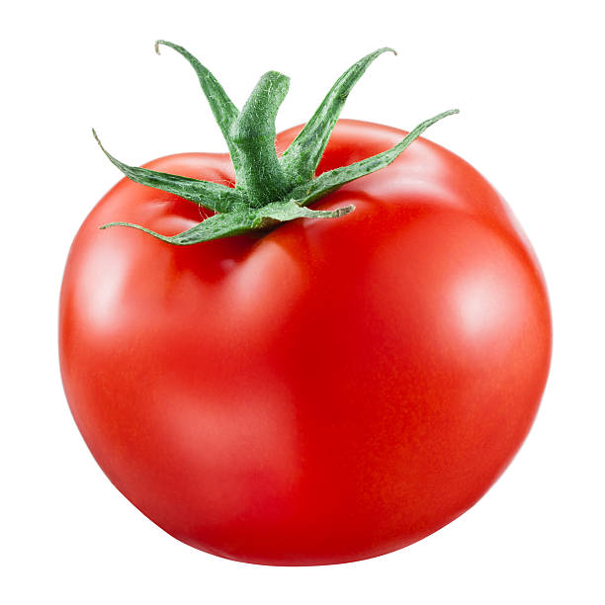

Count and tell the correct number

Slide 4



Recapitulation

Slide 5

Counting number 12 with objects
CW
25/11/21

Slide 6


Colour the picture having 12 objects
CW
25/11/21
Notes:
CW

Slide 7

1 .Practice counting 1-5
ASSIGNMENT
25/11/21
1.Practice counting 11 to20
2.Do the work given in nt bk
Notes:
2.Do bk pg no-63

Slide 8
THANKING YOU
ODM EDUCATIONAL GROUP

