Slide 1



CLASS : NURSERY
DATE : 23.09.2021
SUBJECT :
MATHS
CHAPTER NAME- NUMBERS
SUB-TOPIC :
NUMBERS(REVISION-8 )

Slide 2








IDENTIFY THE GIVEN NUMBERS

Slide 3

Revision-8
In note book
Notes:
Revision-7

Slide 4
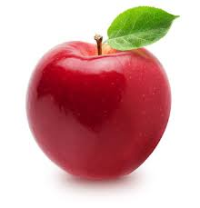


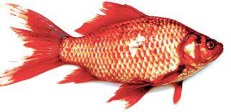
Revision -8
CW
23/09/21
q.1.Count the picture and encircle the correct number.
5 | 2 | 4
1 | 3 | 6
3 | 6 | 1
5 | 8 | 3
Notes:
x

Slide 5
Write numbers 1-8 under T.O
HW
23/09/21
T | O
 | 1
Notes:
HW

Slide 6

1 .Practice counting 1-5
ASSIGNMENT
23/09//21
1.Practice Revision work
2.Do the work given in note bk
Notes:
Do the work given in note bk

Slide 7
THANKING YOU
ODM EDUCATIONAL GROUP

