Slide 1



CLASS : NURSERY
DATE : 21.09.2021
SUBJECT :
MATHS
CHAPTER NUMBER- NUMBERS
SUB-TOPIC :
NUMBERS(REVISION-6 (write the missing numbers)

Slide 2


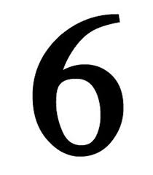




IDENTIFY THE GIVEN NUMBERS

Slide 3

Note book work
Notes:
Note book work

Slide 4
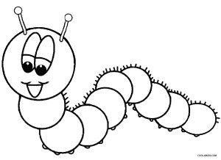

Revision -6
CW
20/09/21
Q’1 Write the missing number.
x
Notes:
x

Slide 5
Say and Write
HW
21/09/21
Notes:
HW

Slide 6

1 .Practice counting 1-5
ASSIGNMENT
21/09//21
1.Practice Revision work
2.Do the work given in note bk
Notes:
Do the work given in note bk

Slide 7
THANKING YOU
ODM EDUCATIONAL GROUP

