Slide 1



CLASS : NURSERY
DATE : 02.12.2021
SUBJECT :
MATHS
TOPIC :
:NUMBER-14 IN NT BK

Slide 2




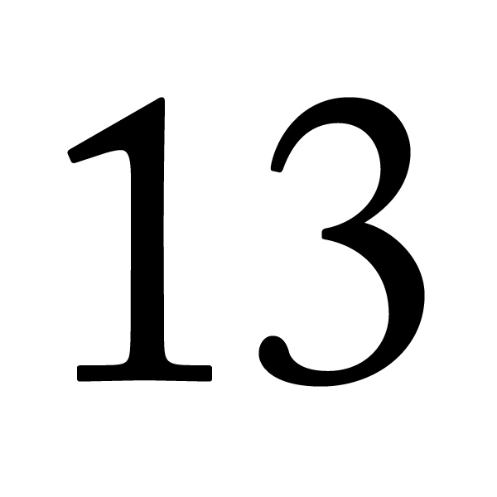

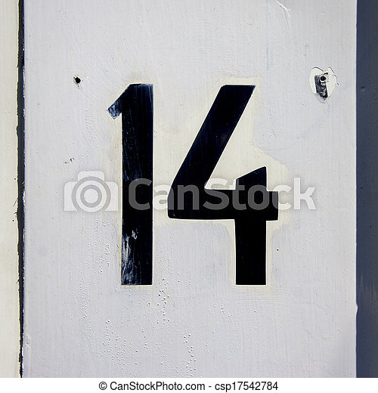
Identify the given number

Slide 3

Identification of number 14

Slide 4

Counting the objects

Slide 5

HI children

Slide 6

IN BK PG NO-14
NUMBER-14 IN NT BK
Notes:
Note book work

Slide 7

Number-14
CW
2/12/21

Slide 8
Say and write number-14
CW
2/12/21

Slide 9
SAY AND WRITE
HW
2/12/21

Slide 10

1 .Practice counting 1-5
ASSIGNMENT
02/12/21
1.Practice counting 11 to20
2.Complete the work given in nt bk
Notes:
2.Do bk pg no-63

Slide 11
THANKING YOU
ODM EDUCATIONAL GROUP

