Slide 1



CLASS : NURSERY
DATE : 18.11.2021
SUBJECT :
MATHS
TOPIC :
ACTIVITY IN NT BK

Slide 2

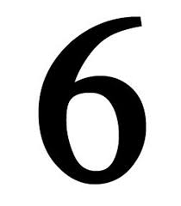







IDENTIFY THE GIVEN NUMBERS

Slide 3
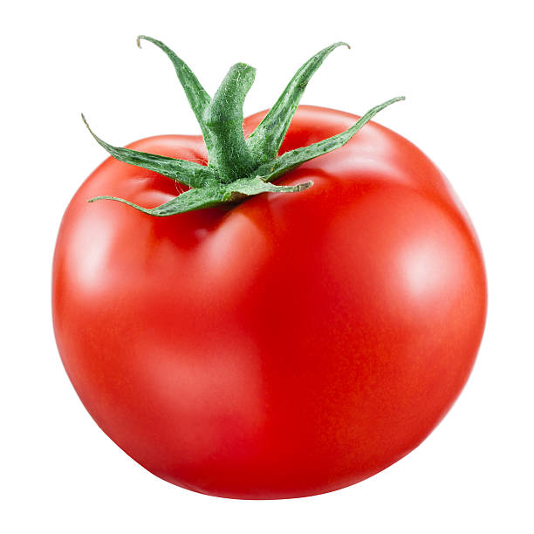
Count and tell the correct number

Slide 4


rRecapitulation

Slide 5

Counting number 11 with objects
CW
17/11/21

Slide 6
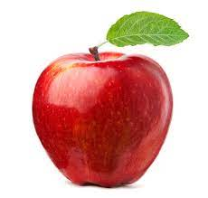
ACTIVITY
CW
18/11/21
Count the object and encircle the correct number
6 9 8
3 5 6
9 8 7

Slide 7
Write numbers 1 to 10 under T.O
HW
T | O
 | 1
1 | 0

Slide 8

1 .Practice counting 1-5
ASSIGNMENT
1811/21
1.Practice counting 11 to20
2.Do the work given in nt bk
Notes:
2.Do bk pg no-63

Slide 9
THANKING YOU
ODM EDUCATIONAL GROUP

