Slide 1



CLASS : NURSERY
DATE : 17.11.2021
SUBJECT :
MATHS
TOPIC :
NUMBER-11 IN NT BK

Slide 2

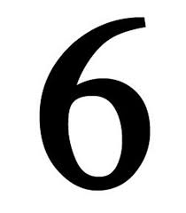







IDENTIFY THE GIVEN NUMBERS

Slide 3

Identification of number 10

Slide 4
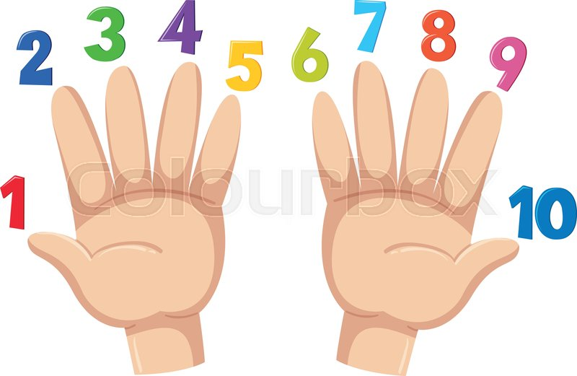
Counting numbers on fingers

Slide 5
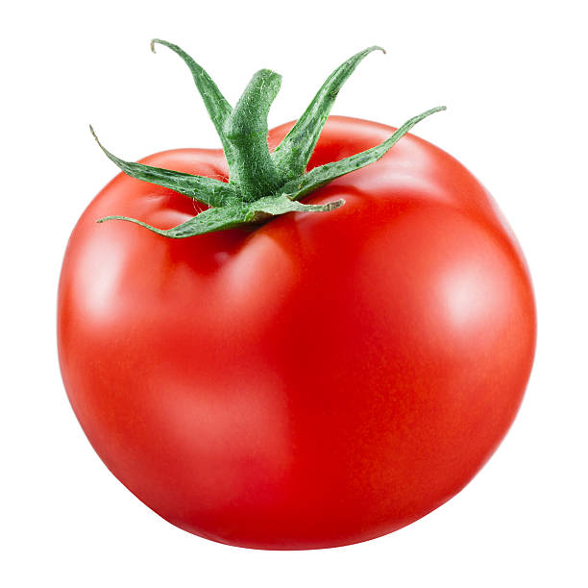

Slide 6


Introduction of number-11

Slide 7

Counting number 11 with objects
CW
17/11/21

Slide 8

Number-11 in nt bk
CW
17/11/21

Slide 9
Number-11 in nt bk
CW
17/11/21

Slide 10

1 .Practice counting 1-5
ASSIGNMENT
17/11/21
1.Practice counting 11 to20
2.Do the work given in nt bk
3.DO BK PG NO-66 (FUN ZONE)
Notes:
2.Do bk pg no-63

Slide 11
THANKING YOU
ODM EDUCATIONAL GROUP

