Slide 1



CLASS : NURSERY
DATE : 16.11.2021
SUBJECT :
MATHS
CHAPTER NUMBER- BK PG NO -, 61,62
SUB-TOPIC :
NUMBER-10 IN NT BK

Slide 2

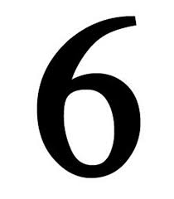







IDENTIFY THE GIVEN NUMBERS

Slide 3
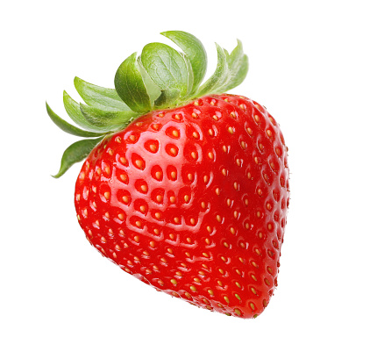

Slide 4

Identification of number 10

Slide 5
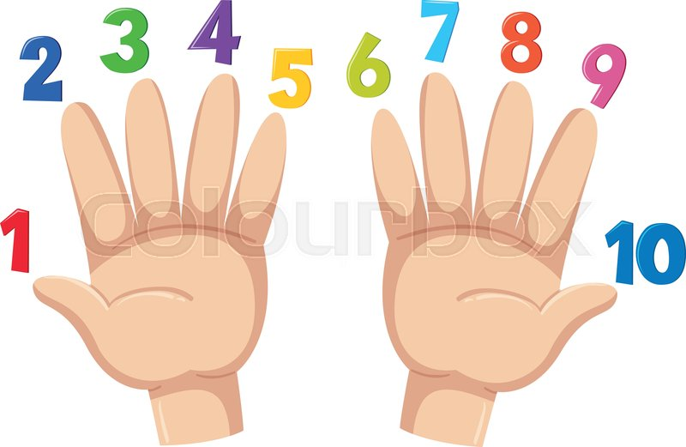
Counting numbers on fingers

Slide 6
Number-10
CW
16/11/21
Notes:
16/11/21

Slide 7
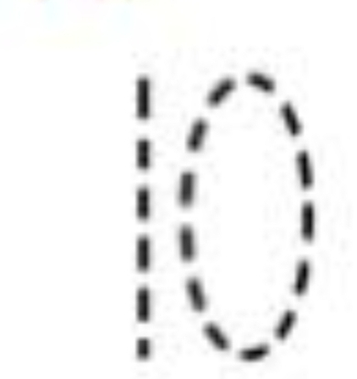
TRACE AND WRITE
CW
16/11/21

Slide 8

1 .Practice counting 1-5
ASSIGNMENT
1611/21
1.Practice counting 11 to20
2.Do the work given in nt bk
3.Do bk pg no-63
Notes:
2.Do bk pg no-63

Slide 9
THANKING YOU
ODM EDUCATIONAL GROUP

