Slide 1



CLASS : NURSERY
DATE : 15.09.2021
SUBJECT :
MATHS
CHAPTER NUMBER- NUMBERS
SUB-TOPIC :
NUMBERS(REVISION-2)

Slide 2







IDENTIFY THE GIVEN NUMBERS

Slide 3
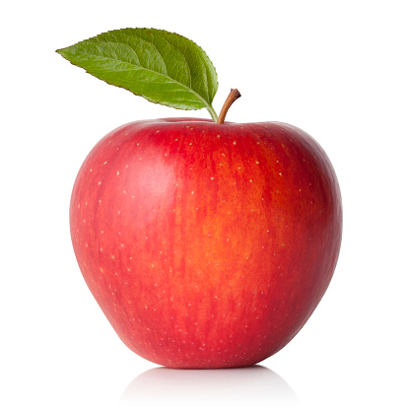


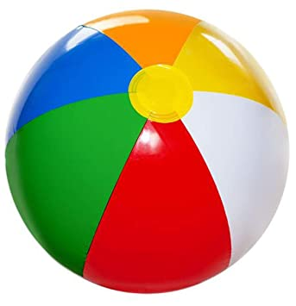
Revision -3
CW
15/09/21
Q 1.Count the picture and write the correct number
5
3
4
2
Notes:
CW

Slide 4

Note book work
Notes:
Note book work

Slide 5
Write each number three times
1
2
3
4
5
Notes:
14/09/21

Slide 6

1 .Practice counting 1-5
ASSIGNMENT
14/09//21
1.Practice Revision work
Notes:
2.practice the activity done today

Slide 7
THANKING YOU
ODM EDUCATIONAL GROUP

