Slide 1



CLASS : NURSERY
DATE : 13.09.2021
SUBJECT :
MATHS
CHAPTER NUMBER- NUMBERS
SUB-TOPIC :
NUMBER-1(REVISION-1)

Slide 2







IDENTIFY THE GIVEN NUMBERS

Slide 3
REVISION -1
CW
13/09/21
Circle and color number number 1&2
Q-1
6
1
3
2
5
1
4
2
6
2
4
1
5
2
1
4
Notes:
Q-1

Slide 4

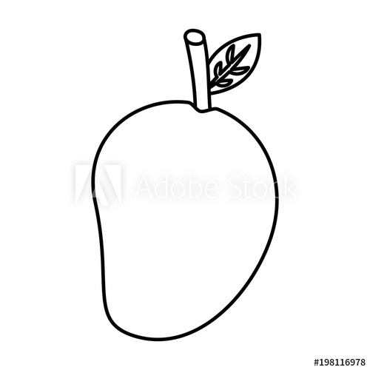


Colour the picture as per the given number
CW
Q 2.
13/09/21
1
3
4
2
Notes:
Q2

Slide 5

1 .Practice counting 1-5
ASSIGNMENT
13/09//21
1.Practice Revision wwork
2.Do b pg n-56
Notes:
2.practice the activity done today

Slide 6
THANKING YOU
ODM EDUCATIONAL GROUP

